Slide 1
1
Hard Skills Capacity Building for PHC Performance Management
Day 1: Digital Literacy and Microsoft Office Skills
(Word, Excel, PowerPoint)
Notes:
[WELCOME AND OPENING]
Good morning and welcome to the Hard Skills Capacity Building for PHC Performance Management Programme. Over the next five days, we will work together to build your confidence in using data, digital tools, and quality improvement methods.
Today is Day 1, and our focus is on Digital Literacy and Microsoft Office Skills. The goal today is not mastery — it is building confidence. By the end of today, you should feel comfortable creating documents, entering data, and building simple presentations.
A few ground rules: this is a safe learning space. Mistakes are expected and encouraged. If you are already confident with these tools, please support your neighbours — peer learning strengthens everyone.

Slide 2
Session 1.1 Orientation and Expectations

Slide 3
Orientation and Expectations
Aim
The primary aspiration of Hard Skills Capacity Building for PHC Performance Management initiatives aims to enhance value & effectiveness of PHC systems by strengthening the very basic yet taken for granted, the managerial competencies of healthcare administrators in practical, data driven decision making and performance management for effective PHC service monitoring, planning and improvement.
Objectives
Optimised PHC Performance management
Demonstrate competencies in using data for decision making to improve health outcomes
Competently apply requisite analytic skills and IT Applications
Possess basic computer literacy skills(MS Word, software for virtual meetings
Apply standardized approaches in achieving performance outcomes.
To foster & sustain stronger health system.

Slide 4
Session 1.2: Microsoft Word

Slide 5
What is your understanding of Microsoft Word?
A word Processing Program
Used to create documents such as letters and reports
Notes:
[WHAT IS MICROSOFT WORD?]
Before we dive in, let me ask: how many of you use Word regularly at work? [Show of hands]
Word is a word processing programme — it is used to create documents such as letters, reports, memos, and minutes. In PHC settings, you will use it for monthly reports, correspondence, and documenting improvement plans.
Today we will focus on the basics: opening, saving, formatting, and structuring documents. Do not worry about advanced features — we want functional confidence.

Slide 6
By the end of the lesson, participants should be able to:
Open MS Word
Describe aspects of the interface
Create new documents
Save documents
Open documents
Notes:
[LEARNING OUTCOMES]
These are our targets for the Word session. By the end, you should be able to open Word, navigate the interface, create and save documents, and reopen them.
These sound simple, but they are the foundation. If you cannot save a document reliably, you cannot produce a report. Let us build these basics solidly.

Slide 7
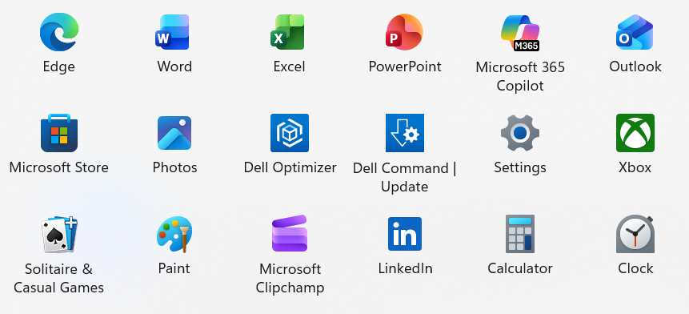
Running Microsoft Word Application
Running MS Word
Understanding the Interface
Creating New Documents
Saving, Opening & Closing Documents
Notes:
[RUNNING MS WORD]
There are two ways to open Word. You can double-click the blue W icon on your desktop, or find it through the Start Menu under Microsoft Office.
Please try this now on your own laptop. If you cannot find it, ask your neighbour or raise your hand.
[PAUSE — let participants open Word. Walk around the room to check everyone has it open.]
Good. Everyone should now have Word open with a blank document.

Slide 8
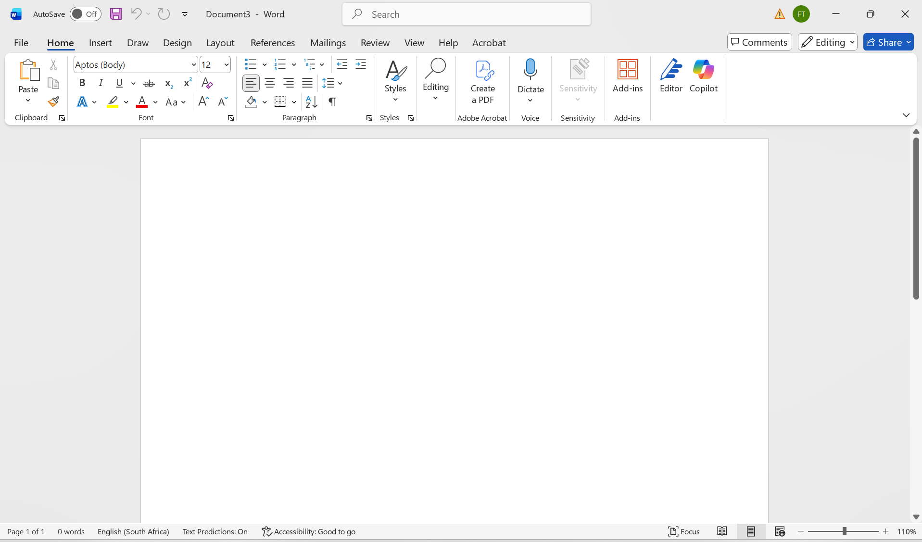
MS Word Interface Overview
Menu Bar
Minimize, maximise
and Close
Title Bar
Formatting Bar
Document Area
Status Bar
Zoom bar
Notes:
[MS WORD INTERFACE OVERVIEW]
Let me walk you through what you see on screen.
The Title Bar at the top shows the application name and your document name — right now it says Document1 because we have not saved it yet.
The Menu Bar or Ribbon has all the tools organised in tabs: Home, Insert, Layout, and so on. We will use Home and Insert most today.
The Document Area is the white space where you type. The Status Bar at the bottom shows page numbers and zoom level.
Take a moment to identify these on your own screen. [PAUSE]
The key message: always know where your document is saved, and save regularly. Ctrl+S is your best friend.

Slide 9
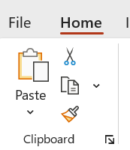
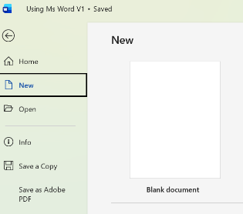
Creating Documents
In the menu bar, click on File
Click New
Click on blank document
Notes:
[CREATING DOCUMENTS]
To create a new document: click File, then New, then Blank Document. It is that simple.
Let me demonstrate. [DEMONSTRATE on screen]
Now you try. Create a new blank document. [PAUSE for practice]
Good. You now have a blank canvas to work with.

Slide 10
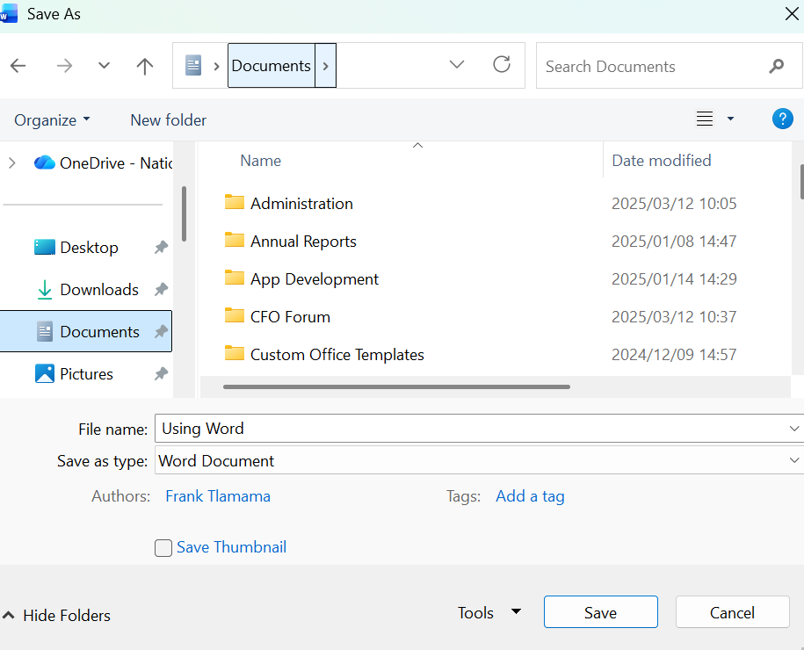
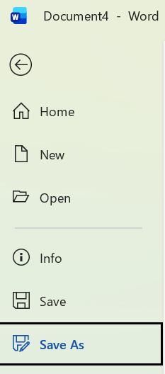
Saving Documents
Save As
Click File and then Click Save or Save As
Up one folder
Select More storage spaces
Storage spaces in this folder
File Name
Notes:
[SAVING DOCUMENTS]
This is one of the most important skills today. If you do not save, you lose your work.
There are two options: Save and Save As. Use Save As when saving for the first time or saving to a new location. After that, Ctrl+S will save to the same location.
Key tips: Always save to a known location — Desktop or Documents folder. Use clear file names like Report_January_2025, not Document1. Save frequently.
Let me demonstrate Save As now. [DEMONSTRATE]
Now save your document to the Desktop with a clear name. [PAUSE for practice]

Slide 11
Session 1.3: Microsoft Word – Text Entry, Formatting, and Layout

Slide 12
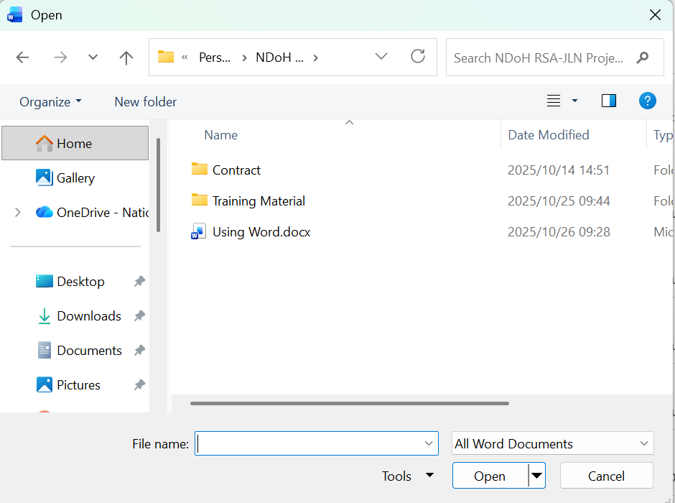
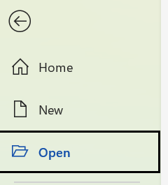
Opening Documents
Click File and then Click Open
Open
Select Folder
Up one folder
Storage spaces in this folder
File Name
Notes:
[OPENING DOCUMENTS]
Before we move on, let me show you how to reopen a saved document.
Click File, then Open. Navigate to where you saved the file — in this case, the Desktop. Select the file and click Open.
Try this now: close your document (File > Close), then reopen it from the Desktop. [PAUSE]
This is a skill you will use daily. Always know where your files are stored.

Slide 13
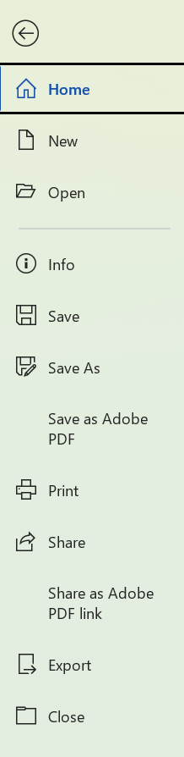
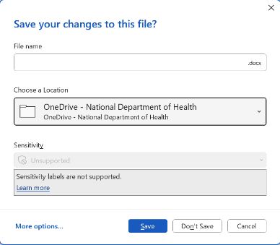

Closing Document
Click File and then Click Close
Type the File name, chose Location to store a file and click Save
Click X to close the application
Notes:
[CLOSING DOCUMENTS]
To close a document, click File then Close. If you have unsaved changes, Word will ask if you want to save.
To close Word entirely, click the X button in the top right corner.
A common mistake is closing without saving. Always check for that save prompt. If in doubt, press Ctrl+S before closing.

Slide 14
Entering text into a document
Create a new document and enter the following text
“To enter text in Microsoft Word, click where you want to type and start typing using the keyboard. To change the text, first select it by clicking and dragging the mouse over the words. When the text is selected, you can use the buttons on the Home tab to change the font size, make the text bold, or change how the text is aligned (left, centre, or right). These tools help make your document clear, neat, and easy to read.”
Notes:
[ENTERING TEXT]
Now let us practice entering text. I have a paragraph on screen that I would like you to type into your document.
This is a hands-on exercise. Take your time — accuracy matters more than speed. If you make a mistake, use the Backspace key to correct it.
[PAUSE — give 3-5 minutes for typing. Walk around to assist.]
Well done. You have just created your first document content. Now let us learn how to format it.

Slide 15
Selecting text
Using your mouse, select the words “Microsoft Word” on the text you captured.
Alternatively, use your keyboard to select the words “Microsoft Word”
Notes:
[SELECTING TEXT]
Before you can format text, you need to select it. There are two ways:
Mouse method: Click at the start of the text, hold the mouse button, and drag to the end.
Keyboard method: Hold Shift and use the arrow keys to select.
Try selecting the words "Microsoft Word" in your document now, using either method. [PAUSE]
You will see the selected text is highlighted in blue. Once selected, you can apply formatting.

Slide 16
Using the different Formatting text options
To keep track of the changes in the document
  Click Review on the Title Bar, click Tracking and click Track Changes
  Check spelling
    Click Review on the Title Bar, click Spelling and Grammar
  Insert page numbering
    Click Insert on the Title Bar, click Page Numbering and chose where you want the page numbering
  Insert Comment
    Select the text you want to comment on
    Click Insert on the Title Bar, then click on comment
    Enter the comment in the text box
Notes:
[FORMATTING OPTIONS]
These are some useful formatting features beyond bold and font size.
Track Changes is important for collaborative documents — it shows what edits have been made. You will find it under Review > Track Changes.
Spell check is under Review > Spelling and Grammar. Always run this before finalising a document.
Page numbering is under Insert > Page Number. And you can add comments by selecting text and clicking Insert > Comment.
I will demonstrate each briefly. You do not need to memorise these now — they are in your workbook for reference.

Slide 17
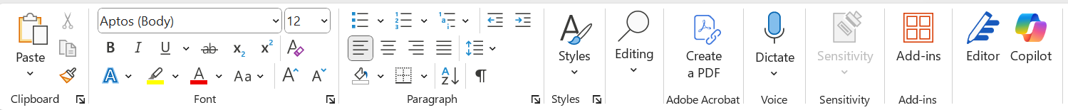






Formatting Bar
 | Font Type
 | Font Size
 | Bold, Italic, Underline
 | Text Alignment
 | Bullets and Numbering
 | Text Colour
Notes:
[FORMATTING BAR]
This is your formatting toolbar — the most-used tools in Word.
From left to right: Font Type lets you change the typeface. Font Size controls how large the text appears. Bold, Italic, and Underline add emphasis. Text Alignment controls whether text is left, centre, right, or justified. Bullets and Numbering create lists. Text Colour changes the colour of your text.
Let me demonstrate each one briefly. [DEMONSTRATE]
The key message: use formatting purposefully. Consistency in font, size, and alignment makes documents professional and easy to read.

Slide 18
Using the different Formatting text options
On the new document that you typed, select a text before to use the formatting tool and do the following
  Font Size
    Change the font size of the last sentence to 14
  Bold, Italic, Underline
    Bold the first sentence
    Make the word Microsoft word Italic
    Underline the same word
  Align
    Align the whole paragraph to justify
  Text Color
    Change the colour of sentence to red
Notes:
[FORMATTING EXERCISE]
Now it is your turn to practice. Using the document you typed earlier, complete these tasks:
1. Change the font size of the last sentence to 14.
2. Bold the first sentence.
3. Make the words "Microsoft Word" italic.
4. Underline those same words.
5. Justify the whole paragraph.
6. Change one sentence to red.
Take your time. If you get stuck, ask your neighbour first, then raise your hand.
[PAUSE — give 5-7 minutes. Circulate actively to support.]

Slide 19
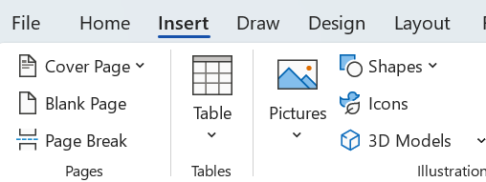
Insert an image
Click insert on title bar
Click pictures
Select the file with a picture
Select the picture
Click insert
Notes:
[INSERTING IMAGES]
Sometimes you need to add images to a document — for example, a screenshot of a dashboard or a facility photo.
The process: Click Insert on the menu bar, click Pictures, navigate to your image file, select it, and click Insert.
Let me demonstrate. [DEMONSTRATE]
You will practise this in the integrated exercise at the end of the day.

Slide 20
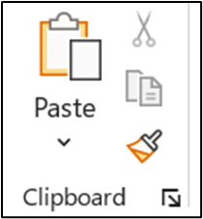
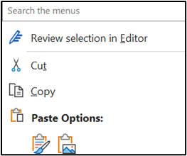
Cut, Copy and Paste, and Screen shot
To screen shot
  Press and hold shift
  Click print screen (prt sc)
  Paste (by clicking paste or pressing CTRL, V)
Save the document on your desktop as "Test"
Notes:
[CUT, COPY, PASTE AND SCREENSHOT]
These are essential keyboard shortcuts you should memorise:
Ctrl+C = Copy. Ctrl+X = Cut. Ctrl+V = Paste. Ctrl+Z = Undo.
For taking a screenshot: hold Shift and press Print Screen (PrtSc). Then paste it into your document with Ctrl+V.
This is useful when you need to capture something from a dashboard or system and include it in a report.
Let us practice: take a screenshot of your current screen and paste it into your document. [PAUSE]

Slide 21
Session 1.4: Microsoft Word – Tables, Headers, Footers and Bullets

Slide 22
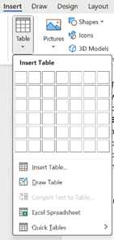
Insert a table
Open a new document
Insert a table with four (4) columns and three (3) rows with the following headings
Save the document with column on your desktop and name it "QI Improvement"
Plan | Do | Study | Act
Notes:
[INSERTING TABLES]
Tables are one of the most useful features for PHC reporting. You can use them for staff lists, activity summaries, PDSA tracking, and data presentation.
To insert a table: click Insert, then Table, and select the number of rows and columns.
Let us practice together. Open a new document and insert a table with 4 columns and 3 rows. The headings should be: Plan, Do, Study, Act.
[DEMONSTRATE, then let participants practice. PAUSE for 3-4 minutes.]
You have just created a PDSA template in Word. We will use this structure again on Day 4.

Slide 23
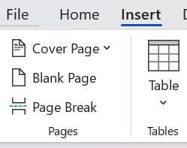
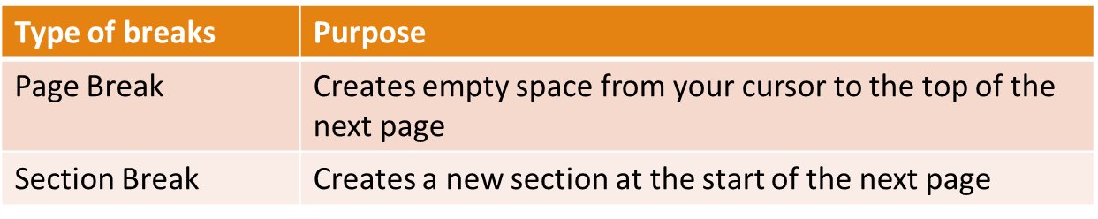
Insert Breaks
Notes:
[PAGE BREAKS]
Page breaks let you control where a new page starts. This is useful for separating sections in a report.
Insert a page break by clicking Insert > Page Break, or pressing Ctrl+Enter.
This is a small but important formatting skill for professional documents.

Slide 24
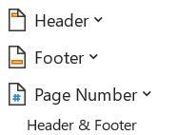
Insert Header and Footer
Click insert and click on header or footer
In the header type your name and surname
In the footer enter the page numbering
Notes:
[HEADERS AND FOOTERS]
Headers and footers appear on every page of your document. They are used for document identification — your name, the document title, page numbers, dates.
Click Insert, then Header or Footer. Type your content directly.
Practice now: put your name in the header, and add page numbering in the footer. [PAUSE]
This is standard practice for any official document at your facility.

Slide 25
Bullets and Numbering
Using the formatting bar, highlight the document created, press enter after every full stop to make separate sentences.
Click on bullets and numbering
Choose whether bullets or numbers
Notes:
[BULLETS AND NUMBERING]
Bullets and numbered lists improve readability. Use bullets for unordered items, numbers for steps or sequences.
To apply: select your text, then click the Bullets or Numbering button on the formatting bar.
Practice: highlight the text in your document and convert it into a bulleted list. [PAUSE]
Remember: bullets are for readability, not decoration. Use them purposefully.

Slide 26
Short online MS Word training material
https://www.youtube.com/watch?v=2MCmnr2L50o
Notes:
[MS WORD ONLINE RESOURCE]
Here is a link to a short online training video for Microsoft Word. You can watch this in your own time to reinforce what we covered today.
The link is in your workbook. You do not need to memorise it.
Let us now take a short break before we move to Microsoft Excel. [IF TEA BREAK TIME]

Slide 27
Session 1.5: Microsoft Excel – Introduction and Interface

Slide 28
What is your understanding of Microsoft Excel?
Can be used for storing, organizing, and manipulating data.
It features calculation, graphing tools, pivot tables, and macro programming language
Notes:
[WHAT IS MICROSOFT EXCEL?]
Let me ask: how many of you use Excel at work? [Show of hands] And how many feel confident with it? [Show of hands]
Excel is a spreadsheet programme used for storing, organising, and manipulating data. It can do calculations, create charts, and help you analyse information.
In PHC settings, you use Excel for monthly data summaries, indicator calculations, and creating graphs for reports and presentations.
Today we focus on the basics. Do not worry about advanced features — we want you comfortable with data entry, simple formulas, and charts.

Slide 29
By the end of the lesson, participants should be able to:
Start MS Excel
Understand what a spreadsheet is
Recognise the interface sections
Create new workbooks
Save workbooks
Open existing workbooks
Notes:
[LEARNING OUTCOMES — EXCEL]
By the end of this section, you should be able to start Excel, understand the interface, create and save workbooks, and navigate the spreadsheet.
These are the building blocks. Once you are comfortable here, the formulas and charts will come easily.

Slide 30
Running Microsoft Excel Application
Running MS Excel
Understanding the Interface
Creating New Spreadsheet
Saving, Opening & Closing Spreadsheets
Notes:
[RUNNING MS EXCEL]
Just like Word, you can open Excel from the desktop icon or the Start Menu.
Please open Excel now on your laptops. [PAUSE]
You should see a blank spreadsheet. This is your workspace for data.

Slide 31
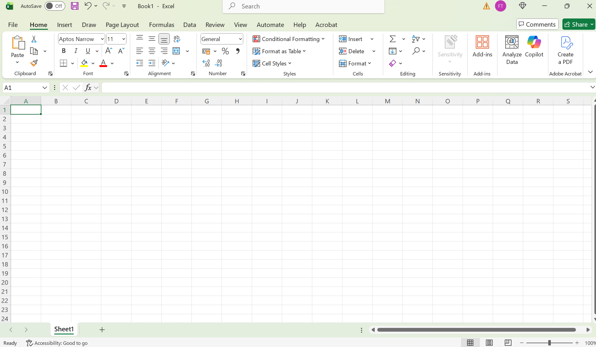
MS Excel Interface Overview
Formatting Bar
Minimize, maximise
and Close
Title Bar
Menu Bar
Zoom bar
Document Area
Worksheet Bar
Notes:
[EXCEL INTERFACE OVERVIEW]
The Excel interface looks similar to Word, but with some key differences.
The main area is the spreadsheet grid — organised into rows (numbered) and columns (lettered). Where a row and column meet is a cell. Each cell has an address, like A1 or B5.
The Menu Bar and Formatting Bar work the same as in Word. At the bottom, you will see Worksheet tabs — you can have multiple sheets in one workbook.
Take a moment to identify these on your screen. [PAUSE]
Key message: Excel works in rows and columns. Accuracy matters more than speed.

Slide 32
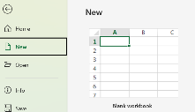
Creating a workbook
In the menu bar, click on File
Click New
Click on blank Workbook
Notes:
[CREATING A WORKBOOK]
Creating a new workbook is the same process as Word: File > New > Blank Workbook.
Try this now. [PAUSE]
You should see a fresh spreadsheet with empty cells.

Slide 33
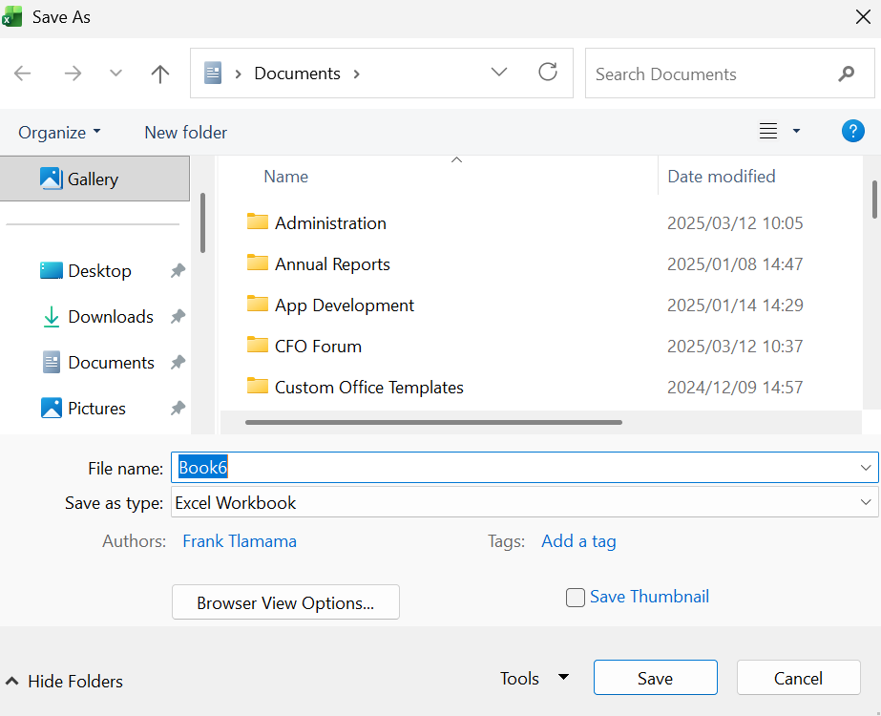
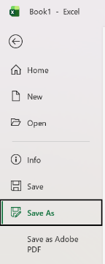
Saving a workbook
Click File and then Click Save or Save As
Save As
Select More storage spaces
Up one folder
Storage spaces in this folder
File Name
Notes:
[SAVING A WORKBOOK]
Saving works identically to Word: File > Save As, choose location, name the file clearly.
Save your workbook to the Desktop now with a descriptive name. [PAUSE]
Remember: save frequently. Ctrl+S.

Slide 34
Session 1.6: Microsoft Excel – Data Entry, Formatting, and Simple Calculations

Slide 35
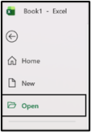
Opening workbook
Click File and then Click Open
A new workbook will open
Notes:
[OPENING A WORKBOOK]
To open an existing workbook: File > Open, navigate to the location, and select the file.
This is the same as Word. Practice reopening the workbook you just saved. [PAUSE]

Slide 36
Closing workbook
Click File and then Click Close
Type the file name, chose location to store a file and click save
Click X to close the application
Notes:
[CLOSING A WORKBOOK]
Same as Word: File > Close, or click the X. Remember to save first.
If you see a save prompt, always click Save unless you intentionally want to discard changes.

Slide 37
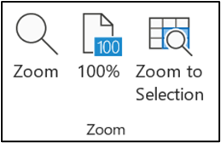

Using Zoom
Select View in the menu bar
In the zoom menu, select the Zoom and select amount that you need
Notes:
[USING ZOOM]
Zoom helps you see your data more clearly. You can find it under View > Zoom, or use the zoom slider at the bottom right of the screen.
If your data looks too small, zoom in. This is a simple but useful feature. Try adjusting your zoom now. [PAUSE]

Slide 38
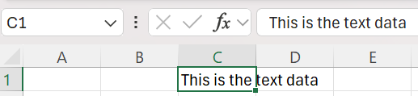
Entering text or data
Select Cell C1 and enter text
Select Cell D1 and enter number
Notes:
[ENTERING DATA]
Now let us enter some data. Click on a cell to select it, then type. Press Enter to move down, or Tab to move right.
Select cell C1 and type some text. Select cell D1 and type a number. Notice that text aligns left and numbers align right — this is normal.
[PAUSE for practice]
Key message: always start formulas with an equals sign. We will get to formulas shortly.

Slide 39
Formatting text and numbering cells
 | Font Type
 | Font Size
 | Bold, Italic, Underline
 | Text Alignment
 | Bullets and Numbering
 | Text Colour
Notes:
[FORMATTING TEXT AND NUMBERS]
The formatting toolbar in Excel works the same as in Word: font type, size, bold, italic, colour, alignment.
You can also format numbers specifically — as currency, percentage, date, and so on. We will practice percentage formatting shortly.
For now, try bolding your column headers and changing the font size. [PAUSE]

Slide 40
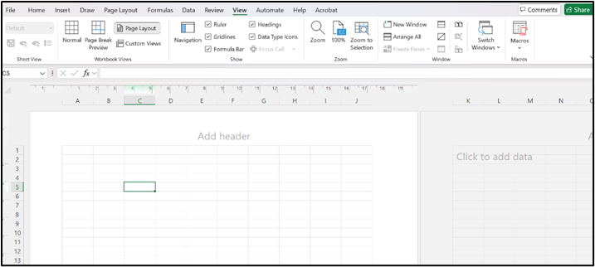
Headers and Footers
To access the header and footer select View, and under the Workbook view group, select page layout. The add Header column will appear.
Notes:
[HEADERS AND FOOTERS IN EXCEL]
Headers and footers in Excel work differently from Word. You access them through View > Page Layout, where the header area appears at the top.
This is useful for printed reports. You can add your facility name and date to the header.

Slide 41
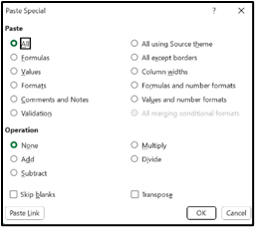
Cut, Copy and Paste
Paste Special
Notes:
[CUT, COPY AND PASTE IN EXCEL]
The same shortcuts work: Ctrl+C, Ctrl+X, Ctrl+V.
There is also Paste Special, which lets you paste values only (without formulas) or paste formatting only. This is very useful when you want to copy numbers without carrying over formulas.
I will demonstrate Paste Special now. [DEMONSTRATE]

Slide 42
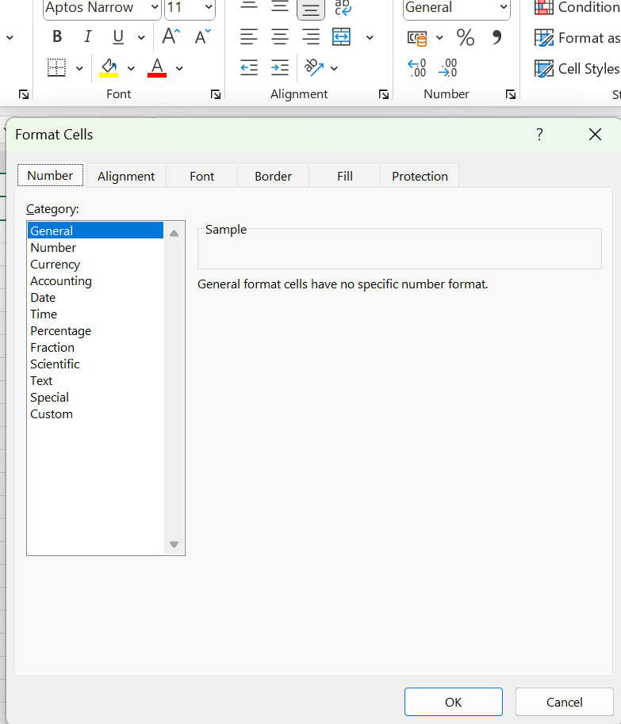
Formatting Cells
Right click on the cell
Select Format Cells
Click on Number tab
Click on Alignment tab
Click on Font
Click on Border tab
Notes:
[FORMATTING CELLS]
For more detailed formatting, right-click on a cell and select Format Cells.
Here you can set number format (decimal places, percentage, currency), alignment (horizontal and vertical), font, and borders.
This is how you make your data tables look professional. Let me demonstrate. [DEMONSTRATE]

Slide 43
Mathematical Operators
Signs | Definition
* | This is the symbol for multiplication. You cannot use the normal “x” since this is the same as the X letter. So a formula that multiplies 5 and 3 with each other in MS Excel would look like THIS =5*3
/ | This is the symbol for division. A formulas that divide 6 by 3 will look like =6/3
+ | This is the plus symbol and used for addition =9+1
- | This the minus symbol and used for subtraction =14-3
Notes:
[MATHEMATICAL OPERATORS]
Before we do formulas, you need to know the mathematical operators in Excel.
Multiplication uses the asterisk (*), not the letter X. Division uses the forward slash (/). Plus (+) and minus (-) are as expected.
These are on screen for reference. The key thing to remember: every formula starts with an equals sign (=).

Slide 44
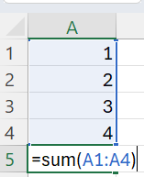

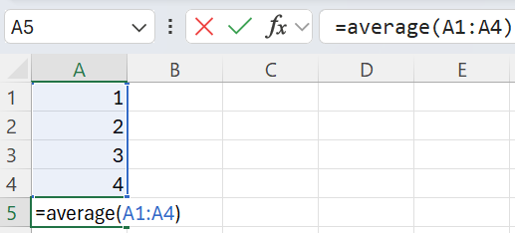
Using formulas
The rule of BODMAS applies with formulas
Always put an equal sign before the formula
Sum (enter one of the following)
  =A1+A2+A3+A4
  =sum(A1:A4)
Autosum is another way to get the same result, an even easier one
Average
=Average(A1:A4)
Notes:
[USING FORMULAS]
This is the heart of Excel. Formulas let you calculate automatically.
The rule of BODMAS applies: Brackets, Orders, Division, Multiplication, Addition, Subtraction.
Let me demonstrate SUM: you can type =A1+A2+A3+A4, or use the shortcut =SUM(A1:A4). Both give the same result.
For Average, use =AVERAGE(A1:A4).
AutoSum is even easier — select the cell below your data and click the AutoSum button.
Now let us practice. Enter some numbers in cells A1 to A4, then use SUM to add them up. [PAUSE — give 5 minutes. Circulate to help.]
Common mistake: forgetting the equals sign. If your formula is not working, check that it starts with =.

Slide 45
Recognising Formula Errors:
Message | What it Means
###### | The Contents of the cell cannot be displayed correctly as the column is to narrow
#REF! | Indicates that a cell reference is invalid. This often displayed when you delete cells that are involved in a formula.
#NAME? | Excel does not recognise text contained within a formula
#VALUE? | One of the arguments in your formula is the wrong kind of value. You could be using a text value where you should be using a number.
#DIV/0 | The formula is trying to divide by 0. Check to see if one of your arguments in the formula is 0.
#NUM | One or more than one of the number arguments are not valid
Notes:
[FORMULA ERRORS]
When something goes wrong with a formula, Excel shows an error message. Here are the most common ones:
Hash marks (######) mean the column is too narrow — just widen it by dragging the column border.
#REF! means a cell reference is invalid, often because you deleted cells that were part of a formula.
#DIV/0 means you are dividing by zero. Check your formula.
Do not panic when you see these. They are Excel telling you what to fix. Check the table on screen for the full list.

Slide 46
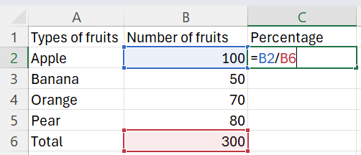
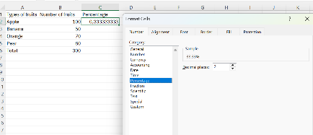
Calculating a percentage
Percentage:
=Number/total
=B1/B6
Then right click
Click on number
Click on percentage
Notes:
[CALCULATING PERCENTAGES]
Percentages are commonly used in PHC reporting — coverage rates, targets, performance indicators.
The formula is simple: =Number/Total. For example, =B1/B6.
After entering the formula, you need to format the cell as a percentage: right-click, Format Cells, Number tab, Percentage.
Let me demonstrate. [DEMONSTRATE]
Now practice: enter some numbers, calculate a total using SUM, then calculate the percentage of each number against the total. [PAUSE — give 5-7 minutes.]

Slide 47
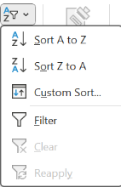
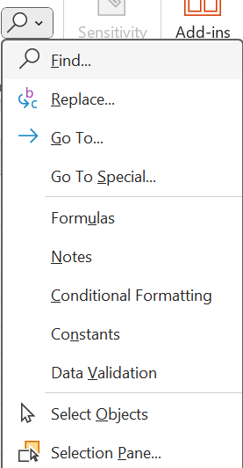
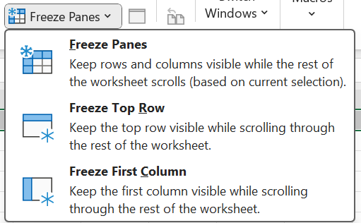
Fillters, Freeze panes and Find and Replace
Filters and auto filters
Find and Replace
Freeze Panes
Notes:
[FILTERS, FREEZE PANES AND FIND/REPLACE]
Three useful features for working with larger datasets:
Filters let you show only the data you need. Select your header row, then Data > Filter. Click the dropdown arrows to filter.
Freeze Panes keeps your header row visible when scrolling. View > Freeze Panes > Freeze Top Row.
Find and Replace (Ctrl+H) lets you search for text and replace it across the whole spreadsheet.
These become essential as your data grows. We will not practice these in detail now, but they are in your workbook for reference.

Slide 48
Session 1.7: Microsoft Excel – Basic Charts and Visualisation

Slide 49



Introductions to Graphs
Pie Graph
Bar Graph
Line Graph
Notes:
[INTRODUCTION TO GRAPHS]
There are three main chart types you will use:
Bar graphs are good for comparing values across categories — for example, comparing headcount across months.
Line graphs show trends over time — for example, immunisation coverage over 12 months.
Pie charts show proportions of a whole — for example, the percentage breakdown of services provided.
The key principle: one chart, one message. Keep it simple with clear titles and labels.

Slide 50
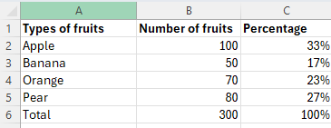
Developing Graphs
Type the table onto a new excel document
Use sum to get the total in Cell B6
Use percentage steps to get percentage of B2 against Total
Repeat the steps for Cell C2 to C5
Select the data
Select insert and the Chart Wizard button
Next select the chart that you want to use.
Notes:
[DEVELOPING GRAPHS — EXERCISE]
Now let us create a chart together.
First, enter the data from the table on screen into a new Excel document. Use SUM for the total. Calculate percentages.
Then select your data, click Insert, and choose a chart type. I recommend starting with a bar chart.
Add a title and data labels so the chart is clear and self-explanatory.
[DEMONSTRATE step by step, then let participants follow along. PAUSE — give 10 minutes.]
Remember: charts support decision-making. A good chart answers a question at a glance.

Slide 51
Short online MS Excel training material
https://www.youtube.com/watch?v=2MCmnr2L50o
Notes:
[MS EXCEL ONLINE RESOURCE]
Here is a link to additional Excel training material you can watch in your own time. The link is in your workbook.
Excel confidence develops with practice. The more you use it, the more comfortable it becomes.

Slide 52
Session 1.8: Microsoft PowerPoint – Basics of Creating Presentations

Slide 53
What is your understanding of Microsoft PowerPoint?
Microsoft PowerPoint is an electronic presentation program that helps people present a speech using a collection of slides.
A PowerPoint presentation is a collection of slides that can be used to create oral presentations
Notes:
[WHAT IS MICROSOFT POWERPOINT?]
PowerPoint is an electronic presentation programme. It helps you communicate information visually using slides.
The key principle I want you to remember: slides support the speaker. They do not replace the speaker. Keep text minimal, use visuals, and speak to your audience — do not read from the slide.

Slide 54
By the end of the lesson, participants should be able to:
Understand the toolbars in PowerPoint
Create new presentations
Save presentations
Open presentations
Insert Slides
Select slides themes
Notes:
[LEARNING OUTCOMES — POWERPOINT]
By the end of this session, you should be able to create a simple presentation, save it, insert slides, and choose a theme.
PowerPoint is the most straightforward of the three applications. If you are comfortable with Word, PowerPoint will feel familiar.

Slide 55
Running Microsoft PowerPoint Application
Running MS PowerPoint
Understanding the Interface
Creating New Spreadsheet
Saving, Opening & Closing Spreadsheets
Smart Art
Notes:
[RUNNING POWERPOINT]
Open PowerPoint from the desktop icon or Start Menu, just like Word and Excel.
Please open it now. [PAUSE]
You should see a blank presentation with one slide.

Slide 56
MS Excel Interface Overview
Formatting Bar
Minimize, maximise
and Close
Title Bar
Menu Bar
Zoom bar
Document Area
Worksheet Bar
Notes:
[NOTE: This slide appears to show the Excel interface again. Skip or mention briefly.]
This slide shows the Excel interface for reference. We covered this earlier — the layout is similar across all Microsoft Office applications, which makes it easier to learn.

Slide 57
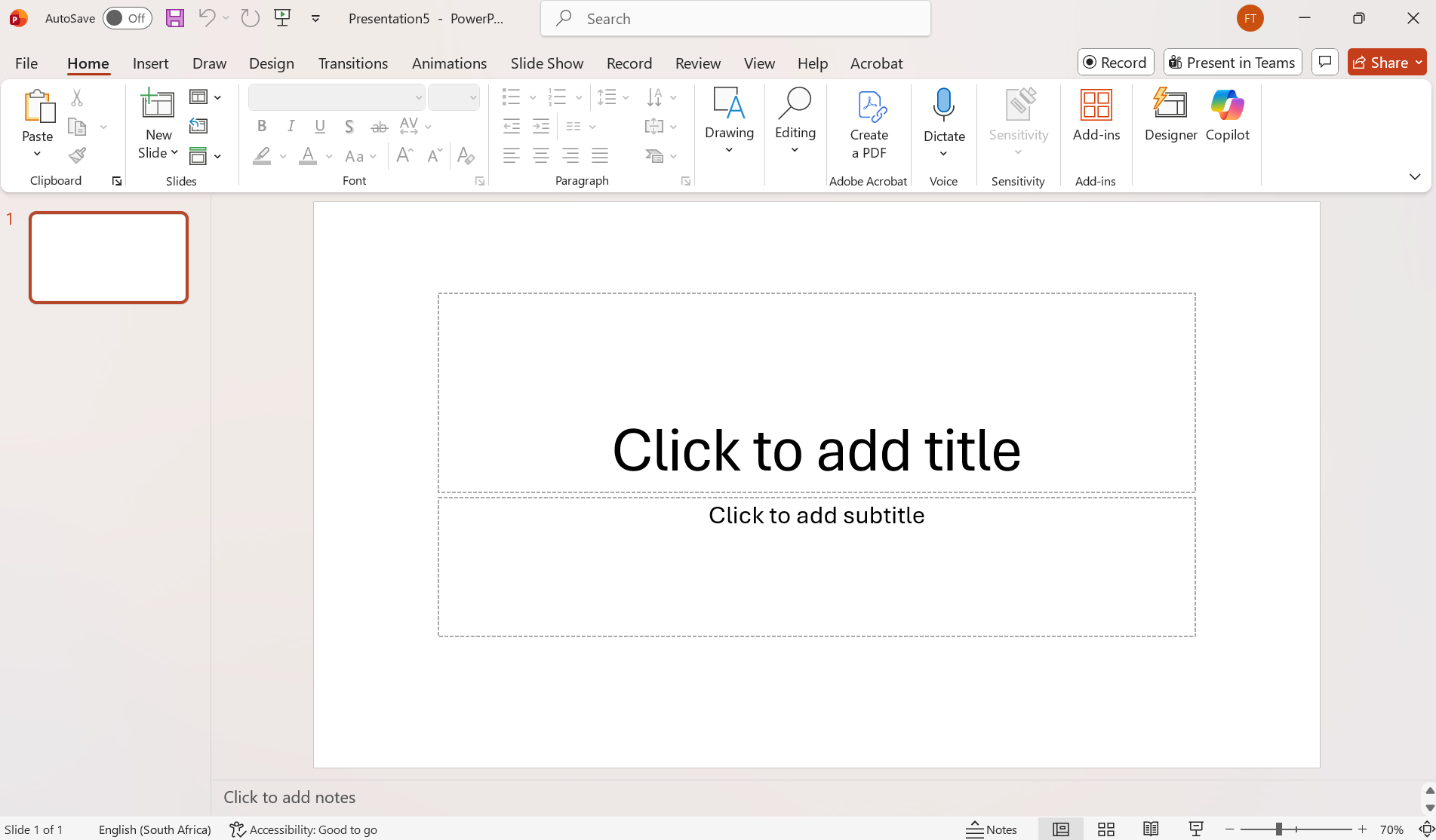
MS PowerPoint Interface Overview
Formatting Bar
Minimize, maximise
and Close
Title Bar
Menu Bar
Zoom bar
Slide Area
Worksheet Bar
Notes:
[POWERPOINT INTERFACE]
The PowerPoint interface has the same Menu Bar and Formatting Bar structure.
The key difference is the Slide Panel on the left, showing all your slides as thumbnails, and the Slide Area in the centre where you edit.
At the bottom, the Notes section is where you can add speaker notes — what you want to say during the presentation.

Slide 58
Formatting Bar
Font Type
Font Size
Bold, Italic, Underline
Text Alignment
Bullets and Numbering
Text Colour
Merge Cells and centre text
Fill colour
Conditional Formatting
Editing (Find and Replace)
Designer
Notes:
[POWERPOINT FORMATTING BAR]
The formatting tools are familiar from Word and Excel. You can change fonts, sizes, colours, and alignment.
PowerPoint also adds Designer — a tool that suggests professional layouts for your slides. And you can use conditional formatting for data displays.
The golden rule: keep slides clean. Less text, more visuals. Maximum 6 words per line, 6 lines per slide.

Slide 59
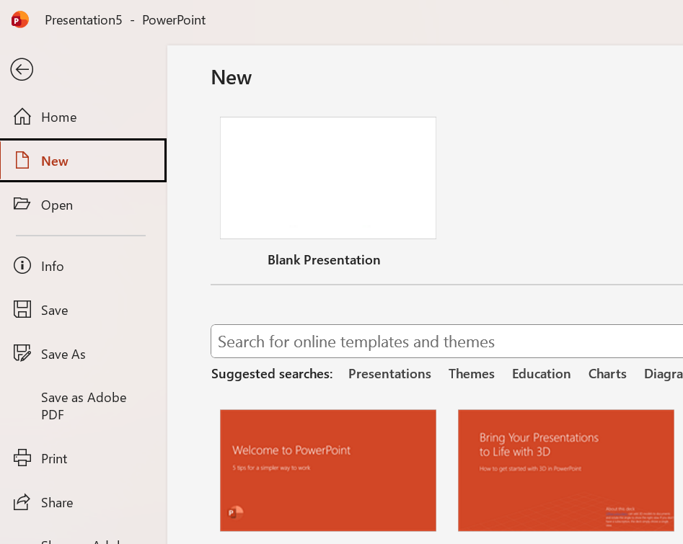
Creating a Presentation
In the menu bar, click on File
Click New
Click on blank Presentation
Notes:
[CREATING A PRESENTATION]
To create a new presentation: File > New > Blank Presentation.
Try this now. [PAUSE]
You have a blank slide ready to work with.

Slide 60
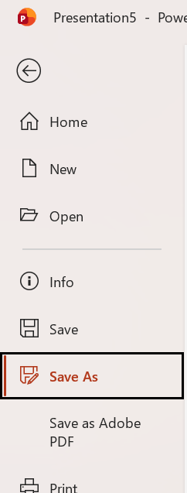
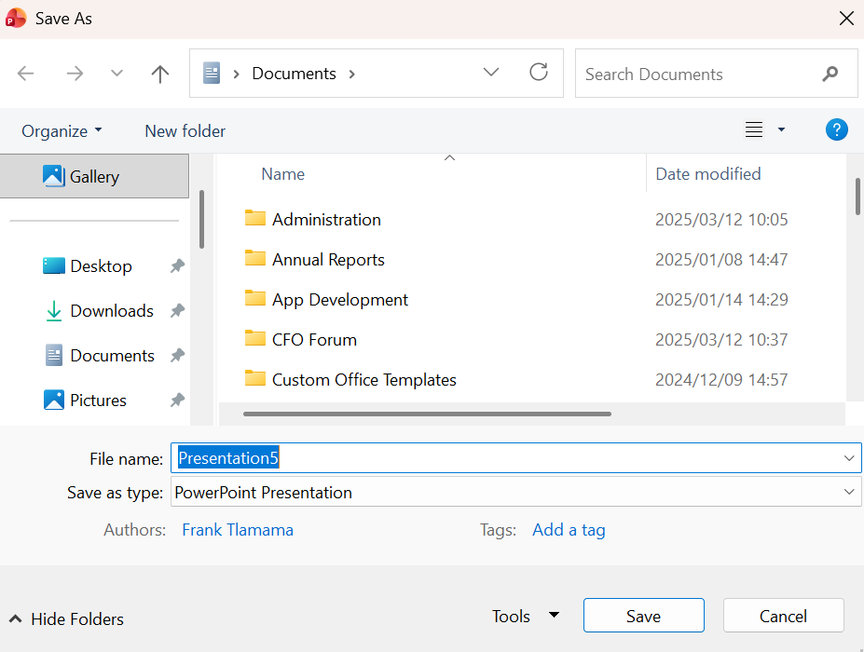
Saving Presentations
On the menu bar, click File and then Click Save or Save As
Save As
Select More storage spaces
Up one folder
Storage spaces in this folder
File Name
Notes:
[SAVING PRESENTATIONS]
Same process: File > Save As, choose location, name it clearly.
Save your presentation to the Desktop now. [PAUSE]

Slide 61
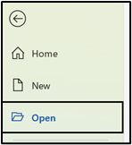
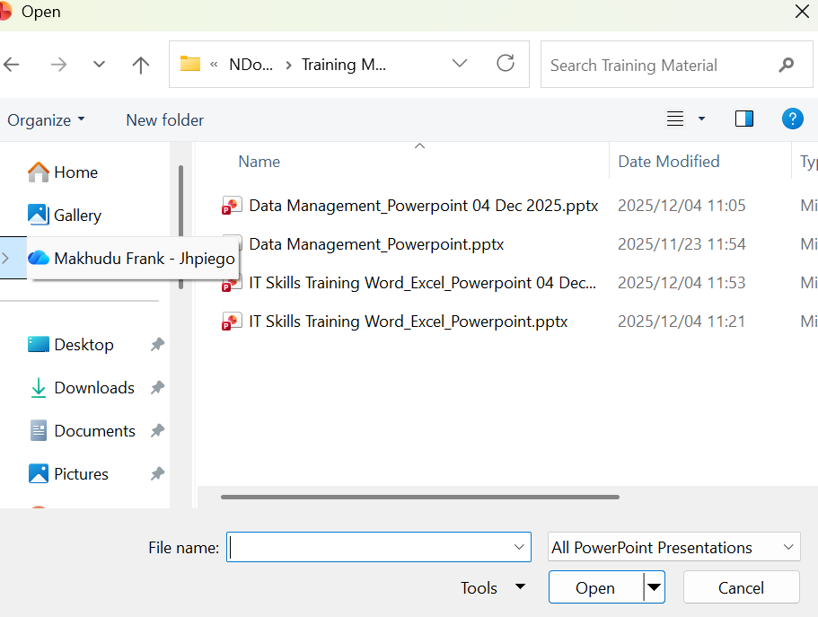
Opening Presentations
On the menu bar, click File and then Click Open
Notes:
[OPENING PRESENTATIONS]
To reopen: File > Open, navigate to the file. Same as Word and Excel.
Practice: close your presentation and reopen it. [PAUSE]

Slide 62

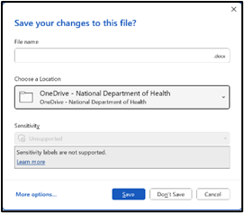
Closing Presentations
On the menu bar, click File and then Click Close
Notes:
[CLOSING PRESENTATIONS]
File > Close, or click X. Remember to save first.
You are now comfortable with the save/open/close cycle across all three applications.

Slide 63
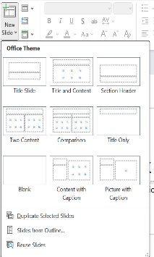
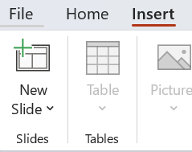
Inserting a new slide
On the formatting bar, click New Slide
Then select the type of slide you want
Notes:
[INSERTING NEW SLIDES]
To add a slide: click New Slide on the Home tab. You can choose different layouts — title slide, content slide, two-column, blank.
Choose the layout that best fits your content. Try inserting a new slide now. [PAUSE]

Slide 64
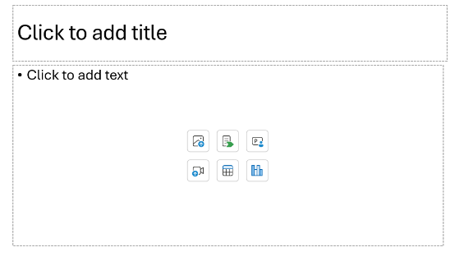
Inserting text into a PowerPoint slide
Type in the presentation heading and the context text.
You can also chose whether you want to use a table, smart art graphic, video and other based on the graphics
Notes:
[INSERTING TEXT]
Click on the text placeholder and type. You can add a title and body text.
You can also use tables, SmartArt, and other graphics by clicking the icons in the placeholder.
Type a heading and some bullet points on your new slide. [PAUSE]

Slide 65
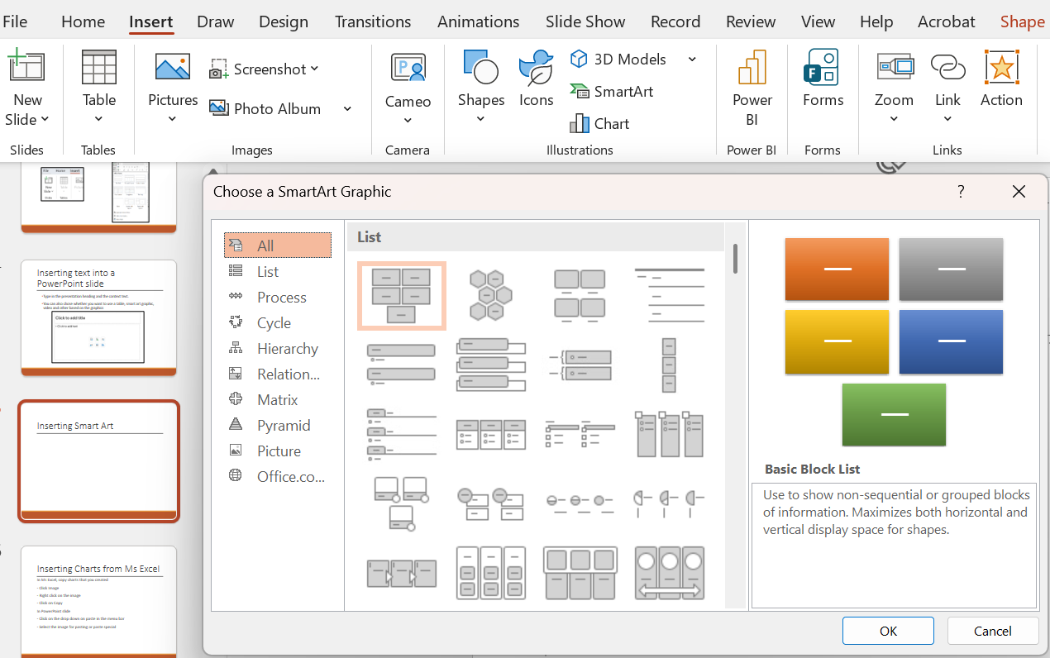
Inserting image or Smart Art
Notes:
[INSERTING IMAGES AND SMARTART]
To insert images: Insert > Pictures. To use SmartArt (pre-designed graphics for processes, lists, and relationships): Insert > SmartArt.
SmartArt is particularly useful for showing process flows and organisational structures. You will find it helpful for presenting QI work on Day 5.

Slide 66
Inserting Charts from Ms Excel
In MS Excel, copy charts that you created
  Click Image
  Right click on the image
Click on Copy
In PowerPoint slide
  Click on the drop down on paste in the menu bar
  Select the image for pasting or paste special
Notes:
[INSERTING CHARTS FROM EXCEL]
This is a very useful skill. You can copy a chart from Excel and paste it directly into PowerPoint.
In Excel: click on the chart, then Ctrl+C. In PowerPoint: Ctrl+V, or use Paste Special for more options.
We will practice this in the integrated exercise coming up next.

Slide 67
Exercise
Microsoft Word
  Please create a folder on your desktop called last day
  Open MS word and save as “Request for more staff”
  In that document, write a letter to the CEO requesting more staff
  Include a table highlighting the available staff (at least 3 names). Headings to be as follows: Name, PERSAL No, Contact No
  Insert page numbering
  Save the letter
Microsoft Excel
  Open MS Excel and save as “Request for more staff”
  Create a table with heading as follows: Name, Salary, Percentage (percent to be calculated from the total salaries paid)
Notes:
[INTEGRATED PRACTICAL EXERCISE — PART 1]
This exercise brings together everything you learned today. You will use Word, Excel, and PowerPoint together.
Let me walk you through the instructions:
For Word: Create a folder on your Desktop called "Last Day." Open Word, save as "Request for more staff." Write a letter to the CEO requesting more staff. Include a table with at least 3 staff names, PERSAL numbers, and contact numbers. Add page numbering. Save.
For Excel: Open Excel, save as the same name. Create a table with Name, Salary, and Percentage columns. Calculate the percentage using the total.
Take your time. Focus on completion, not perfection. Ask for help if you need it.
[CIRCULATE actively to support. Allow 15-20 minutes for this part.]

Slide 68
Exercise Contd.
  Draw a line graph using the percentage data
    (Add title and data labels)
  Copy the graph to sheet 2
  Rename sheet 2 to “Staff”
  Then copy the graph to MS word document named “’Request for more staff”
  Give a little narration on your word document and save in the Last day folder
Microsoft PowerPoint
  Again copy the graph from MS excel and paste it in a new slide on MS PowerPoint
  Put the heading on MS PowerPoint as Request for more staff
  Save the presentation in the folder “last day” on the desktop
Notes:
[INTEGRATED PRACTICAL EXERCISE — PART 2]
Continuing the exercise:
In Excel: draw a line graph using the percentage data. Add a title and data labels. Copy the graph to Sheet 2. Rename Sheet 2 to "Staff." Then copy the graph to your Word document and add a brief description. Save in the "Last Day" folder.
In PowerPoint: copy the graph from Excel and paste it into a new slide. Add the heading "Request for more staff." Save the presentation in the "Last Day" folder.
This exercise tests all three applications working together — which is exactly how you will use them in practice.
[CIRCULATE to support. Allow 10-15 minutes for this part.]
What "good enough" looks like: a saved Word document with text and a table, an Excel file with calculated percentages and a chart, and the chart copied into both Word and PowerPoint.

Slide 69



Wrap-up and Reflection
Questions
What was easiest about today?
What was most challenging?
Key messages
Digital tools support data quality and reporting.
Confidence matters more than perfection.
Peer learning strengthens skills.
Celebrate learning – progress matters more than perfection!

Slide 70
Additional Material
Short online MS PowerPoint training
material
https://www.youtube.com/watch?v=KqgyvGxISxk
Notes:
[POWERPOINT ONLINE RESOURCE]
Here is a link to additional PowerPoint training material. The link is in your workbook for reference.
That concludes our tour of the three Microsoft Office applications.

