Slide 1
Basic IT Skills for PHC Managers In Liberia
JLN/JLF-MoH Liberia Hardskills Training
December 8-12, 2025

Slide 2
Session 1.1: Navigating the Operating System
(using a mouse, keyboard)

Slide 3
Obectives
At the end of this session, participants will be able to:
Use the keyboard and navigate tools:
A. The Mouse (Structure of the standard mouse, uses of buttons on a mouse)
B. Keyboard (structure of the standard keyboard, sections of the keyboard and uses, key combinations and their uses)

Slide 4
The Mouse
Mouse: a pointing device which allows users to move the cursor and make selections on the computer screen.
Just as use would use your hands to interact with objects in the physical world, you can use your mouse to interact with items on your computer screen.
Using the mouse, you can move objects, open them, change them, throw them away (delete), and perform other actions. All these can be done by pointing, clicking (Single/Double, Right or Left), and dragging.

Slide 5
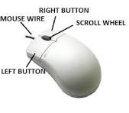
Basic Parts of a Mouse
A mouse typically has two buttons:
Primary Button - usually the left button. Most often used.
Secondary Button - usually the right button
Scroll Wheel - between the two buttons

Slide 6
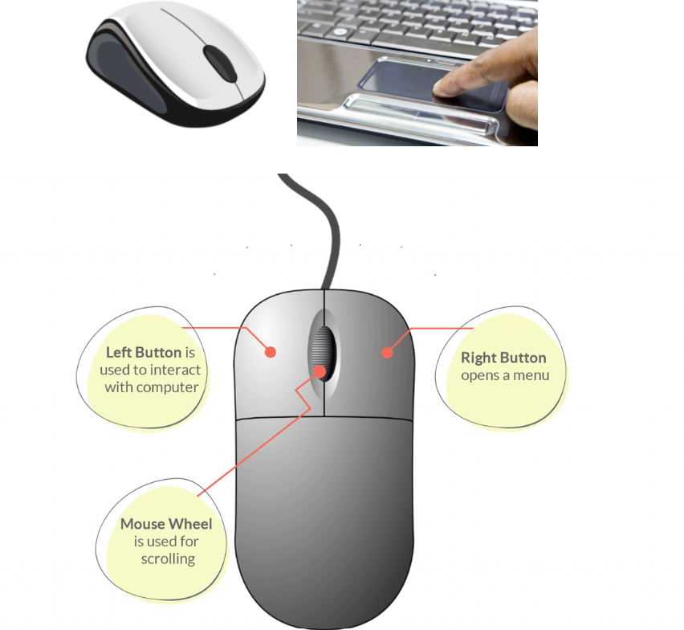
Basic Parts of a Mouse

Slide 7
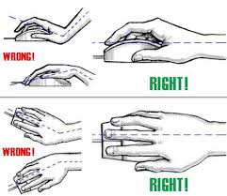
Practice Session 1: Using the Mouse

Slide 8
Practice Session 1: Using the Mouse
Under the supervision of Facilitators, participants are to turn on their Laptops.
Place your mouse beside your keyboard on a clean, smooth surface, such as a mouse pad.
Hold the mouse gently, with your index finger resting on the “primary button” and your thumb resting on the side.
To move the mouse, slide it slowly in any direction.

Slide 9
Practice Session 1: Using the Mouse
Don’t twist it - keep the front of the mouse aimed away from you. As you move the mouse, a pointer on your screenmoves in the same direction.
If you run out of space to move your mouse on your desk or mouse pad, just pick up the mouse and bring it back closer to you.
Hold the mouse lightly, keeping your wrist stright.

Slide 10
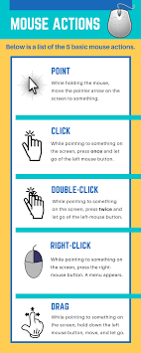
Practice Session 1: Using the Mouse (Pointing)
  Pointing on an item on the screen means moving your mouse so the pointer appears to be touching the item. When you point to something a screen tip often appears that describes the item.
  For exmaple, when you point to the Recycle Bin on the desktop, a screen tip appears with this information:
  “Contains the files and folders that you have deleted”.

Slide 11
Practice Session 1: Using the Mouse (Clicking - Single Clicking)
  To click an item, point to the item on the screen, and then press and release the primary button (usually the left button).
  Clicking is most often used to select (mark) an item or to execute a command with a command button.
Clicking is also called single-clicking or left-clicking.

Slide 12
Practice Session 1: Using the Mouse
(Clicking - Double Clicking)
  To double-click an item, point to the item on the screen, and then click twice quickly. If the two clicks are spaced too far apart, they may be intepreted as two individual clicks rather than as one double-click.
Double-clicking is most often used to open items on your desktop. For example, you can start a program or open a folder by double-clicking its icon on the desktop.

Slide 13
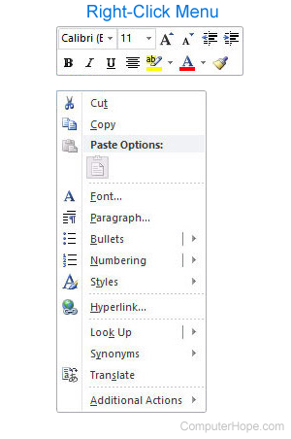

Practice Session 1: Using the Mouse (Right Clicking)
  To Right-click an item, point to the item on the screen, and then press and release the secondary button (usually the right button).
Right-clicking an item usually displays a pop up menu with a list of things you can do with the item.

Slide 14
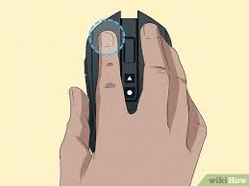
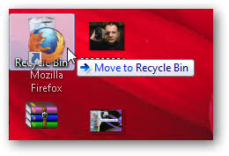
Practice Session 1: Using the Mouse (Dragging)

Slide 15
Practice Session 1: Using the Mouse (Dragging)
  You can move items around your screen by dragging them.
  To drag an object, point to the object on the screen, press and hold the primary button, move the object to a new location, and then release the primary button.
Dragging is often used to move files and folders to a different location and to move windows and icons around your screen.

Slide 16
Practice Session 1: Using the Mouse (Scrolling)
  If your mouse has a scroll wheel, you can use it to scroll through documents and windows instead of using scroll bars.
  To scroll down, roll the wheel backward (toward you). To scroll up, roll the wheel forward (away from you).
The scroll wheel helps you move up or down through documents, windows and webpages more easily.

Slide 17

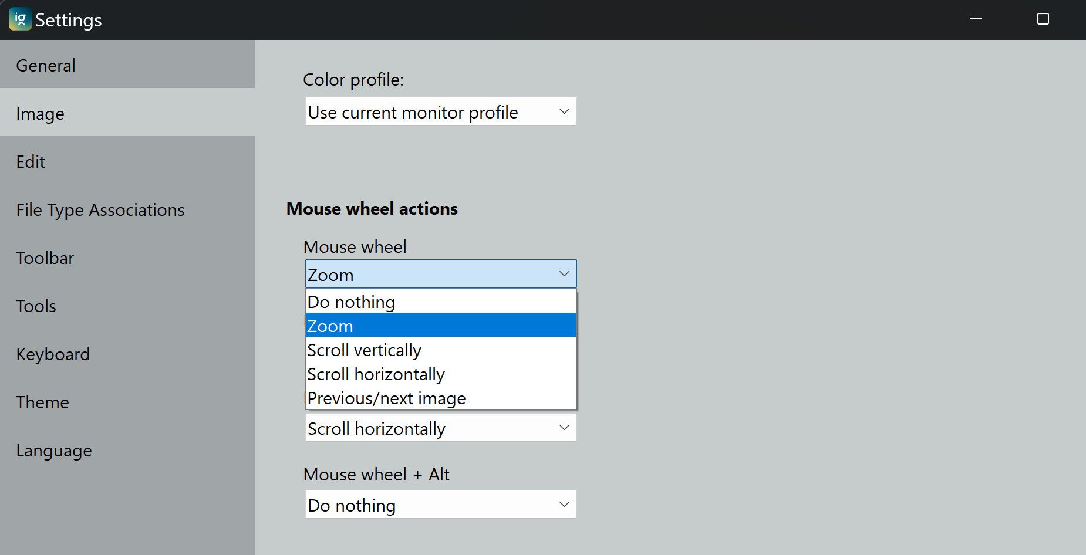
Practice Session 1: Using the Mouse (Scrolling)

Slide 18
BREAK

Slide 19
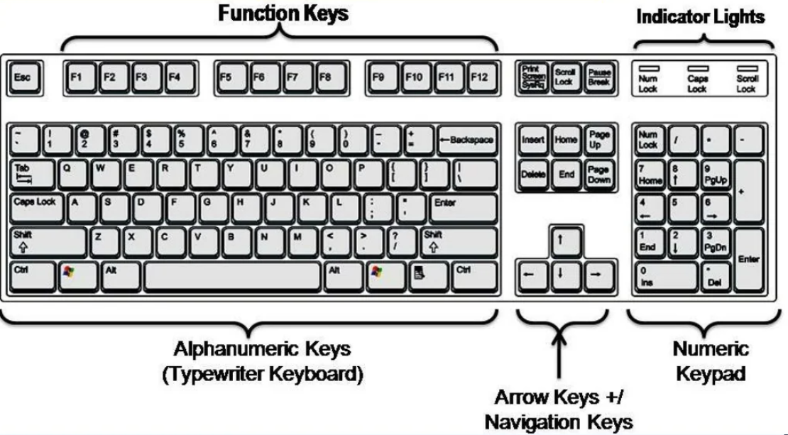
The Keyboard (Parts & Functions)
Used to enter information into the computer.
Also used to control the computer.
A knowledge of a few simple keyboard commands can help you work more efficiently.

Slide 20
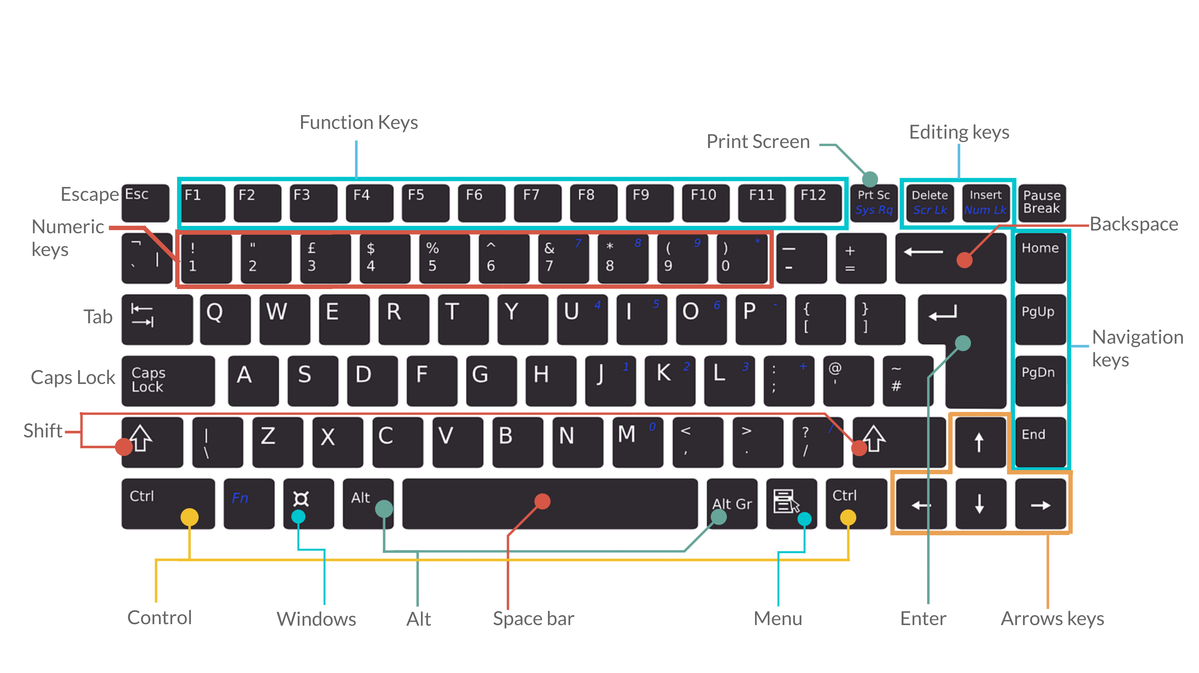
The Keyboard (Parts & Functions)

Slide 21
The Keyboard (Parts & Functions)
Tab - For indenting words in a document or for moving forward through options in a dialog box.
CapsLock - Locks the keyboard in capitals mode, allowing you to type in capital letters.
Esc - For cancelling or quitting certain tasks in some programs.
Enter - Also known as the “Hard Return”, the Enter key is used for creating a new line in a document or for selecting/pressing a dialog box button.

Slide 22
The Keyboard (Parts & Functions)
Function keys - These have a variety of uses depending upon the program e.g. F1 offers help in many application programs.
Arrow keys - To move your cursor and move in specific directions: up, down, left or right.
Numeric keys - Most of these keys can be used for performing calculations. Some repeat themselves on the keyboard e.g. the number keys are found below the Function keys as well.

Slide 23
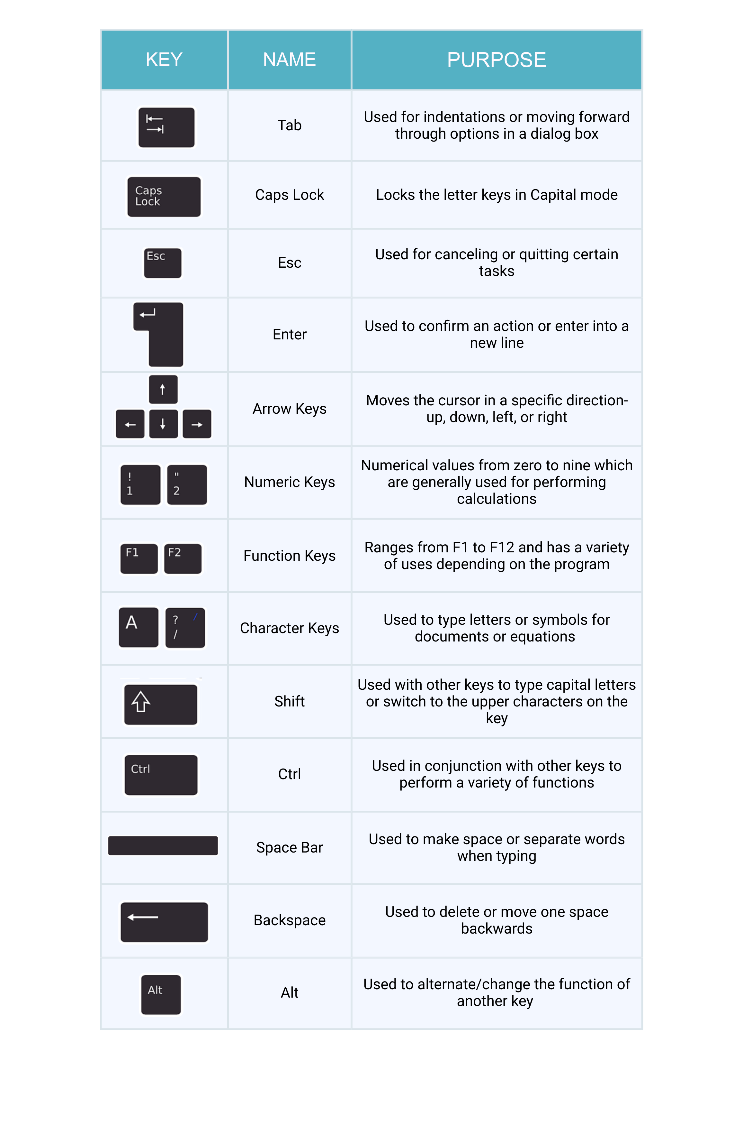

(Parts
& Functions)

Slide 24
The Keyboard (Key Combinations & Their Uses)
Press Alt+Prtscr Or Alt+PrtScn to capture an image of just the active window, instead of the entire screen.
Press Ctrl Home to move to the top of a document and press Ctrl End to move to the end of a document.
Alt+Tab to switch between open programs or windows.
Ctrl+A to select all items in a document or window.
Alt+F4 to close the active item, or exit the active program.

Slide 25
The Keyboard (Key Combinations & Their Uses)
Ctrl+S to save the current file or document.
Ctrl+C to copy the selected item.
Ctrl+X to cut the selected item.
Ctrl +V to paste the selected item.
Ctrl +Z to undo an action.
F1 to get Help.
F2 to rename a selected item.

Slide 26
The Keyboard (Exercise)
Individually type a one-page document (Autobiography) and take the following actions using key combinations:
1) Select all items in the document.
2) Cut and Paste the selected items of the document into a new document.
3) Rename the document.
4) Save the file or document on the desktop.

Slide 27
Small Group Exercises
Instruction: Facilitators Divide Participants into 3 smaller groups, 4 participants per group (Random selection).
Tasks: to do small group excercises (putting knowledge gained to practice).
Materials: Individual Project Computers, Internect Connection, etc...
Group 1: Have some fun with mouse practice. Use your mouse to assemble puzzles using this link: http://www.jigzone.com . Copy the link and paste in a browser after opening the browser and click “ENTER”.

Slide 28
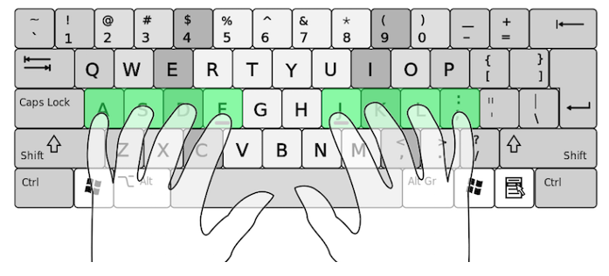
Small Group Exercises
Group 2: Practice Basic Hand Placement on a Keyboard!

Slide 29
Small Group Exercises
Group 2: Practice Basic Hand Placement on a Keyboard!
Rest both thumbs on the space bar.
Starting with the little finger of your left hand on the letter “A”. The other three fingers will rest on the next three letters “S” “D” and “F”.
Skip “G” and “H” and put the index finger of your right hand on the “J” key. The other three fingers of your right hand will rest on “K” “L” and the semi-colon key.
Note: Hunting and pecking typing is good, too. Use whatever is most comfortable to you!

Slide 30
Small Group Exercises
Group 3: Keyboard Shortcut Challenge!
In this group, participants are provided with a list of tasks that can be done with keyboard shortcuts (e.g., copy, paste, save, print).
The first person out of four (4) in the group to correctly execute the command and explain the shortcut combination (e.g., Ctrl+C for copy) earns a prize.

Slide 31
Session Closure & Discussion
From the lectures and excercises on Navigating the operating system with emphasis on the mouse and keyboard,
1) What did you learn new that can change your manegerial scope?
2) Were there challenges? (Responses from each participant)
3) Any Recommendations (Responses from each participant)

Slide 32
BREAK

Slide 33
Session 1.2: Understanding File Systems
(File & Folder Management)

Slide 34
Objectives
To provide participants with basic skills in,
Opening files and folders
Saving and managing files and folders

Slide 35
Definitions
A File or Document has a collection of data that has a name and stored in a computer.
A folder is just like a container for storing programs and files, similar to a folder in a file cabinet.
File Management is organizing and keeping track of files and folders helping us to stay organized so that information can be easily located.

Slide 36
FILES
There are many different types of files you can use. For example, Microsoft Word documents, digital photos, digital music, and digital videos are all types of files.
You might even think of a file as a digital version of a real-world thing you can interact with on your computer. When you use different applications, you'll often be viewing, creating, or editing files.
Files are usually represented by an icon. In the image below, you can see a few different types of files below the Recycle Bin on the desktop.

Slide 37
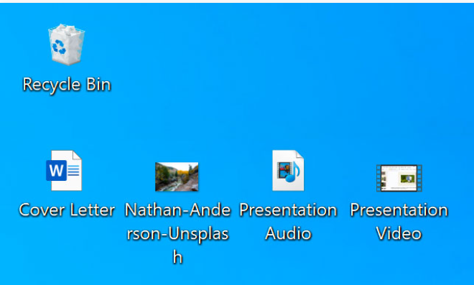
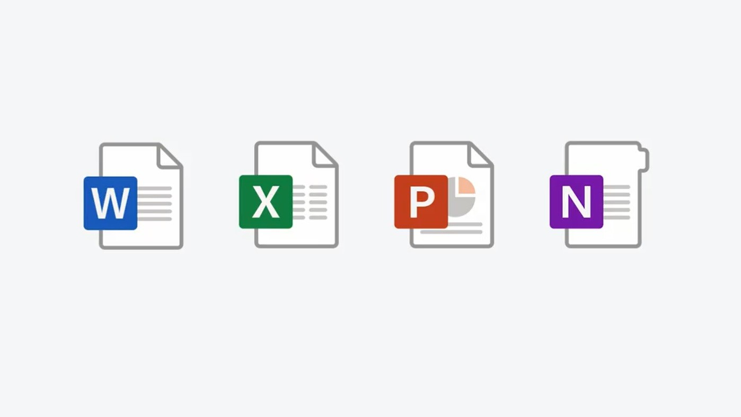
FILES

Slide 38
FILES - Opening & Saving Files
Opening Files (Method 1): Double-click the file
Find the .ppt file on your computer.
Double-click the file to open it. The file maybe WORD, PPT, PDF, or Excel file or Document.
If it doesn't open, right-click the file, select "Open with," and choose the program you want to use from the list.

Slide 39
FILES - Opening & Saving Files
Opening Files (Method 2): Open from within File
Open the desired file first.
Click on the File tab in the top-left corner.
Select Open from the menu that appears.
Click Browse to find and select your file, or check the Recent or Shared with Me lists.
Click the file and then click Open.

Slide 40
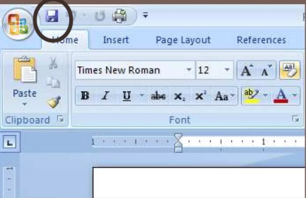
FILES - Opening & Saving Files
When you first create your file or document, save it right away. There are many ways to save a file, but we will consider a few in this training.
1) When your file is opened, click the “disk” symbol at the top left.

Slide 41
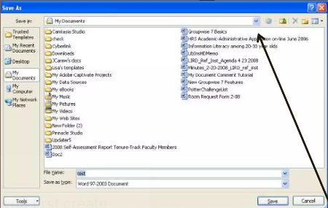
FILES - Opening & Saving Files
After you have clicked the “disk”, a window will open. First you need to say where to save the file, if you have a USB Drive, you need to find it first.
Click on the drop-down list at the top to find your USB drive.

Slide 42
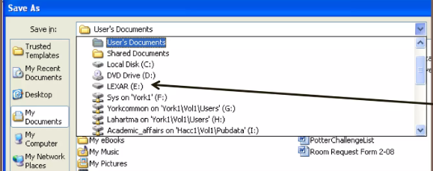
FILES - Opening & Saving Files
Find your USB drive (or any other drive or folder you need), and click.
Click on the drop-down list at the top to find your USB drive.

Slide 43
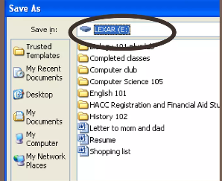
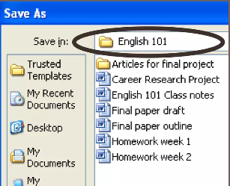
FILES - Opening & Saving Files
The place where you want to save the file should appear at the top of the window.
You might want to double-click on one of the folders to save your file to a specific folder.

Slide 44
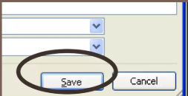
FILES - Opening & Saving Files
Choose a good name for your document and type it next to “file Name”.
Click “Save” after you have named your document.

Slide 45
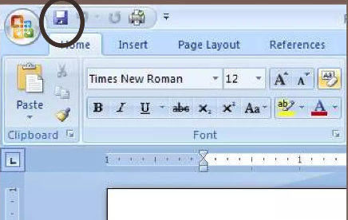
FILES - Opening & Saving Files
Once you have named and save your file the first time, it is easy to save it after that.
Just click the disk agian at the top left, and it will automatically save it with the same name, and in the same place.

Slide 46
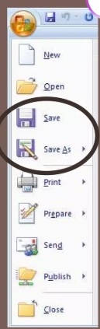
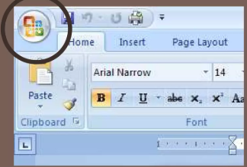
FILES - Opening & Saving Files
2) The Use of “Save As”
Click on the window circle at the top left and find the “Save” option on the list.

Slide 47
FILES : Files Explorer
You can view and organize files and folders using a built-in application known as File Explorer (called Windows Explorer in Windows 7 and earlier versions).
To open File Explorer, click the File Explorer icon on the taskbar, or double-click any folder on your desktop. A new File Explorer window will appear. Now you're ready to start working with your files and folders.

Slide 48
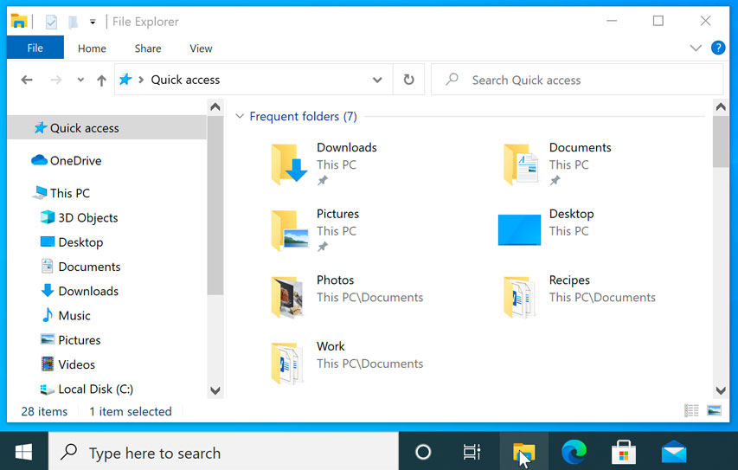
FILES : Files Explorer
From File Explorer, double-click a folder to open it. You can then see all of the files stored in that folder.

Slide 49
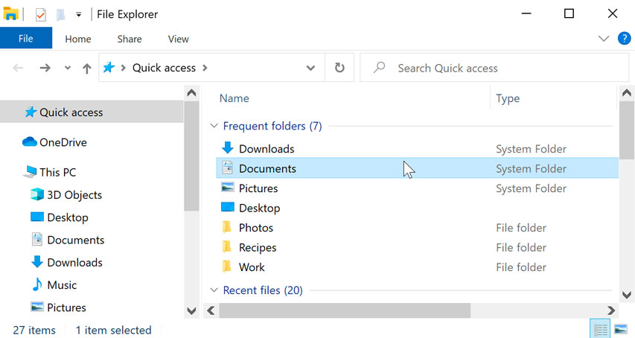
FILES : Files Explorer
Notice that you can also see the location of a folder in the address bar near the top of the window.

Slide 50
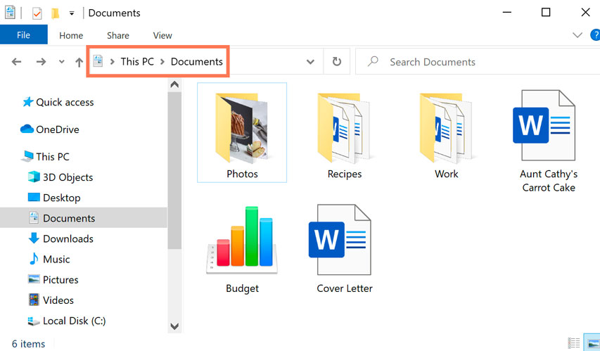
FILES : Files Explorer

Slide 51
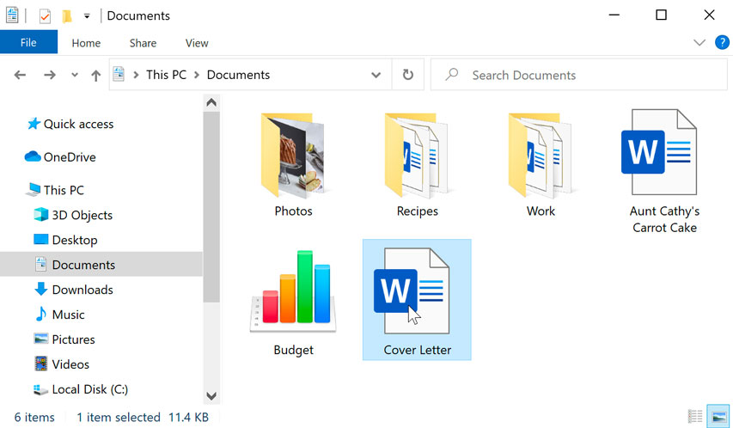
FILES : Opening A File
There are two main ways to open a file:
1) Find the file on your computer and double-click it. This will open the file in its default application. In our example, we'll open a Microsoft Word document (Cover Letter.docx), which will open in Microsoft Word.

Slide 52
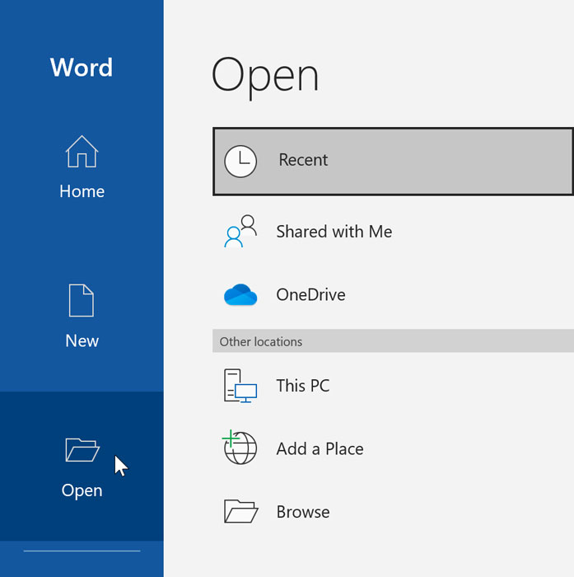
FILES : Opening A File
There are two main ways to open a file:
2) Open the application, then use the application to open the file. Once the application is open, you can go to the File menu at the top of the window and select Open.

Slide 53
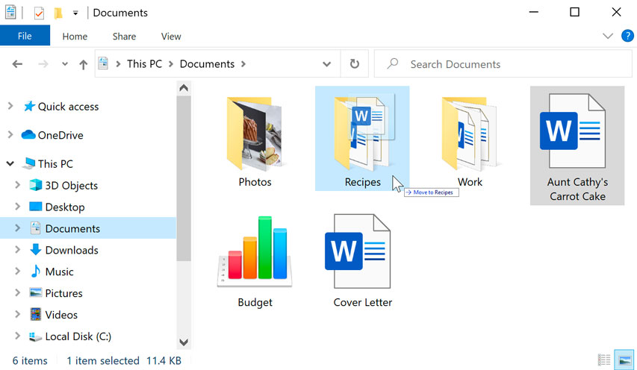
FILES : Moving and deleting files
It's easy to move a file from one location to another. For example, you might have a file on the desktop that you want to move to your Documents folder.
1) Click and drag the file to the desired location.

Slide 54
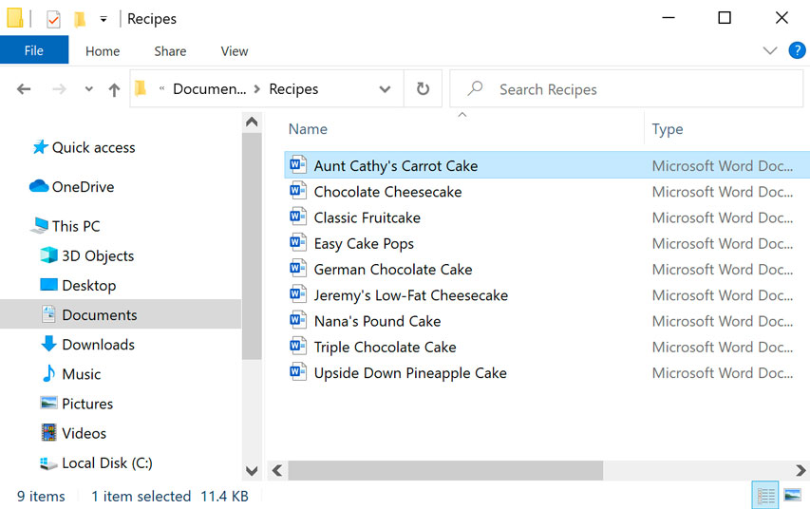
FILES : Moving and deleting files
2) Release the mouse. The file will appear in the new location. In this example, we have opened the folder to see the file in its new location.
You can use this same technique to move an entire folder. Note that moving a folder will also move all of the files within that folder.

Slide 55
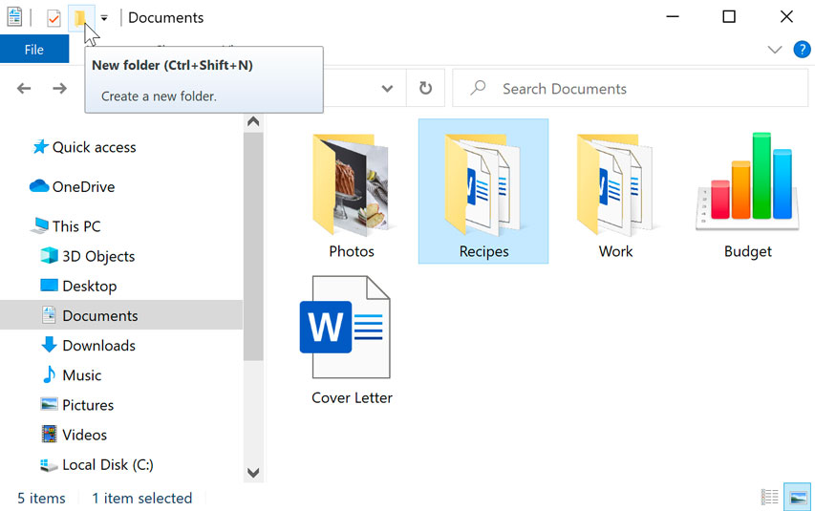
FOLDERS : Creating A New Folder
To create a new folder:
1) Within File Explorer, locate and select the New folder button. You can also right-click where you want the folder to appear, then select New > Folder.

Slide 56
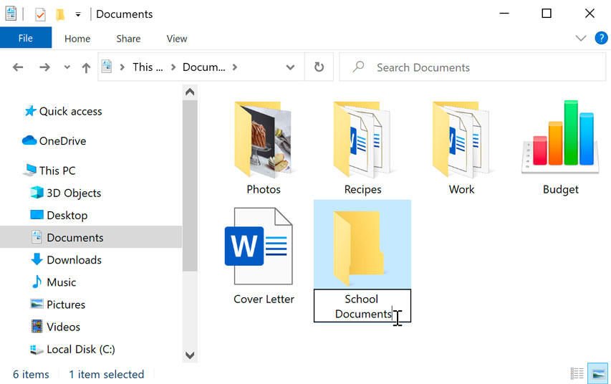
FOLDERS : Creating A New Folder
To create a new folder:
2) The new folder will appear. Type the desired name for the folder and press Enter. In our example, we'll call it School Documents.

Slide 57
FOLDERS : Creating A New Folder
To create a new folder:
2) The new folder will appear. Type the desired name for the folder and press Enter. In our example, we'll call it School Documents.
3) The new folder will be created. You can now move files into this folder.

Slide 58
Tips for Naming OR Renaming A File
To name files effectively, use descriptive, consistent names that include key information like a project name, date in YYYY-MM-DD format, and a version number. Avoid spaces by using underscores or hyphens, special characters, and excessively long names to improve compatibility across different systems.
Structure and content
Be descriptive but concise: Keep names meaningful enough to understand the file's content but avoid making them excessively long. Aim for a length of around 30 characters.

Slide 59
Tips for Naming OR Renaming A File
Structure and content
Use a consistent format: Decide on a structure and stick to it. A common format is ProjectName_Date_Description_Version.
Use dates consistently: Use the YYYY-MM-DD format to ensure files sort chronologically.
Use numbers for ordering: When numbering files, use leading zeros to ensure correct numerical order (e.g., 01, 02, ... 10).

Slide 60
Tips for Naming OR Renaming A File
Structure and content
Include versioning: Use a v followed by the version number (e.g., v01, v02) to track changes.
Add versioning and date as the final elements: Placing version and date at the end makes it easy to find the latest version or to sort chronologically within a specific project.

Slide 61
Tips for Naming OR Renaming A File
Formatting and characters
Avoid spaces: Replace spaces with hyphens (-) or underscores (_) to prevent compatibility issues, especially on web servers.
Avoid special characters: Do not use characters like *, ?, \, /, :, #, %, or ~ as they can cause errors or be changed by other systems.
Use alphanumeric characters: Stick to letters (A-Z) and numbers (0-9).
Maintain case consistency: Be consistent with capitalization, especially if working in a team, as some operating systems are case-sensitive.

Slide 62
Tips for Naming OR Renaming A File
What to avoid
Vague terms: Avoid generic words like "miscellaneous," "final," or "draft" at the beginning of a filename.
Redundancy: Do not repeat information that is already clear from the folder structure or file contents.
Excessively long names: Stick to a reasonable length to avoid issues with file path length limits.
Unnecessary punctuation: While hyphens and underscores are useful, avoid other punctuation marks that can cause problems.

Slide 63
FOLDERS : Renaming A File OR Folder
You can change the name of any file or folder. A unique name will make it easier to remember what type of information is saved in the file or folder.
1) Click the file or folder, wait about one second, and click again. An editable text field will appear.
2) Type the desired name on your keyboard and press Enter. The name will be changed.

Slide 64
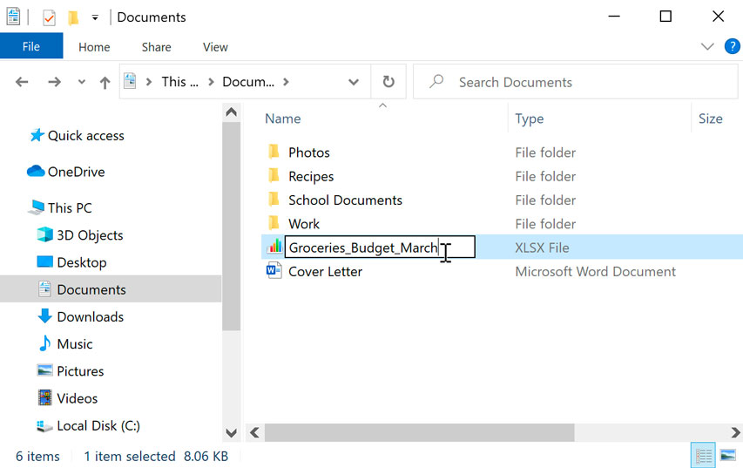
FOLDERS : Renaming A File OR Folder

Slide 65
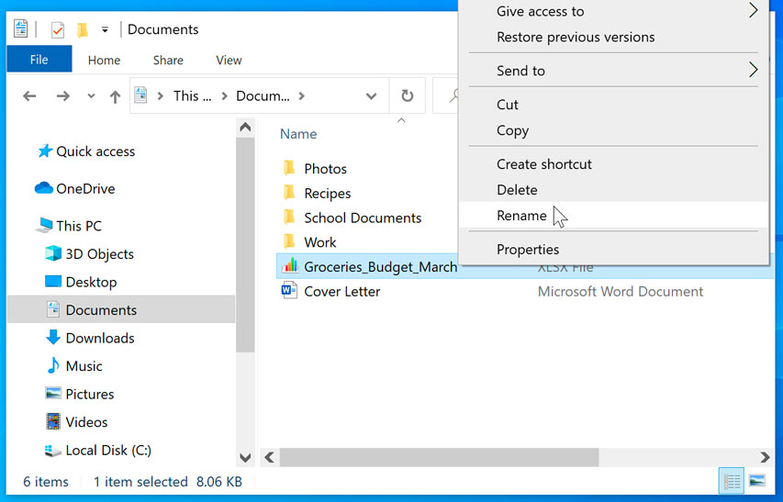
FOLDERS : Renaming A File OR Folder
You can also right-click the folder and select Rename from the menu that appears.

Slide 66
FOLDERS : Deleting A Folder OR File
If you no longer need to use a file, you can delete it. When you delete a file, it is moved to the Recycle Bin. If you change your mind, you can move the file from the Recycle Bin back to its original location. If you're sure you want to permanently delete the file, you will need to empty the Recycle Bin.
1) Click and drag the file to the Recycle Bin icon on the desktop. You can also click the file to select it and press the Delete key on your keyboard.

Slide 67
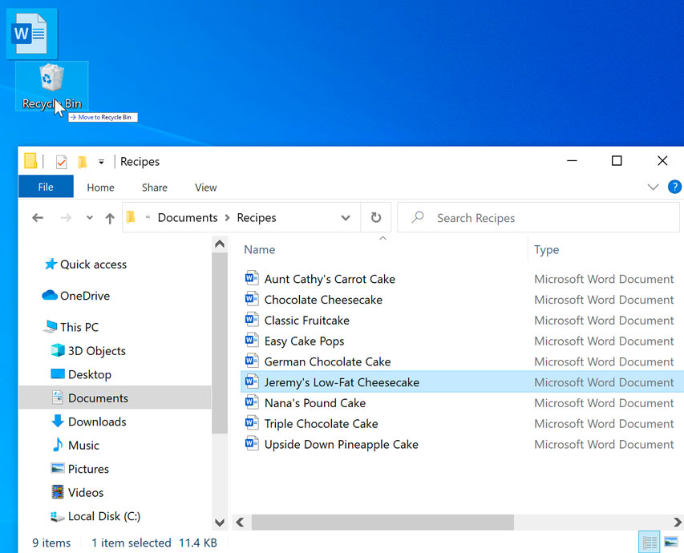
FOLDERS : Deleting A Folder OR File

Slide 68
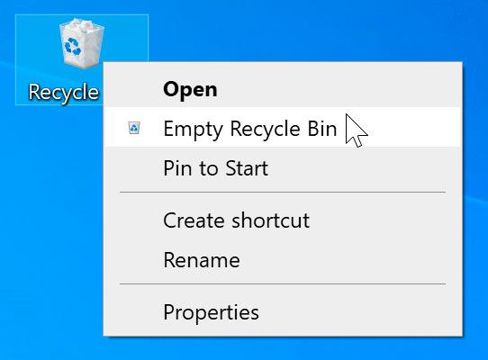
FOLDERS : Deleting A Folder OR File
2) To permanently delete the file, right-click the Recycle Bin icon and select Empty Recycle Bin. All files in the Recycle Bin will be permanently deleted.
Note that deleting a folder will also delete all of the files within that folder.

Slide 69
Selecting Multiple Files
Now that you know the basics, here are a few tips to help you move your files even faster.
There are a few ways to select more than one file at a time:
1) If you're viewing your files as icons, you can click and drag the mouse to draw a box around the files you want to select. When you're done, release the mouse; the files will be selected. You can now move, copy, or delete all of these files at the same time.

Slide 70
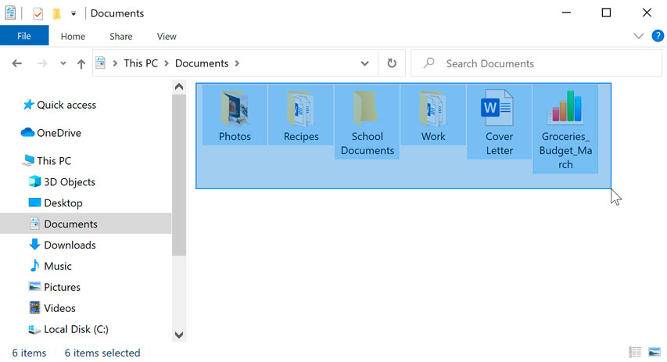
Selecting Multiple Files
1) If you're viewing your files as icons, you can click and drag the mouse to draw a box around the files you want to select. When you're done, release the mouse; the files will be selected. You can now move, copy, or delete all of these files at the same time.

Slide 71
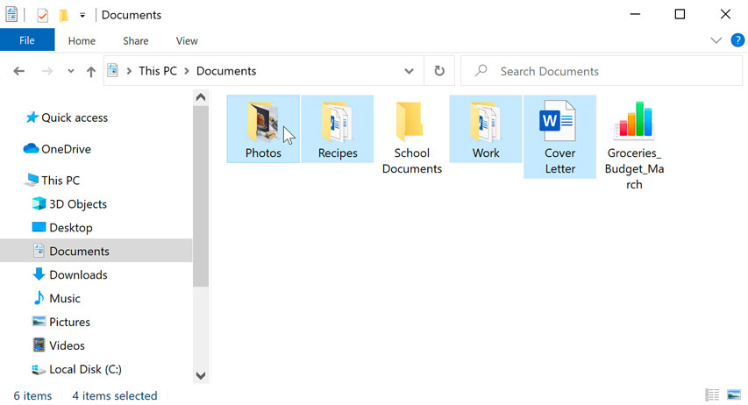
Selecting Multiple Files
2) To select specific files from a folder, press and hold the Control key on your keyboard, then click the files you want to select.

Slide 72
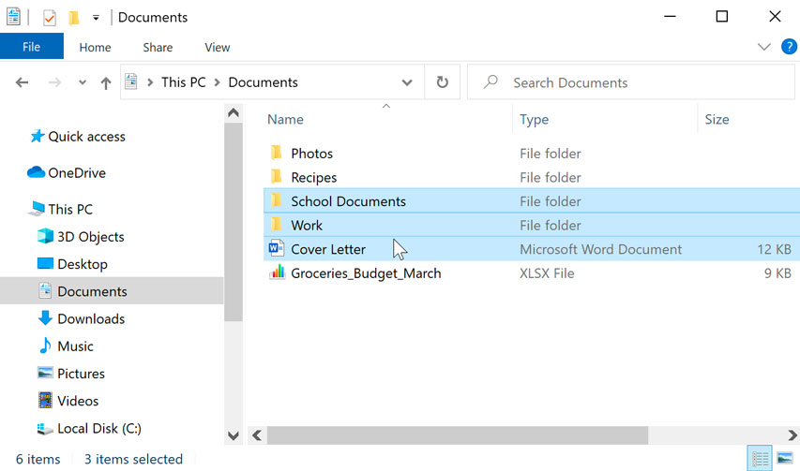
Selecting Multiple Files
3) To select a group of files from a folder, click the first file, press and hold the Shift key on your keyboard, then click the last file. All of the files between the first and last ones will be selected.

Slide 73
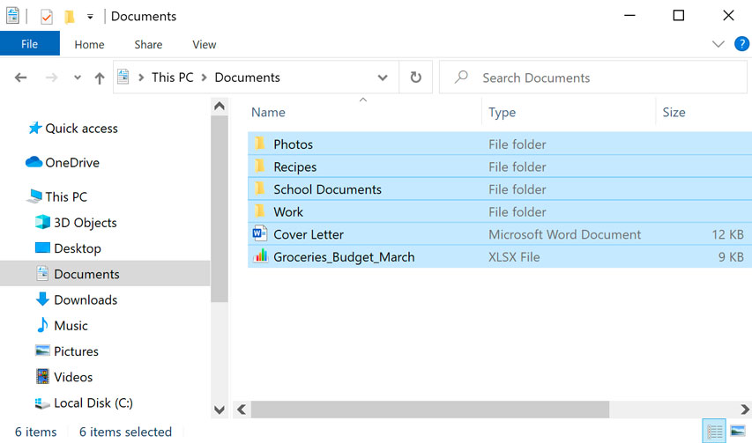
Selecting All Files
If you want to select all files in a folder at the same time, open the folder in File Explorer and press Ctrl+A (press and hold the Control key on your keyboard, then press A). All of the files in the folder will be selected.

Slide 74
Creating Shortcuts
Note that creating a shortcut does not create a duplicate copy of the folder; it's simply a way to access the folder more quickly.
If you delete a shortcut, it will not delete the actual folder or the files it contains.
Also note that copying a shortcut onto a flash drive will not work; if you want to bring a file with you, you'll need to navigate to the actual location of the file and copy it to the flash drive.

Slide 75
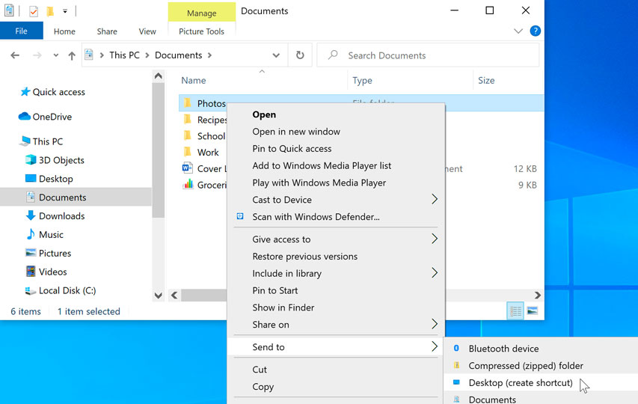
Creating Shortcuts
To Create Shortcuts,
1) Locate and right-click the desired folder, then select Send to Desktop (create shortcut).

Slide 76

Creating Shortcuts
To Create Shortcuts,
2) A shortcut to the folder will appear on the desktop. Notice the arrow in the lower-left corner of the icon. You can now double-click the shortcut to open the folder at any time.
You can also hold the Alt key on your keyboard, then click and drag the folder to the desktop to create a shortcut.

Slide 77
BREAK, AFTER GROUP ACTIVITIES !

Slide 78
Group Activities On Understanding File Systems
Materials: Individual Computers, Notepads....
Groups: 4 groups of 3 paarticpants to perform the following Tasks. Random slection of participants per group by the facilitator(s).
Group 1:
On your desktop, create a word document, an excel, and a power point file/document in a folder. Name the word document “ANC Record Record”. Name the excel file “Training Participants”, and name the power point presentation “Facility Q3 Report”. Name the folder “Purity” and in the folder containing these files, create another folder (subfolder) titled “Important”, then copy the documents in it.

Slide 79
Group Activities On Understanding File Systems
Materials: Individual Computers, Notepads....
Groups: 6 groups of 2 paarticpants to perform the following Tasks,
Group 2:
Create a word document in “Document” and save the file or document with the name “PHC Performance”. Delete the file and then restore it. After restoring the file, move the file to Desktop and save it in a folder titled “A000T2X” and rename the file “Justified” and save it.

Slide 80
Group Activities On Understanding File Systems
Materials: Individual Computers, Notepads....
Groups: 6 groups of 2 paarticpants to perform the following Tasks,
Group 3:
Create 3 power point files in drive C and name them AZ1, AZ2, and AZ3. Also create 3 folders in the same drive and name them AZ1,AZ2 and AZ3. Copy all files and AZ1, AZ3 folders only and move to Desktop and Save in a New Folder titled “UHC”. Move UHC to a new folder in “Document” and tiltle it “UHC Prime”, then create a shortcut for “UHC Prime” on the Desktop.

Slide 81
Group Activities On Understanding File Systems
Materials: Individual Computers, Notepads....
Groups: 6 groups of 2 paarticpants to perform the following Tasks,
Group 4:
Create 5 excel files on Destop and name them E1,E2,E3,E4,E5. Delete files E1, E3, E5. Empty Recycle Bin. Then create a folder titled “Survivors” and save files E2 and E4 in it. Open the new folder and create a folder tiltled “Pluto” and in Pluto create a world document titled “key notes” and safe it.

Slide 82
WE TAKE A SHORT BREAK

Slide 83
Session 1.3: Using Word, Excel, PowerPoint
(Including creating charts and Tables)

Slide 84
Objectives
By the end of this session, it is expected that participants will:
Have basic understanding of using word, excel and powerpoint.
Have understanding of creating charts and Tables and their significance in the context of healthcare.

Slide 85
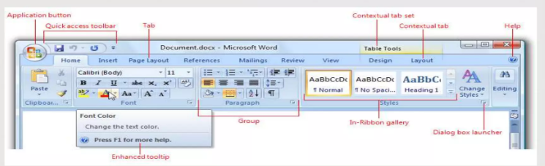
WORD
Microsoft Word or MS-Word is a Graphical word processing program that users can type with.
It is made by the computer company Microsoft. Its purpose is to allow users to type and save documents.

Slide 86
WORD: Features
Speech Recognition
Spelling and Grammar checker, word count (this also counts letters and lines)
Inserts pictures in documents
Choice of type faces
Displays synonyms of words and can read out the text
Prints in different ways
Web pages, graphs, etc.
Tables
Special codes

Slide 87
WORD: Features
Speech Recognition
Spelling and Grammar checker, word count (this also counts letters and lines)
Inserts pictures in documents
Choice of type faces
Displays synonyms of words and can read out the text
Prints in different ways
Web pages, graphs, etc.
Tables
Special codes

Slide 88
WORD: Advantages & Uses
Saves time
Enhances document appearance
Allows sharing of documents
Copies can easily be made, which saves on printing, and it is much easier to do
Can save multiple version of documents and easily sort them so that user can go back to previous versions of the same document.
Preparing Reports, Letters, Resumes, Notices, and Meeting Agendas
Preparing Calendars
Preparing Memorandum
Preparing Applications, etc.

Slide 89
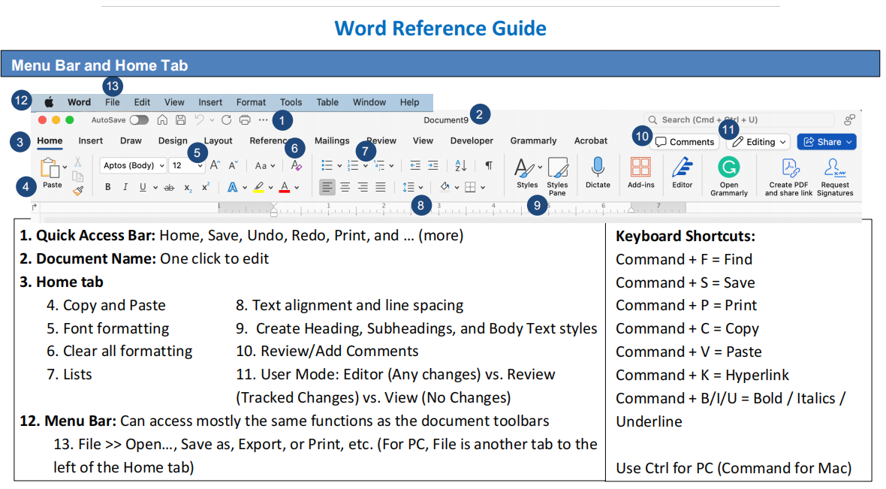
WORD: Reference Guide

Slide 90
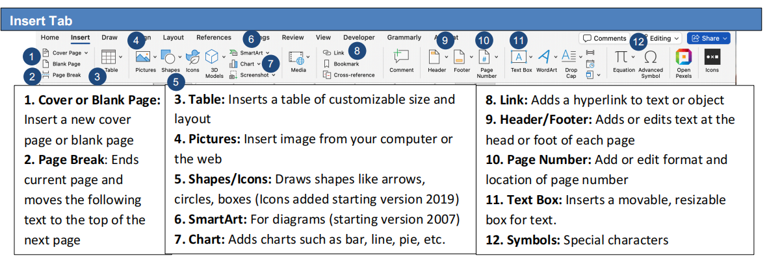
WORD: Reference Guide

Slide 91
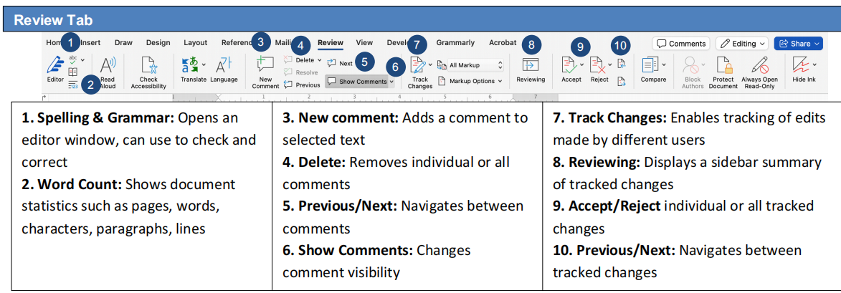
WORD: Reference Guide

Slide 92
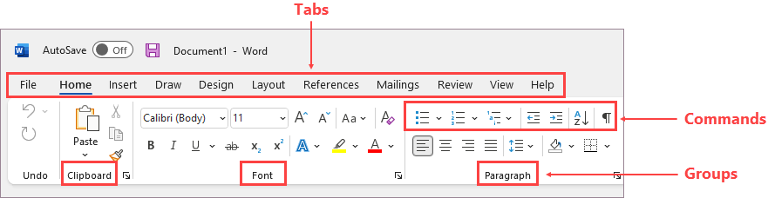
WORD: Parts of Interface
1) RIBBON
a user interface element which was introduced by Microsoft in 2007.
Located below the Quick Access Tool Bar and the Title Bar.
It comprises seven (7) tabs, namely: Home, Insert, Page layout, References, Mailing, Review, and View.

Slide 93
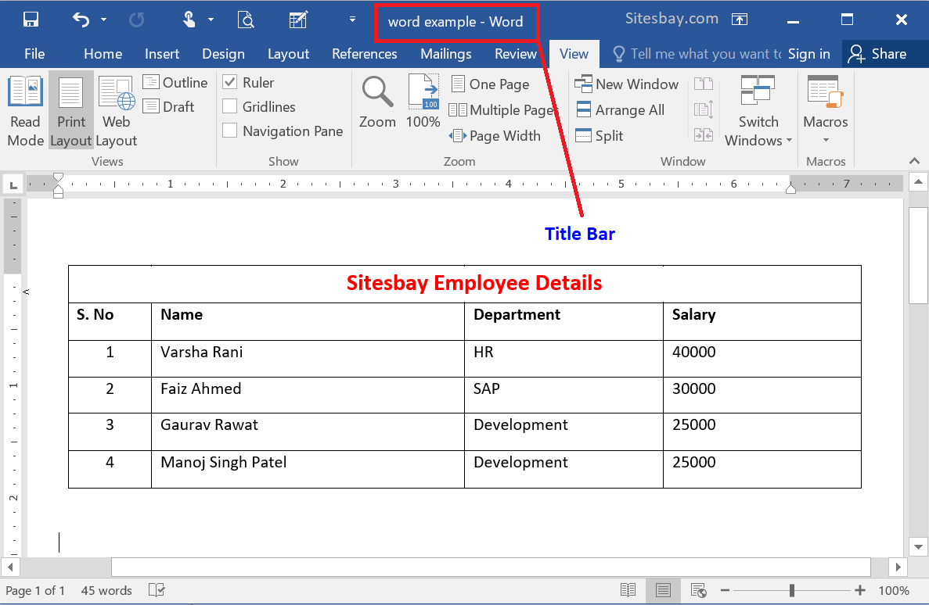
WORD: Parts of Interface
2) TITLE BAR
a bar located at the top of a window or a dialog box that displays the name of a window or software program being used.

Slide 94
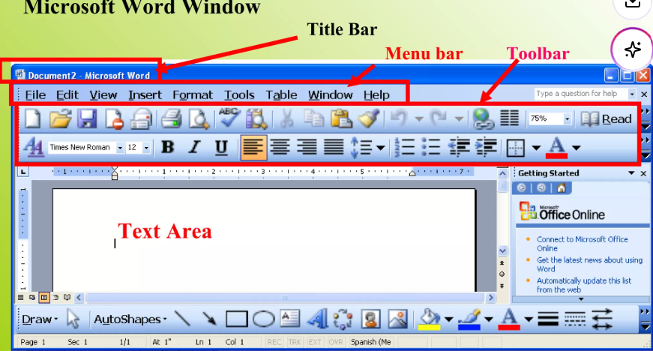
WORD: Parts of Interface
3) MENU BAR
when you first start word, the Menu and toolbars display basic commands and buttons that we use most often and are stored as personalized settings and displayed on menu and tool bars.

Slide 95
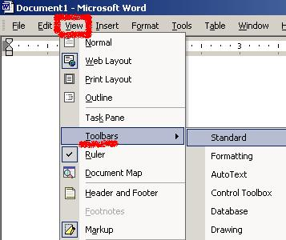
WORD: Parts of Interface
4) TOOL BAR
below the Menu Bar are the Tool Bars. There are 16 different Toolbars in WORD.
The two most common ones are the Standard ToolBar and the Formatting ToolBar.

Slide 96
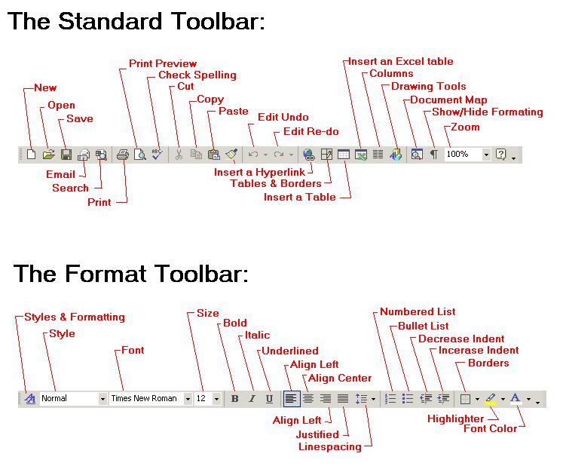
WORD: Parts of Interface
4) TOOL BAR

Slide 97

WORD: Parts of Interface
5) SCROLL BAR
allows you to move the window viewing area up, down, left, or right.
Two Types: Horizontal and Vertical Scroll Bars.

Slide 98

WORD: Parts of Interface
6) STATUS BAR
indicates information about the current file or document. It displays information about what page you are on, as well as your line number on the page and character number on the line.

Slide 99

WORD: Whole Group Exercise
Materials: Computers and Notepads, Pen.
Task: Open a Blank Word Document on your computer (each participant). Type 3 pages on The Management of PPH at your individual facility. With the file opened, identify the parts of the Word interface.

Slide 100

EXCEL: Introduction
Microsoft Excel is a spreadsheet application.
Can be used for storing, organizing, and manipulating data.
It features calculation, graphing tools, pivot tables, and macro programming language.
It is a very widely applied speadsheet.

Slide 101
EXCEL: Application & Importance
To manage name list of data records
To perform mathematical calculation easily in daily works
Inventory Management
Create forms and consolidate results
Analytical tools
Budgeting, etc..

Slide 102

EXCEL: Reference Guide

Slide 103

EXCEL: Reference Guide

Slide 104


EXCEL: Application & Importance
Easy Arithmetic solutions
Various formatting options
Availability of online Access
Graphing
Data Organization
Human Resource Planning
Programming

Slide 105
EXCEL: Basic Features
Has the basic features of all spread sheets
A grid of cells arranged in numbered rows and letter-named columns to organize data manipulations like arithmetic operations
answers statistical, engineering, and financial needs
Displays data as line graphs, histograms, and charts
Allows the user to employ a wide variety of numerical data
Has a variety of interactive features

Slide 106

EXCEL: Operations

Slide 107

EXCEL: Basic Terms
1) Formulas in Excel, a formula is an expression that operates on values in a range of cells or a cell. For example, A₁+A₂+A₃, which finds the sum of the range of values from cell A₁ to cell A₃.

Slide 108

EXCEL: Basic Terms
1) Formulas

Slide 109

EXCEL: Basic Terms
2) Functions in Excel are pre-defined formulas. They eliminate laborious manual entry of formulas while giving them human-friendly names. For example,
=SUM (A₁:A₃). The function sums all the values from A₁ to A₃.

Slide 110

EXCEL: Basic Terms
2) Functions in Excel are pre-defined formulas. They eliminate laborious manual entry of formulas while giving them human-friendly names. For example,
=SUM (A₁:A₃). The function sums all the values from A₁ to A₃.

Slide 111

EXCEL: Screen Components

Slide 112

EXCEL: Screen Components

Slide 113

EXCEL: Screen Components

Slide 114

EXCEL: Screen Components

Slide 115

EXCEL: Screen Components

Slide 116

EXCEL: Screen Components

Slide 117

EXCEL: Screen Components

Slide 118

EXCEL: Screen Components

Slide 119

EXCEL: Screen Components

Slide 120

EXCEL: Screen Components

Slide 121

EXCEL: Screen Components

Slide 122

EXCEL: Screen Components

Slide 123

EXCEL: Screen Components

Slide 124
EXCEL: Screen Components

Slide 125

EXCEL: Screen Components

Slide 126

EXCEL: Screen Components

Slide 127

EXCEL: Screen Components

Slide 128

EXCEL: Screen Components

Slide 129

EXCEL: Screen Components

Slide 130

EXCEL: Screen Components

Slide 131

EXCEL: Screen Components

Slide 132

EXCEL: Screen Components

Slide 133

EXCEL: Screen Components

Slide 134
EXCEL: Whole Group Activity
With understanding gained so far in Excel. Let us do some activities.
1) We are going to create tables in Excel:
• Using hand-written data from health facility for Q2 and Q3 ANC Attendance,
– Type your data into Excel with clear column headers
• Select the Data
– Click and drag your mouse over all the cells (including headers) that you want in the
table.
• Insert the Table
– Go to the Insert tab on the top menu.
• Ensure the correct range is selected and check: “My table has headers.”
• Click OK

Slide 135

EXCEL: Whole Group Activities (Creating Tables & Calculating In Excel)
2) Assuming the below table dicpits the ANC Attendance of facilities in Tubmanburg for Q1-Q2,
Find the sum of each facility’s ANC Attendance for the two quarters.

Slide 136
EXCEL: Whole Group Activities (Creating Charts- Bar Charts In Excel)
What is a Bar Chart?
• A chart that uses rectangular bars to represent data
– X-axis: Categories (e.g. diseases, clinics)
– Y-axis: Values (e.g. number of cases)
• Bars show how values differ between categories
– Compare service use across facilities
– Show diseases cases by age or sex
– Display stock levels or immunization data
– Visualize attendance or health education participation

Slide 137
EXCEL: Whole Group Activities (Creating Charts- Bar Charts In Excel)
When to Use Bar Charts
When comparing categories (not over time).
When visualizing differences across groups.
When showing distributions (e.g., by sex or location).
When NOT to Use Bar Charts
Not for time trends (use line charts instead)
Not ideal for showing parts of a whole (use pie charts)

Slide 138
EXCEL: Whole Group Activities (Creating Charts- Bar Charts In Excel)
How to Create a Bar Chart (Manual)
Draw X and Y axes
Label X-axis with categories
Label Y-axis with value range
Draw bars representing values
Add chart title and labels
Mini-exercise: each participant to practice this using a flip chart. Materials: flip chart, marker.... Facilitators to review manual bar charts.

Slide 139

EXCEL: Whole Group Activities (Creating Charts- Bar Charts In Excel)
How to Create a Bar Chart (Excel)
Enter data in two columns: Category and Value.
Highlight data and insert a bar chart.
Label the chart and format it for clarity
Example: Disease Cases in a Month
• Top OPD cases in the month
– Malaria: 60
– Diarrhea: 30
– Pneumonia: 25
– Skin Infections: 20
– Eye Infections: 15

Slide 140
EXCEL: Whole Group Activities (Creating Charts- Bar Charts In Excel)
How to Create a Bar Chart (Excel): Breakout Group Exercise
Instructions: Facilitators to divide participants into 3 groups (random selection) for breakout group exercises on the creation of Bar Charts in Excel.
Group 1 Task: Create a Bar Chart for Clinics Data on Nov. 15, 2025 Total OPD Consultations:
Clinics Data
– Clinic A: 100
– Clinic B: 75
– Clinic C: 125

Slide 141
EXCEL: Whole Group Activities (Creating Charts- Bar Charts In Excel)
How to Create a Bar Chart (Excel): Breakout Group Exercise
Instructions: Facilitators to divide participants into 3 groups (random selection) for breakout group exercises on the creation of Bar Charts in Excel.
Group 2 Task: Create a Bar Chart for Total Numbers of Vaginal Deliveries at your facility from Q1 to Q3.
Group 3 Task: Create a Bar Chart for Total Numbers of patients counseled for Family Planning at your facility from Q1 to Q3.

Slide 142
BREAK, AFTER WE LOOK AT EXCEL

Slide 143
Brain Teasers
What is Microsoft Powerpoint?
Have you used it before, if yes...In what setting?
(Solicit Answers for each Participant)

Slide 144

Powerpoint: Definition
Microsoft PowerPoint is an electronic presentation program that helps people present a speech using a collection of slides.
A PowerPoint presentation is a collection of slides that can be used to create oral presentations.
This is the standard first slide of a PowerPoint presentation.

Slide 145

Powerpoint: Reference Guide

Slide 146

Powerpoint: Reference Guide

Slide 147

Powerpoint: Reference Guide

Slide 148

Powerpoint: Creating Tables In Excel (Group Exercise)
• Using hand-written data on number of staff per department at your health facility,
1. START PowerPoint, if the program is not already running.
2. Name the presentation and save it as “Staff At Facility 2025”
3. Insert a new slide with the Title “Staff Per Department”.
4. Click the Insert Table icon in the content placeholder. Then Insert Table dialog box opens.

Slide 149
Powerpoint: Creating Tables In Excel (Group Exercise)
• Using hand-written data on number of staff per department at your health facility,
5. In the Number of Columns text box, overwrite the existing text if necessary and type the desired number to specify three columns, press Tab to move to the Number of Rows text box, and the desired number of rows. Click OK. PowerPoint creates the table in the content area.
6. Type your information in the the table, format and save the table for course facilitators to view and evaluate.

Slide 150
Powerpoint: Creating Tables In Excel (Group Exercise)
End of Exercise Discussion
Q&A

Slide 152


Slide 153
Session 1.4 : Understanding Email management

Slide 154
Objectives
By the end of this session, participants will be able to:
understand the importance of email in modern age
create and manage an email account

Slide 155
Understanding Email management
To Begin, Who All In This Training Have Email Acounts? (Participants with Email Accounts to Stand and State which type of Accounts they have and how often do they use thier email accounts to communicate)?
Participants without Email Accounts to state why they do not have Email Accounts?

Slide 156
Understanding Email management
Welcome to Email. This Session will give you the skills you need to open an email account, send and receive Email. Also to send and receive attachments.
Email | Postal (Snail Mail)
Send messages instantly | Messages arrive after 2-3 days
Access anywhere | Fixed physical address
Free (with internet access) | Cost of postage

Slide 157

Understanding Email management - Anatomy of an Email Address

Slide 158



Understanding Email management - Webmail

Slide 159

Understanding Email management - Creating An Email Account
1) Open your favorite Browser

Slide 160


Understanding Email management - Creating An Email Account
2) Switch on the Internet

Slide 161

Understanding Email management - Creating An Email Account
3) Create An Account

Slide 162


Understanding Email management - Creating An Email Account
3) Create An Account

Slide 163

Understanding Email management - Creating An Email Account
3) Create An Account

Slide 164

Understanding Email management - Creating An Email Account
3) Create An Account

Slide 165

Understanding Email management - Creating An Email Account
3) Create An Account

Slide 166

Understanding Email management - Creating An Email Account
3) Create An Account

Slide 167

Understanding Email management - Creating An Email Account
3) Create An Account

Slide 168

Understanding Email management - Creating An Email Account
3) Create An Account

Slide 169


Understanding Email management - Creating An Email Account
3) Create An Account

Slide 170

Understanding Email management - Creating An Email Account
3) Create An Account

Slide 171

Understanding Email management - Creating An Email Account
GROUP ACTIVITY
Instruction: Participants who have email accounts are to help those participants who do not have email accounts open their email accounts.

Slide 172
Understanding Email management - Sending & Receiving Email
What you need
a computer with internet access
an email account with a service provider such as Yahoo, Gmail, Hotmail, etc.
Enter or Sign into your email account
Click on COMPOSE

Slide 173
Understanding Email management - Sending & Receiving Email
The parts of an email
To : enter the exact email address of your recipient (remember: name@provider.domain)
For multiple recipients, separate each address with a comma
CC : carbon copy
BCC : BLIND carbon copy – is anonymous
Subject : the topic of your email – very important
Body : the message of your email
Attachments : the paperclip symbol - files or photos

Slide 174
Understanding Email management - Sending & Receiving Email
Communication can be tough with written correspondence. No body language or facial cues to help.
Err on the side of too formal
  Punctuation & spelling
  Greeting & closing signature
ATTACH a file from a flash drive
Click on SEND to mail your letter
Message will now appear in your SENT folder

Slide 175
Understanding Email management - Sending & Receiving Email
Once an email is sent, you cannot stop it or take it back
Spell-check & proofread!
Check your SENT box
Drafts: When creating an e-mail the computer will automatically save your work periodically. If for any reason you should be interrupted (i.e. lapse in internet connection) you can retrieve your latest work what is called the DRAFT BOX.

Slide 176
Understanding Email management - Sending & Receiving Email
Receiving email
If you have any messages you should see them listed on the screen or in your Inbox
At the top of each message is a header with information about the sender, date, and routing of each message.
From: dwalker@surfcity-hb.org (Danielle Walker)
To: you@yahoo.com/gmail.com/hotmail.com
CC:
Subject: Email Basics class
Date: Mon, 3 May 2010 8:31 GMT

Slide 177
Understanding Email management - Sending & Receiving Email
Replying to an email
Reply vs Reply All
When you click on Reply, your message will automatically be sent to the person who sent you the email (FROM field in header.)
When you click on Reply All, your message will automatically be sent to the person who sent you the email AND everyone in the TO and CC fields in the header.

Slide 178
Understanding Email management - Sending & Receiving Email
Forwarding an email
When you click on FORWARD, you may share the email you’ve received by sending it to others.
You may add your own message before sending.

Slide 179
Understanding Email management - Sending & Receiving Email
Opening attachments
Usually photos or documents. If you don’t know the sender, do NOT open the attachment.
SAVE vs OPEN file dialog box

Slide 180
Understanding Email management - Sending & Receiving Email
Deleting email &trash can
Once you’ve read an email, you must decide if you want to save it or delete it.
Click on delete to send the email to the TRASH CAN
The message disappears from your list of messages but is not truly deleted yet, so if you make a mistake you can get the message back.
Just look in the Trash folder. However, once you exit the program, the messages are usually deleted for good.

Slide 181

Understanding Email management - Sending & Receiving Email
Netiquette
Common abbreviations
Emoticons aka smilies

Slide 182
Understanding Email management - Sending & Receiving Email
Privacy, viruses, & spam
Viruses: Never open attachments from unknown senders.
Safety: Never send personal financial information via email, even if it looks like a legitimate request from your bank or financial institution.
Spam: unsolicited commercial email
  Delete
  Click on Report Spam
  SPAM BOX

Slide 183

Understanding Email management - Sending & Receiving Email

Slide 184
END OF DAY 1
HAVE A BLESSED EVENING! SEE YOU ALL TOMORROW MORNING

