Slide 1
1
Hard Skills Capacity Building for PHC Performance Management
Day 2:
Data Management

Slide 2
Course Overview
  Introduction to the Information Cycle
  Collection
  Processing
    Collation
    Data Quality
    Verification
    Validation
  Analysis
    Basic Statistics
  Presentation
  Interpretation
  Use
  Monitoring and Evaluation

Slide 3
Introduction to the information cycle
30 Minutes

Slide 4
Intro to Information Cycle
This cycle helps you to understand procedures for collection , processing, analyzing, distribution and use of data
We will be using the information cycle as a data management tool

Slide 5
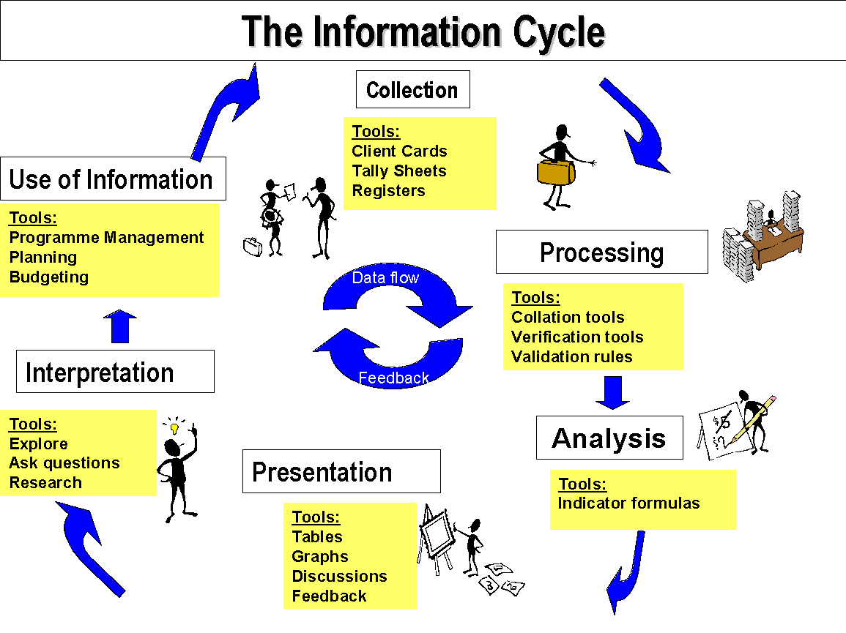
This cycle enables you to see the links between the different phases of collecting data, processing data, analyzing data, presenting information and using the information for evidence-based decision making

Slide 6
Information cycle data
requirements
Data must align with agreed national indicator data sets
Data must be accurate, complete, timely, and consistent
Data quality assurance processes must be applied
Facilities must review performance against plans and targets
Information must be presented in a clear and understandable format
Data must be interpreted to inform decision-making
Decisions, actions, and improvements must be guided by information

Slide 7
Data Collection

Slide 8
Data Collection
The guiding principles behind data collection should be that:
Data collected can be used to monitor progress toward objectives and targets
Only data that is essential (“must know”) should be collected
Data can be analyzed
Data is easily available when needed

Slide 9
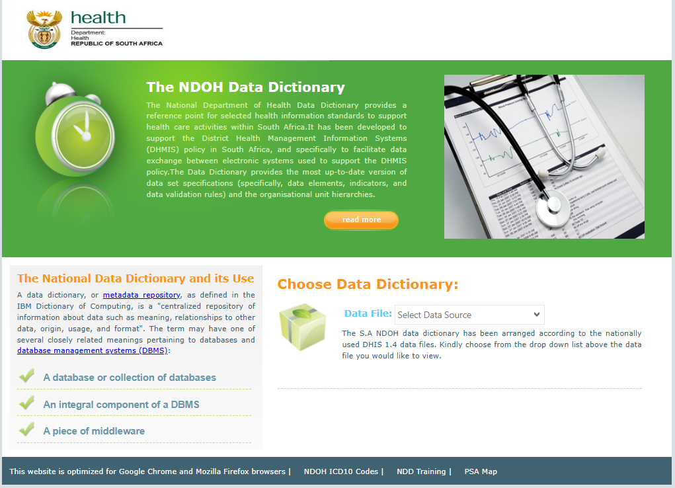
Data Collection
Data collection involves four important components:
  Standardized data element and indicator definitions
  An essential data set based on a defined minimum indicator set
  Appropriate data collection tools
  Appropriate sources of data / places of data collection
National Health Data Dictionary- source for understanding indicator definitions and data elements
https://dd.dhmis.org/index.html

Slide 10
Data Collection
Essential data set (EDS): Includes only the most critical data elements needed to manage the health program effectively . Helps managers to make informed decisions without getting lost in excessive data
Essential data set includes the following data types listed below:
Special programs - are the priority programs to receive special attention
Routine service data records –are basic data that is collected routinely.
Epidemiological surveillance data - is data collected about notifiable diseases to track outbreaks & inform health actions
Administrative data – is used by management,
Population data - important to know how many people live in the catchment area and need health services.

Slide 11
Examples of a facility that does not follow EDS
Special Programs (HIV, TB, Immunization)
Required (EDS):
  Number of patients tested HIV Positive
  Number initiated on ART
What the clinic is doing:
  Recording patients’ full employment history in the HIV register
  Capturing detailed family member names and ID numbers (not required)
  Problem : This data is not routinely required and is not reported
Epidemiological Surveillance Data
Required (EDS):
  Notifiable diseases (e.g., measles, TB, COVID-19)
What the clinic is doing:
  Recording common cold and mild flu cases as notifiable conditions
  Collecting detailed travel history for every minor illness
Problem: Misclassification and unnecessary detail distort surveillance data

Slide 12
Data Collection
Patient monitoring tools are used to capture & manage individual pts
Those tools are:
  Patient records, including individual patient information forms
  Patient registers with entries for the same patient over time
  Electronic (computerized) patient information systems
Data Sources:Is where actual data is obtained for broader HIS for analysis and reporting
  Routine clinical records e.g. Patient files, Tick registers, Referral forms, HTS registers, etc.
  Electronic Health information systems e.g. DHIS, Tier.Net, HPRS
  Admin and operational data e.g. HR records, stock control records
  Performance monitoring and QI data e.g. surveys

Slide 13
Data Collection
Data collection tools should be measured against the SOURCE criteria:
  Simple and easy-to-use for collecting data and extracting it
  Overlap between tools should not exist
  Useful to data collectors locally, supervisors and researchers
  Relevant to key functions of the unit
  Clearly laid out and easy to understand
  Effective
Which tools do you use daily?
Where do you see duplication in terms of reporting?

Slide 14
Group exercise
Discuss the impact
What are the consequences of collecting the same data twice?
How does this affect the following:
  Data quality?
  Workload?
  Reporting (SPMR/DPMR)?
Suggest improvements
How can the facility reduce duplication?
What systems or processes can be integrated?
Identify overlapping data
Which patients appear in both registers?
What information is duplicated?
Identify non-overlapping data
Which patients appear in only one register?
Why might this happen?

Slide 15
Group exercise on identifying data overlaps
1. PHC Headcount Register
2. TB Screening Register
Date | Patient Name | Reason for Visit | TB Symptoms Screened
10 Mar | John Maseko | General consultation | Yes
10 Mar | Nomsa Dlamini | Immunisation visit | Yes
10 Mar | Maria Dube | TB contact screening | Yes
10 Mar | Peter Molefe | Cough investigation | Yes
10 Mar | Zanele Sithole | Walk-in screening | Yes
Date | Patient Name | Service Received | TB Screening Done
10 Mar | John Maseko | General consultation | Yes
10 Mar | Nomsa Dlamini | Immunisation visit | Yes
10 Mar | Thabo Nkosi | Minor illness | Yes
10 Mar | Lerato Mokoena | Family planning | Yes
10 Mar | Sipho Khumalo | Chronic medication pick-up | Yes

Slide 16
Group exercise answers
Overlapping patients:
John Maseko
Nomsa Dlamini
Non-overlapping patients:
Headcount only: Thabo Nkosi, Lerato Mokoena, Sipho Khumalo
TB Register only: Maria Dube, Peter Molefe, Zanele Sithole
Key Issues Identified:
Duplicate data collection
Risk of double counting
Key Issues Identified continues:
Increased workload
Poor data consistency
Suggested Solutions:
Integrate registers or use one primary tool
Capture data once and use across Programmes
Strengthen SOPs for data collection
Improve coordination between Programmes
“Data should be collected once, used many times — not collected many times for the same purpose.”

Slide 17
Data Processing

Slide 18
This cycle enables you to see the links between the different phases of collecting data, processing data, analyzing data, presenting information and using the information for evidence-based decision making

Slide 19
Data Processing
  Data collation
  Data quality checks
  Data verification
  Data validation

Slide 20
Data Processing
Data Collation
  Data collation means to gather together, compare and examine the captured data
  Every health care worker should take personal responsibility for collating the data they collect, thereby sharing the workload

Slide 21
Data Processing: Data collation
What is Data collation= is the process of gathering and organizing data from various sources into a single, unified view . It's like collecting puzzle pieces and putting them together to get a clearer picture. This helps with analysis, reporting, and making informed decisions
Tools used:
Tier.Net
DHIS2
Patient registers (e.g., HIV, TB, chronic registers)
Daily tally sheets and monthly summary sheets

Slide 22
Data Processing: Data collation
Example scenario:
At a PHC clinic, an admin clerk captures HIV patient data (e.g., viral load results, ART visits) into Tier.Net. At the end of the month:
The facility compiles totals (e.g., number of patients due for viral load).
These totals are then uploaded into DHIS2 for district-level reporting.

Slide 23
Quality checks
Three C’s of data quality (Correct, complete and Consistent)
Data Processing
Components of good quality data are :
  It must be current and on time
  Available at all levels
  Comprehensive - collected from all possible data sources.
  Reliable and accurate
  Usable, if not discard the data.
  Comparable i.e. using the same definitions of data items. If we don’t measure by using the same tool or definitions we can’t compare each other’s results.
The most effective way to ensure data quality is to look at the data and conduct visual scanning (eyeballing), looking for the potential data quality problems

Slide 24
Quality checks
Data Processing
Good quality data facilitates (leads to) :
  Good decision making
  Appropriate planning
  Ongoing monitoring and evaluation
  Improved coverage and quality of care
  An accurate picture of health programs and services

Slide 25
Quality checks
Data Processing
To ensure good quality data – need to:
  Train staff in data collection, data quality checks and the use of information for action
  Make standardized definitions available at data collection points and are understood.
  Look for possible weaknesses in the system.
  Make data collection as easy as possible.
  Pre-test any new data collection tools before introducing them
  Having clearly defined responsibilities at every step in the information cycle
  Having procedures in place to check data quality

Slide 26
Quality checks
Data Processing
To ensure good quality data – need to:
  Provide feedback to staff on the quality of the data they submit
  Help staff to understand why they collect data.
  Identify errors, look for the source of the error and correct where possible
  Identifying gaps in staffing and motivate strongly for vacant posts to be filled

Slide 27
Verification
Verification identifies incorrect data to correct it so that only valid data are entered.
Data Processing
For data verification to be correctly applied the following must be in place at facility level to support verification
  data element and indicator definitions and
  procedures (correct tools, correct data flow)
  Staff responsible for data collection are trained and skilled in proper procedures

Slide 28
Data Processing -verification
Listed below are some quick and most common ways to check data quality:
  Eyeballing” the data for gaps and outliers
  Using software data quality functions (for those who work with the DHIS software,) the software can assist with:
    Regular setting of minimum and maximum ranges
    Missing record and outlier analysis
    Displaying records with “check it” ticked
    Applying validation rules
  Comparing data to historical trends
  Comparing data to other units (facilities/ districts/ province/ hospital)
  Searching for patterns and analysing the relationships between data elements.

Slide 29
Common sources of error
Data Processing
Error | Example
Missing data (gaps) | Data items missing for the whole month. Individual data items missing – outstanding data (a blank). A zero (service available but no activity) or N/A (not applicable) (service not delivered) should be entered.
Duplicate data | Same set of values entered for two months in a row
Thumb-suck | Data capturers make up a value because there isn’t one or they can’t read it.
Unlikely values for a variable | A man being pregnant or giving birth
Contradictions between variables (values outside the normal range) | More deliveries (mothers) than births (babies) or too many women giving birth to more than one baby (usually not more than 2%)
Calculation errors | Mistakes in adding
Typing error | Data is entered into the computer incorrectly
Capture in wrong box | Typing data into the wrong box
Data verification Contd.

Slide 30
Data processing-Validation
Validation involves checking whether data is valid (is a true reflection of the situation).
Validation is often done automatically through computer checks to ensure that the data entered makes sense and is reasonable.
The aim of data validation is to reduce data entry errors and to improve the integrity of data before data is saved.

Slide 31
Data processing-Types of validity checks
Type of validation | How it works
Alphabetic/Numeric Check | Ensures correct words or numbers have been captured
Range Check | Determines whether number is within specified range. A minimum and a maximum value for the range is selected before you capture the data.
Consistency Check | Tests for logical relationship between two or more fields
Completeness Check | Checks that the data is completely captured

Slide 32
Data processing -Validation
Data validation can be done manually or electronically in the DHIS or without a computer .
Validation rules are predefined rules to ensure the quality of the data. There are two forms of validation rules:
  Absolute rules apply when one value cannot be higher than another. If child attendance is 234, then the total headcount cannot be 225.
  Statistical rules are more flexible and are designed to ensure that the ratios between data elements are not broken, e.g. children with diarrhoea is correlated with headcount for children under 5 years. If the headcount goes up, one expects the number of cases of diarrhoea to increase as well in the same proportion.

Slide 33
Data processing -Validation
Data validation can be done manually or electronically in A number of these rules are pre-defined in the DHIS and the system will run these check and give warnings if the data that was entered violated any of these rules. Data Capturers must carefully check the data and verify possible wrong entries with the facilities that submitted the data.
The following slides show are a few examples of validation rules.

Slide 34
Data processing – Data validation
Example of a Monthly Data Input form that is submitted by a facility
 | Data Element | Data entry value
1 | PHC headcount under 5 years | 5
2 | PHC headcount 5 years and older | 5
3 | PHC total headcount | 10
4 | PHC headcount seen between 7 pm and 7 am | 2
5 | Pharmacy headcount (repeat visit) | 2
6 | Curative care visit | 1
7 | Chronic care visits | 1
8 | Preventative care visit | 1
9 | Home visits | 0
10 | HAST service visit | 2
11 | PHC cases seen by Professional Nurse in this facility | 8
12 | PHC cases seen by doctor that was referred in this facility | 2
13 | PHC cases seen by doctor that was not referred in this facility | 2

Slide 35
Data processing – Data validation
Validation rules to check data for attendance:
 | Validation rule description | Calculation | Possible deviations
1 | Under 5 plus above 5 headcount must be equal to the total headcount | 1+2 = 3
2 | Service breakdown must be more or equal than the total headcount | 6+7+8+9 +10 = or > 3 | Services can be more than headcounts as one patient can visit for several services
3 | The headcounts visiting Doctors plus PN plus PA must be more or equal to total headcount | 5+11+12 +13 = ± 3 or > 3 | Most of headcounts are seen by Doctors and PN PA usually have visits for repeat scripts. Nursing assistants can have headcounts but usually small amount

Slide 36
Data processing-data Validation
  In the above examples Validation rule 1 – data is correct.
  Validation rule 2 is violated, because the service breakdown (6-10) is less than the headcount.
  Validation rule 3 is correct because the headcounts seen by staff are more than the headcount.

Slide 37
Group Exercise: Data Processing
For each activity, tick (✔) whether it is Collation, Verification, Validation, or
Quality Checks.
# | Activity in PHC Setting | Collation | Verification | Validation | Quality Checks
1 | A nurse records all TB patients and their treatment details into the TB register | ☐ | ☐ | ☐ | ☐
2 | A data clerk compares TB patient information in the register with patient files and lab results from National Health Laboratory Service | ☐ | ☐ | ☐ | ☐
3 | DHIS2 flags an error because the number of fully immunized children is higher than those registered | ☐ | ☐ | ☐ | ☐
Exercise Table

Slide 38
Group Exercise: Data Processing
# | Activity in PHC Setting | Collation | Verification | Validation | Quality Checks
4 | A supervisor checks that all required fields in the immunization register are completed (e.g., date, age) | ☐ | ☐ | ☐ | ☐
5 | Monthly totals from TB and immunization registers are calculated and captured into DHIS2 | ☐ | ☐ | ☐ | ☐
Exercise Table

Slide 39
Group Exercise: Data Processing
# | Correct Answer
1 | Collation
2 | Verification
3 | Validation
4 | Quality Checks
5 | Collation
Exercise Table

Slide 40
Data processing exercise
Data Validation Checklist: Questions to Ask
Are there any missing entries?
Are there out-of-range values?
Are there any unexplained changes in our data?
Do the value ranges for a given variable make sense?
Are there any unexpected outliers?
Are there any duplicates?

Slide 41
Data Analysis

Slide 42
This cycle enables you to see the links between the different phases of collecting data, processing data, analyzing data, presenting information and using the information for evidence-based decision making

Slide 43
Data Analysis
At facility level, most analysis is in the form of self assessment i.e. compare actual activities against plans made and targets set.
Data analysis allows us to turn data into information. We need to analyse data to assess progress of projects towards their targets and most importantly to support decision making

Slide 44
Data Analysis-Facility Assessment
Four cornerstone questions to ask about every program that is functioning at the facility:
  Coverage – Did everyone who should have received services receive them?
  (e.g. Of all the children under one year, how many were immunized?)
  Quality – How good is the service provided?
  (e.g. Did children under one get the correct vaccines at the right intervals?)
  Continuity – Did you follow-up clients who needed it?
  (e.g. How many of the children who started vaccination completed the nine vaccinations and became fully immunized?)
  Risk – Did you identify all clients with potential problems and then intervened to minimize these potential problems?
  (e.g. What proportion of ANC clients had specific risk factors identified?)

Slide 45
Intro to statistics
Statistics refers to the science of collecting, classifying, analysing,
interpreting and presenting numerical facts or data.

Slide 46
Intro to statistics
Statistical methods have two major branches: Descriptive & Inferential
Descriptive statistics: Used to describe the nature of your data How many?
how often? What is the average?
Immunization
At a clinic:
120 children were immunized in March
80 received measles vaccine
You can calculate:
Total immunizations = 120
Percentage coverage = (80/120) × 100 = 67%
This describes current performance.

Slide 47
Intro to statistics
Statistical methods have two major branches:
  Inferential statistics
  This occurs in an instance whereby data to be collected is so large that we can not have all of it "in hand." We can, however, inspect samples of these larger collections and use what we see there to make inferences, generalisations or predictions of the larger collection.
  We then collect samples and make predictions
  Draw conclusions
  Generalise findings for a larger population
In order to perform statistical analysis of data, the data must be in numerical format.

Slide 48
Intro to statistics
Immunization Coverage
A district reviews data from 10 clinics and finds:
Average immunization coverage = 65%
They may conclude:
Other clinics in the district may also have low coverage
There is a need for outreach programs
This is making a generalization from sample data

Slide 49
Terminologies
Intro to statistics
    Error: Difference between your answer and the true answer.
    Measurement: Making observations and recording them in numerical form as measurement e.g. measuring baby’s length, 55cm.
    Variables: Are the elements that we measure e.g. the birth weight of babies are variables as there are overweight or underweight babies.
    Frequency: Refers to the occurrence of the event. That is the number of times you can count a result or value.

Slide 50
Terminologies
Intro to statistics
  Correlation: An association or relationship between variables. A researcher may investigate the relationship between overweight adults and heart disease and find a high correlation between the two. This means an overweight adult is more likely to develop heart disease.
  Sample: Sample data is selected when the direct measurement of entire populations is impractical or impossible to use so inferences are made based on a selected sample population.

Slide 51
Manual median calculation
Intro to statistics
Median is the middle value when data is ordered from the smallest value to the largest value .In a case whereby there are even number of values , it is average of the 2 middle ones.
1st step arrange the values above in a sequential order
Lowest value cancels the highest value until 2 values in the middle, then average them
6+7 = 13/2 = 6.5 which is a median value
7 | 6 | 3 | 11 | 5 | 7 | 7 | 9 | 6 | 5
3 | 5 | 5 | 5 | 6 | 7 | 7 | 7 | 9 | 11
Notes:
Replaced this with a median slide

Slide 52
Measurement of central tendency or averages
Data Analysis Intro to statistics
Average/Arithmetic Mean:
Add up all the values and divide by the total number of observations. The average here is 6.6
It is the most useful measure of central tendency but should not be used when the scores are skewed or have extreme values at one side of the distribution. Used best when the distribution is symmetrical about the centre.
3 | 5 | 5 | 6 | 6 | 7 | 7 | 7 | 9 | 11

Slide 53
Measures of variation or dispersion
Data Analysis-Intro to statistics
How measurements are arranged in relation to the centre or how much variation exists
The range:
  Is the difference between the largest and smallest value.
i.e. range = highest value – lowest value
  Being based on only 2 extreme values it is an unstable measure. It also ignores variations in the scores. The range is used to describe the data and must be used in conjunction with other measures of variability.
The variance:
  The difference between the mean and the highest value and the mean and the lowest value in the data.

Slide 54
Common misuses of Statistics
Data Analysis-Intro to statistics
How measurements are arranged in relation to the centre or how much variation exists
The range:
  Is the difference between the largest and smallest value.
i.e. range = highest value – lowest value
  Being based on only 2 extreme values it is an unstable measure. It also ignores variations in the scores. The range is used to describe the data and must be used in conjunction with other measures of variability.
The variance:
  The difference between the mean and the highest value and the mean and the lowest value in the data.

Slide 55
Data Presentation

Slide 56
Data flow
This cycle enables you to see the links between the different phases of collecting data, processing data, analyzing data, presenting information and using the information for evidence-based decision making

Slide 57
Presentation
It is important to think about which format best displays the information

Slide 58
Presentation
Tables are difficult to use, if they are big. Tables need to be easy to read and make their point clearly
Graphs are useful to summarize data; detect trends over time; search for patterns among large amount of data and analyze the relationships between variables.
There are four main types of graphs used in the DHIS:
Line graphs
Bar graphs
Pie charts - Pie charts show the proportions of an activity as part of the whole.
Cumulative coverage graph( increasing every month)

Slide 59
Presentation – Line graph
Name | Severe acute malnutrition death under 5 years rate (2017)
Definition | Severe acute malnutrition deaths in children under 5 years as a proportion of total deaths in facility under 5 years
Calculation | Numerator: Severe acute malnutrition (SAM) death under 5 years
 | Denominator: Death in facility 1 month to 5 years
Rationale | Severe acute malnutrition is a failure of prevention services and is a representation of a larger pool of malnutrition in the community. These children should have been found and nutrition intervention begun earlier
Data Source | Facility Register, DHIS
Normal ranges | No children should die of malnutrition or be severely malnourished. Any severely malnourished child is a danger signal of a bigger problem
Common Problems | Most children who die or have severe malnutrion do not come to the health services, or there are not weighed at facilities
Actions to consider | All children with sever malnutrition to be referred to a hospital. Social welfare to be informed and involved

Slide 60
Presentation – Line graph development class exercise
Open excel-Capturer January 2025 in cell B1
Move the cursor to the lower right corner of cell B1 ,once a cross appears ,drag the cross laterally to the right until cell M1 and subsequent months will appear
On cell A2 ,write Acute malnutrition death rate
From cell B2, capture the death rates from January 2025 till December 2025
On cell A3,write median rate
Calculate a median click on any cell outside the table created ,capture = sign , then median, then (),then click inside the close bracket , then highlight the data values from cell B2 to M2 and click enter . The value that you get is a median value
Capture the median value from cell B3 and M3

Slide 61
Presentation – Line graph

Slide 62
Presentation – Bar graph
Name | School learner underweight rate
Definition | Proportion of learners screened by a nurse in line with the ISHP service package diagnosed as underweight (below -2SD but above -3SD)
Calculation | Numerator: School learner underweight
 | Denominator: School learners screened - sum
Rationale | Failure to gain weight, even for one month , indicates early nutritional problem or an acute illness and it is the most sensitive indicator of the nutritional well being of an individual children.
Data Source | Road to health card, Facility Register, DHIS
Normal ranges | No children should fail to gain weight, but the maximum is 3 – 5%.
Common Problems | Children coming back for rehabilitation are entered more than once in a month. Not all children coming are weighed. If only those who look malnourished are weighed, the results will be baised to severe malnutrition.
Actions to consider | Any child not gaining weight needs to be followed closely with support from both mother and the facility.

Slide 63
Presentation – Bar graph

Slide 64
Presentation – Pie graph
The target population
in the facility’s catchment
area can also be represented
in the form of a pie chart.
The total population
is shown as the full circle
(the pie) and the target
population is shown as a
part of the circle
(slices of the pie).
Age Category | Number | Precentage
0 | 201 | 14%
1-4 | 15 | 1%
5-9 | 6 | 0%
10-14 | 7 | 0%
15-19 | 13 | 1%
20-24 | 19 | 1%
25-29 | 38 | 3%
30-34 | 59 | 4%
35-39 | 81 | 6%
40-44 | 100 | 7%
45-49 | 116 | 8%
50-54 | 87 | 6%
55-59 | 110 | 8%
60-64 | 138 | 9%
65-69 | 142 | 10%
70-74 | 116 | 8%
75-79 | 109 | 7%
80-84 | 50 | 3%
85-89 | 33 | 2%
90+ | 14 | 1%
Total | 1454 | 100%

Slide 65
Presentation – Pie graph

Slide 66
Presentation
Points to remember when designing graphs:
Keep it clear and simple. Usually use one indicator on one graph. Rather stick to one group of people or diseases or services.
Have a clear heading, source of the information and time period it represents. Have labels on the axes stating clearly what is being shown and a legend which explains each of the lines or bars.
Where possible, show a target line to show where you are aiming.
Consider colours and shading used in particular if the graph will be printed or photocopied in black and white

Slide 67
Data Interpretation

Slide 68
Data flow
This cycle enables you to see the links between the different phases of collecting data, processing data, analyzing data, presenting information and using the information for evidence-based decision making

Slide 69
Interpretation
The purpose of interpretation is to make sense of the data and to monitor progress

Slide 70
Interpretation
How can we interpret:
  Compare data - as long as you are comparing “apples with apples” (using the same data definitions, same indicators) you can compare yourself to set norms and standards, program targets, other facilities or other geographic areas
  Look for trends. Trends are a form of comparison over time.
  Interpretation of information can be through epidemiological thinking i.e. who, what, when, where, why and how?

Slide 71
Interpretation
Preparing for interpretation :
  The 3C’s accuracy checks (correct, complete and consistent)..
  In order to interpret effectively, one often needs a minimum of 6 months good quality data.
  Have some local knowledge about the population, health data and service data. This allows the data you are analysing to be seen in context with the population, identified health need and where and what services are provided.
  Discuss and explore different views,
  Once data has been analysed and interpreted it becomes information. Information is more user friendly for management.

Slide 72
Use of Information

Slide 73
This cycle enables you to see the links between the different phases of collecting data, processing data, analyzing data, presenting information and using the information for evidence-based decision making

Slide 74
Use of information
Information must be current and up to date in order for it to be useful to managers at all levels.

Slide 75
Use of information
Common uses of information are:
  Compiling a profile of your facility
  Assessment of health situation and prioritization of health needs of the catchment population
  Planning and management of services and resources
  Monitoring and evaluation of progress and impact of health programs
  Mobilization for action at the community and household levels.

Slide 76
Use of information
For information to be used effectively it must be:
  Relevant
  Of good quality
  Presented in user friendly ways
  Available where needed
  Available when needed

Slide 77
Use of information
We can use the information effectively in the planning cycle, to monitor where we are, remaining gaps, how will we get there and what indicators will measure when we get there Relevant
Where are we now?
Situational analysis
How do we know when we arrive?
Quality information at every step
Where do we want to go?
Monitoring & Evaluation
Essential data set
Planning tools: goals objectives, indicators & targets
How will we get there?
Action Plan: Activities & Resources

Slide 78
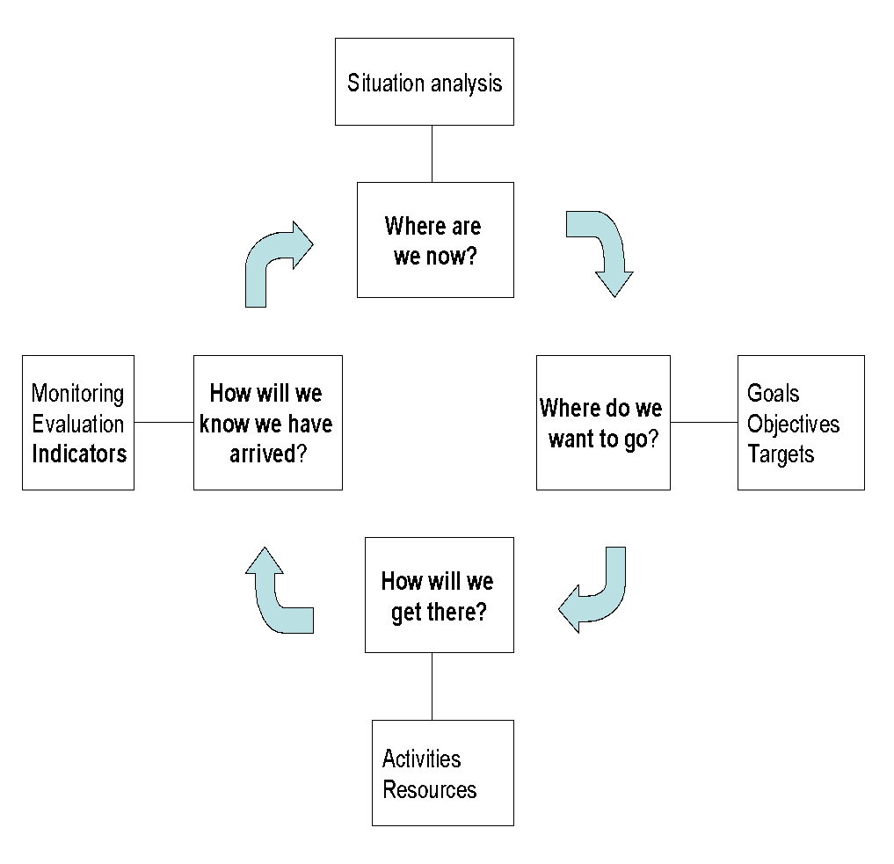
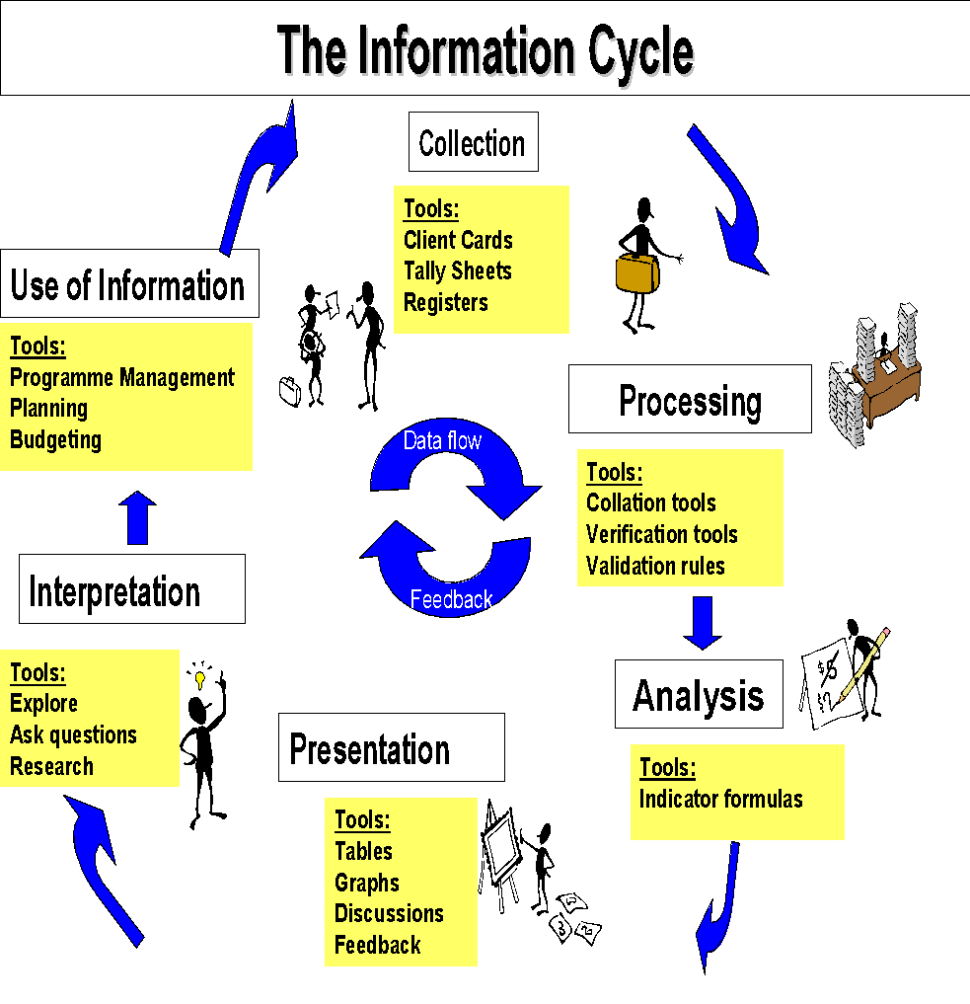
Planning cycle
The information cycle should be kept in mind when monitoring the planning cycle
Information cycle
Indicators
The Planning Cycle

Slide 79
Monitoring and Evaluation

Slide 80
Monitoring and Evaluation
M&E is the process by which data are collected and analyzed
Why:
M&E provides information to policy makers and others for use in program planning and project management.

Slide 81
Monitoring and Evaluation
Monitoring of a program or intervention.
Definition
Monitoring is the routine ongoing assessment of activities to provide managers, decision makers and other stakeholders with regular feedback . It is used to track changes in program performance over time.
Examples
Monitoring number of women attending ANC at facility
Monitoring number of children immunized

Slide 82
Monitoring and Evaluation
Monitoring is sometimes referred to as process evaluation because it focuses on the implementation (performance) process and asks key questions:
How well has the program been implemented?
How much does implementation vary from site to site?
Did the program benefit the intended people? At what cost?

Slide 83
Monitoring and Evaluation
Monitoring:
Characteristics
is an ongoing, continuous process;
requires the collection of data throughout the program cycle, including at the beginning to provide a baseline;
it is used to determine if activities need adjustment during the intervention to improve performance.

Slide 84
Monitoring and Evaluation
Evaluation
Definition
Evaluation is a time-bound, periodic assessment that seeks to answer specific questions to give direction when making decisions. It measures how well the program activities have met expected objectives and the extent to which changes in outcomes can be attributed to the program or intervention.
Measuring the difference between having and not having the program or intervention is known as its "impact“
Example
After an intervention promoting condom use,
is there a reduction in unplanned pregnancies?

Slide 85
Monitoring and Evaluation
Evaluations require:
Data collection at the start of a program (to provide a baseline) and again at the end
(not at repeated intervals during programme)
A control or comparison group in order to measure whether the changes in outcomes can be attributed to the program
A well-planned study design

Slide 86
Monitoring and Evaluation
The difference in having and not having the program or intervention is known as its "impact" and is commonly referred to as "impact evaluation."

Slide 87
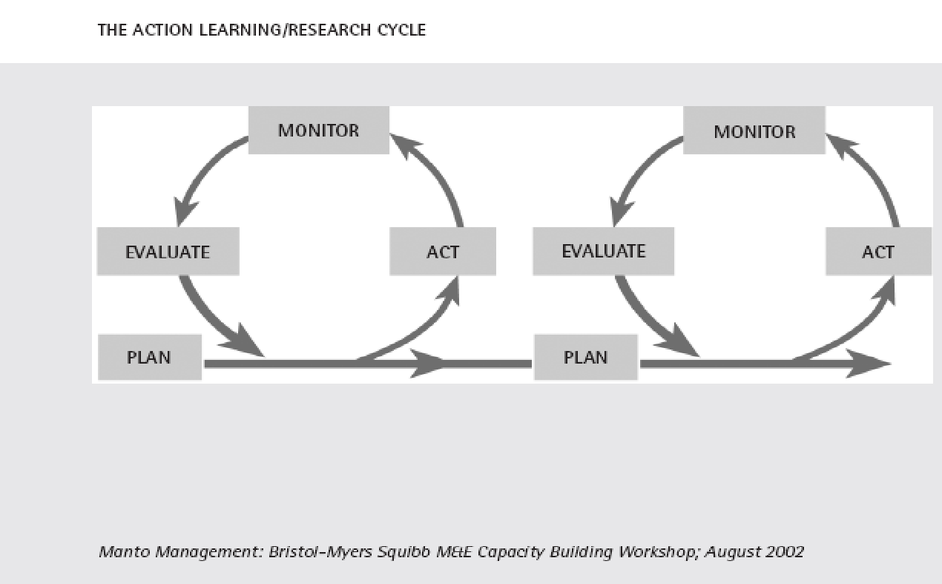
Monitoring and Evaluation
Uses of an M&E system?
The M&E action/learning/research cycle, illustrated below, shows how monitoring and evaluation is used. For example if you plan a service delivery, deliver the service, monitor its progress, evaluate its impact and then revise your plan or improve it.

Slide 88
Key uses of M&E information
Monitoring and Evaluation
1. Support budgeting and planning processes and assist in setting priorities
2. Assist in policy development, policy analysis and program development
3. Manage activities better
4. Monitor efficiency
5. Gain timely information on progress
6. Promote organisational learning

Slide 89
Results-Based M&E
Monitoring and Evaluation
Results-based M&E systems provides feedback on the actual outcomes and goals of government. It focuses on outcomes and not just inputs and outputs to produce relevant information on the performance of government policies, programmes & projects.

Slide 90
Results-Based M&E Model
Monitoring and Evaluation
Impact
Reduce mortality rates for children under 5 years old
Improve use of ORT for managing childhood diarrhoea
Increase maternal knowledge of ORT services
- Increase access to ORT
Results
Outcomes
Outputs
- 15 media campaigns completed
- 100 professionals trained in ORT
Implementation
Activities / Processes
- Launch media campaign to educate mothers
- Train health professionals in ORT
Inputs
- Trainers
- Water/Salt/Sugar
- Pamphlets

Slide 91
Indicator category definitions
Monitoring and Evaluation
Input
  Resources needed to carry out activities (What we use – services indicators)
Process (Activities)
  Activities in which the inputs are used (What we do – accessibility & utilisation indicators)
Output
  Products, services & systems resulting from activities (What we deliver – coverage indicators)
Outcome
  The immediate change resulting from outputs (What we wish to achieve- effectiveness and efficiency indicators)
Impact
  The extent to which long term goal is achieved (It looks at the widespread improvement in society – What we aim to change – mortality rate and life expectancy indicators)

Slide 92
Indicator category definitions
Input
  Resources needed to carry out activities (What we use – services indicators)
Process (Activities)
  Activities in which the inputs are used (What we do – accessibility & utilisation indicators)
Output
  Products, services & systems resulting from activities (What we deliver – coverage indicators)
Outcome
  The immediate change resulting from outputs (What we wish to achieve- effectiveness and efficiency indicators)
Impact
  The extent to which long term goal is achieved (It looks at the widespread improvement in society – What we aim to change – mortality rate and life expectancy indicators)

Slide 93



Wrap-up and Reflection
Questions
What was easiest about today?
What was most challenging?
What surprised you about data quality today?
Key messages
Data quality underpins all decisions.
Everyone plays a role in the information cycle.
Data must be used, not just collected.
Celebrate learning – progress matters more than perfection!
Notes:
Explain that tomorrow focuses on accessing and interpreting data from key systems.

