Slide 1
Hard Skills Training for PHC Managers:
Liberia
Introduction and Data Analysis Skills
December 8-12, 2025

Slide 2
Session 1

Slide 3
Session 1:1 Understanding Data
Notes:
Introduce the session and stress the importance of understanding data for PHC management.

Slide 4
Learning Objectives
By the end of this session, the participants will:
Understand Data in the PHC context
Identify common data sources
Understand collection and entry processes
Apply interpretation for decision-making
Apply analytical insights to improve performance

Slide 5
What is Data?
Data are facts and figures collected for analysis.
In PHC, data reflect service delivery, patient care, and performance.
Examples of Data:
ANC attendance, malaria cases, deliveries, stock levels.
Notes:
Use facility examples. Ask what data participants collect regularly.

Slide 6
Types of Data
Quantitative: numerical
(e.g., ANC visits)
Qualitative: descriptive
(e.g., reasons for missed visits)
Notes:
Clarify difference with real-life examples from facilities.

Slide 7
Common Data Sources in PHC Facilities
DHIS2 reports
Excel-based summaries
Monthly HMIS forms
Facility registers
CHW reports
Notes:
.

Slide 8
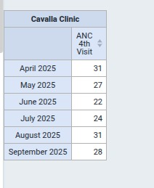
Cavalla Clinic ANC 4th Visit DHIS2 Entry

Slide 9
Cavalla Clinic ANC 4th Visit DHIS2 Analysis

Slide 10
Cavalla Clinic ANC 4th Visit Excel Analysis – Line graph

Slide 11
Cavalla Clinic ANC 4th Visit Excel Analysis – Bar chart

Slide 12
Visualizing Data with Simple Tools
Even without computers, graphs can drawn manually to identify trends.
Example: Plot ANC attendance on paper or board.

Slide 13

Example: Facility Data Snapshot
ANC Visits (July 2025):
Manolu 85
Pleebo 110
Cavalla 22
Delivery Cases (July 2025):
Manolu 42
Pleebo 60
Cavalla 47
Notes:
Discuss interpretation and what these differences might indicate.

Slide 14



Understanding Facility Data
Pleebo has a higher Headcount than Cavalla and Manolou for both delivery and ANC in July
ANC Visits (July 2025):
Manolu 85
Pleebo 110
Cavalla 22
Role play human bar chart
Delivery Cases (July 2025):
Manolu 42
Pleebo 60
Cavalla 47
Discuss possible cause
Notes:
Encourage practical discussion and connection to real scenarios.

Slide 15
Key Takeaways
Understanding data precedes effective use.
Visualization improves clarity.
Link analysis to actions.
Reliable data improves decisions and outcomes.
Notes:
Summarize and link to next session on data variation.

Slide 16


Acknowledgement
Questions ?
Notes:
Thank participants and acknowledge partners. Invite feedback.

Slide 17




Group Exercise Scenario-Based–Understanding Facility Data
  Scenario: Interpreting ANC 1st Visit Trends at Cavalla Clinic
Duration: 30 minutes
Materials: Dataset handout, pens, flipchart
Directions: In group of 4-5 review the scenario and complete the tasks on your worksheet
Scenario
As the Officer-in-Charge (OIC) of Cavalla Clinic, you have been monitoring ANC 1st visit performance over the last six months. You extracted the data from the HMIS form: April to September 2025. The County Health Team has requested an urgent explanation before the next performance review meeting.
Review provided data : Is the trend increasing, decreasing, or fluctuating?
Create a table or line graph using provided data
Identify - Highest month vs lowest month
List 3 possible reasons why the numbers differ or fluctuation exist
Recommend 3 immediate actions you should take as an OIC for each reason
Present Findings

Slide 18

BREAK
Notes:
Encourage practical discussion and connection to real scenarios.

Slide 19
Session 2

Slide 20
Session 2:2 – Understanding Variation

Slide 21
Learning Objectives
Define variation in health data
Differentiate between natural and unnatural variation
Explain factors influencing variation (e.g., catchment population)
Link variation to data validation and benchmarking
Interpret variation for management decisions
Notes:
Emphasize how understanding variation builds toward validation and benchmarking in subsequent sessions.

Slide 22
What is Variation?
Variation means differences or fluctuations in data across time or facilities.
Understanding variation helps identify trends, anomalies, and opportunities for improvement.
Notes:
Ask participants to share examples of variation from their own facility data.

Slide 23
Examples of Variation
Monthly Deliveries (June–August 2025)
Variation is normal but must be understood in context.
Why is there a drop in Pleebo data –Reporting Gap?
Facility | June | July | Sept
Manolou | 40 | 45 | 43
Pleebo | 58 | 62 | 49
Cavalla | 50 | 47 | 46
Notes:
Encourage participants to discuss why Pleebo’s data dropped—population shifts, outreach, or reporting gaps.

Slide 24
Natural vs. Unnatural Variation
Natural variation : include seasonal disease trends, reflecting predictable health changes
Increased malaria cases during rainy season
Unnatural variation: sudden drops in cases can indicate data quality issues or unexpected events
Sudden drops in ANC attendance due to stockout
Notes:
Use examples participants know. Reinforce that identifying the type of variation determines next steps.

Slide 25
Why Understanding Variation Matters
Highlights where interventions succeed or fail
Guides supervision and resource allocation
Detects data quality problems early
Supports performance monitoring and planning
Notes:
Reinforce that variation is a management signal, not an error in itself.

Slide 26
Case Example: Manolou vs. Cavalla Delivery Trend – Natural or Reporting Variation?
Monthly Deliveries:
Discussion:
What could explain Manolou’s drop in Aug? A holiday period reducing clinic visits
Is this natural or reporting variation?
What actions can be taken?
Facility | June | July | Aug
Manolou | 58 | 62 | 49
Cavalla | 50 | 47 | 46
Notes:
Guide participants to link variation interpretation to data validation and supervision responses.

Slide 27
Linking Variation to Validation and Benchmarking
Variation analysis helps determine when to validate data or set benchmarks.
Bench marking compares a facility performance against a standard target
Catchment population -Pleebo:39464 vs Cavalla:5042
Monthly Delivery Target – Pleebo: 177 vs Cavalla: 22
Comparing a small rural clinic to a large hospital may mislead performance interpretation. - different pop.
Notes:
Explain that understanding variation supports fair benchmarking and data correction before decision-making.

Slide 28
From Data to Action
When unusual variation is detected:
- Investigate root causes (e.g. staffing, supplies)
- Discuss during facility meetings
- Adjust supervision or Business plan
- Validate with front-line teams before reporting
Notes:
Highlight that variation should always lead to inquiry and learning, not blame.

Slide 29

Key Takeaways
Variation is normal but meaningful.
Context determines interpretation.
Distinguish between natural and unnatural variation.
Use insights to improve data quality and decisions.
Notes:
Summarize and transition to the next module on Data Validation.

Slide 30
Acknowledgement
Questions?
Notes:
Thank participants and acknowledge partners. Invite feedback.

Slide 31
Scenario-Based Exercise –Understanding Variation
  Scenario: Delivery trends Pleebo and Cavalla- 6-Months Review
Direction: In groups of 4-5 analyze variations and classify them as Natural or Unnatural on the 12 variation cards provided.
Duration: 30 minutes
Materials: Variation cards, flipchart, markers
Scenario
Over the past six months, The OICs of Pleebo and Cavalla Clinics have been monitoring their delivery numbers and have noticed several unusual patterns or variations. In both facilities, deliveries were generally stable—until a sudden and noticeable drop occurred in one particular month.
Digging deeper, teams recalled that around that time, the outreach motorcycle for Cavalla
broke down reducing community follow-up. At the same time, Pleebo Clinic lost one of its most experienced midwives due to an unexpected staff transfer leaving fewer skilled workers on duty.
The clinics are unsure how much each factor contributed to the dip in deliveries—or whether something else might also be influencing the trend.

Slide 32
Scenario-Based Exercise –Understanding Variation
  Scenario: Delivery trends Pleebo and Cavalla- 6-Months Review
Direction: In groups of 4-5 analyze variations and classify them as Natural or Unnatural on the 12 variation cards provided.
Duration: 30 minutes
Materials: Variation cards, flipchart, markers
Scenario
Over the past six months, The OICs of Pleebo and Cavalla Clinics have been monitoring their delivery numbers and have noticed several unusual patterns or variations. In both facilities, deliveries were generally stable—until a sudden and noticeable drop occurred in one particular month.
Digging deeper, teams recalled that around that time, the outreach motorcycle for Cavalla
broke down reducing community follow-up. At the same time, Pleebo Clinic lost one of its most experienced midwives due to an unexpected staff transfer leaving fewer skilled workers on duty.
The clinics are unsure how much each factor contributed to the dip in deliveries—or whether something else might also be influencing the trend.

Slide 33
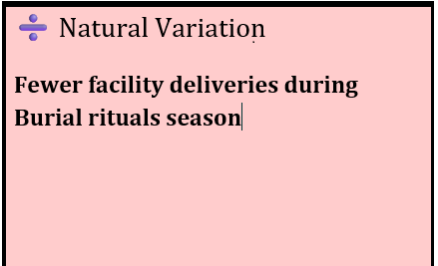
Scenario-Based Exercise –Understanding Variation
  Scenario: Delivery trends Pleebo and Cavalla- 6-Months Review
12 Patterns observed after review of the last six months data Classify as Natural or Unnatural
Broken motorcycle limiting outreach
Staff transfer
Holiday period clinic slowdown
Sharp one-month decline
Market day shifts
Increased deliveries after community meeting
Minor month-to-month fluctuations
Stockout of delivery supplies
Early facility closure
Incorrect HMIS reporting
decrease during farming season
Seasonal malaria peaks
Sample variation card

Slide 34

Group Exercise – Data Variation
Time breakdown:
Task 15mins Presentation 15
Task
  After Identifying natural vs. unnatural variation
  Write the 12 pattern 1 on each variation card then
  Copy them to the flipchart
  Suggest 3 patterns for corrective actions.
  Present group findings
Notes:
Encourage collaboration and discussion. Focus on reasoning rather than accuracy of the numbers.

Slide 35

BREAK
Notes:
Encourage practical discussion and connection to real scenarios.

Slide 36
Session 3

Slide 37
Session 3:3 – Data Validation
Notes:
Introduce the session and stress the importance of understanding data for PHC management.

Slide 38
Learning Objectives
Define
Define data validation and its importance
Link
Link validation to understanding variation
Identify
Identify common data errors and causes
Describe
Describe steps for correcting inaccurate data
Apply
Apply validation findings for improved reporting
Notes:
Explain that validation ensures data is trustworthy for decision-making.

Slide 39
Connecting Variation and Validation
Variation shows differences; validation confirms if those differences are real.
Validation helps separate genuine change from reporting errors.
Notes:
Reinforce connection between variation and validation.

Slide 40
What is Data Validation?
Data validation ensures information is accurate, consistent, and complete
Data Validation occurs at facility, district, county, and national levels
Data Validation Example: Check if total deliveries from DHIS2 matches HMIS +Facility Register + Patient Chart
Notes:
Discuss practical examples using local facility data.

Slide 41
Types of Validation Checks
Internal: OPD totals vs. breakdowns
Cross-tool: Register vs. HMIS/DHIS2
Logical: ANC1 > ANC4
Temporal: Unusual jumps or drops
Notes:
Show a visual screenshot or describe real validation check steps.

Slide 42
Common Causes of Data Errors
Missing entries
Transcription mistakes
Wrong indicator classification
Late reports
Data input mistakes on HMIS form or DHIS2/Excel
Notes:
Ask participants for facility examples of each cause.

Slide 43
Correcting Inaccurate Data
Steps:
Identify issue
Verify with source register
Work with registrar or data clerk
Correct using official channels
Document changes
Notes:
Highlight that every correction must be documented for accountability.

Slide 44
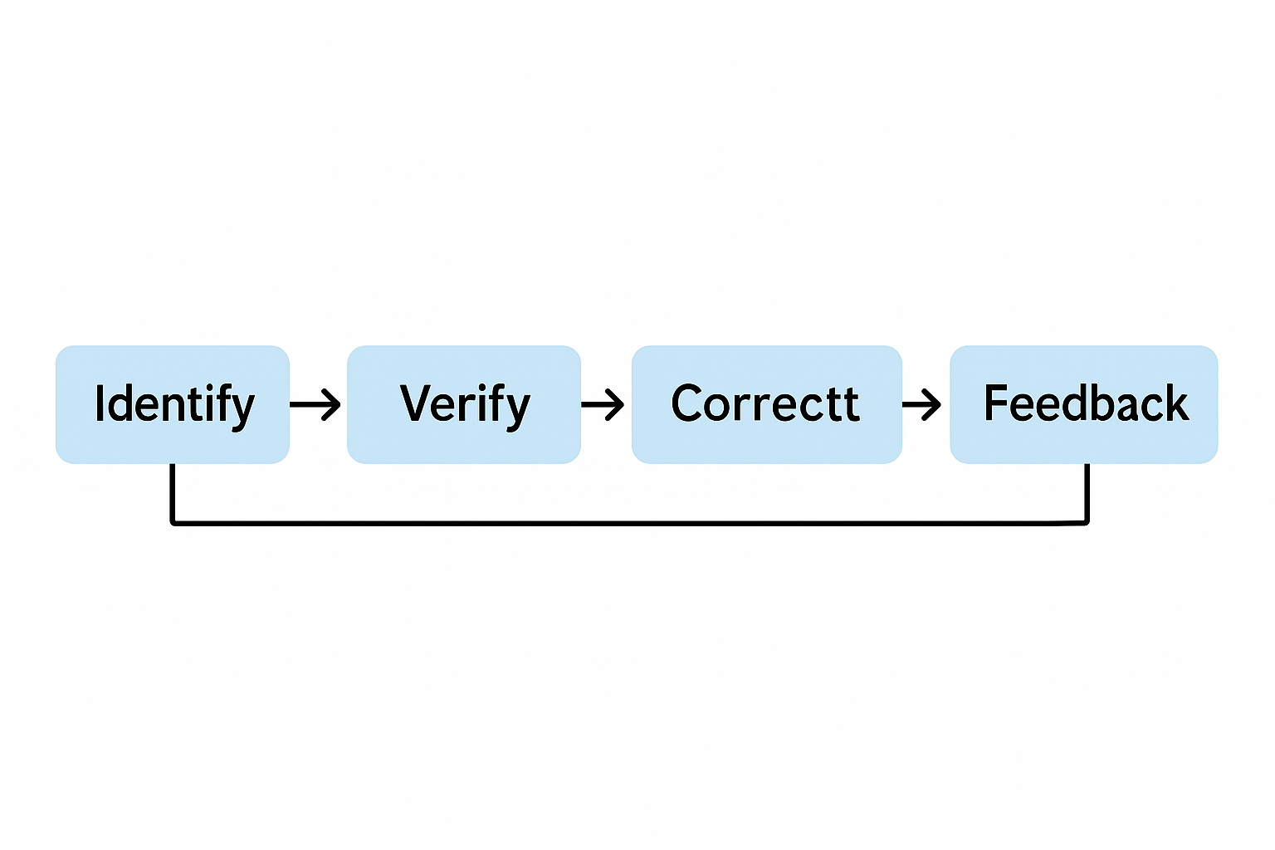
Data Validation Flow Diagram
Each step ensures accountability and continuous improvement.
Responsible parties for validation HF- OIC, staff, registrar,
District- District Data clerk, DHO, staff County- Data manager, supervisors National- M&E Dept
Notes:
Explain each step: who is responsible and what tools are used at the facility level.

Slide 45
Case Example: ANC Data at Manolu Clinic
Indicator | Register | HMIS | DHIS2
ANC1 | 82 | 85 | 95
ANC4 | 50 | 49 | 47
Discussion:
Where might the error be? Identify and verify
How can it be corrected? Work with registrar
How should it be reported? Feed back and document
Which source should be considered the “single source of truth” (SSOT)and why?
Notes:
Guide participants through identifying inconsistencies and corrective steps.

Slide 46

From Data to Action
Validated data supports:
- Supervisory visits
- Resource allocation
- Partner reporting
- Continuous improvement
Notes:
Show how validated data leads to more accurate planning and reporting.

Slide 47
Key Takeaways
Validation ensures data reliability
Builds trust in reports
Detect and correct inaccuracies early
Improves both data and service delivery
Notes:
Summarize and transition to next session on Qualitative Data Analysis.

Slide 48
Acknowledgement
-
-
Questions?
Notes:
Thank participants and acknowledge partners. Invite feedback.

Slide 49
Scenario-Based Exercise –Understanding Data Validation
  Scenario: Numbers :The Mystery of the Error Source !
Materials: Dataset handout of printed registers, HMIS summary pages, DHIS2 screenshot , flipchart, calculators
Duration: 30 minutes
In groups of 4–5, follow the steps to validate a mixed dataset
Scenario
As the OIC, you discover that Manolu PHC Clinic has submitted conflicting ANC figures for July 2025. The HMIS summary form, facility ledger, and DHIS2 report all show different numbers. There is pressure from the district to explain discrepancies. You must determine what caused the discrepancy and guide the team in validating and correcting the data.
Indicator | ANC1 | ANC 4
Facility Register | 95 | 88
Monthly HMIS Summary | 110 | 85
DHIS2 | 80 | 76

Slide 50
Group Exercise – Validating Data
Duration: 30 minutes
Time breakdown:
Task 15mins Presentation 15
Task
- Compare the three data sources
Identify error source
Explain how the mistake could have happened
Recommend 3 corrective steps
Present findings
Notes:
Encourage collaboration and emphasize lessons learned for real facility data validation.

Slide 51

BREAK
Notes:
Encourage practical discussion and connection to real scenarios.

Slide 52
Session 4

Slide 53
Session 4:4 – Qualitative Data Analysis

Slide 54
Learning Objectives
Define qualitative data and its relevance in PHC
Identify sources of qualitative information
Organize and analyze qualitative data using simple tools
Visualize findings using Word Clouds and tables
Use insights for management and policy decisions
Notes:
Explain that qualitative data adds depth and context to quantitative results.

Slide 55
What is Qualitative Data?
Qualitative data describes perceptions, behaviors, and experiences.
- Patient opinions
- CHW feedback
- Staff meeting and discussions
- Community meeting reports
Notes:
Use examples from to show how qualitative feedback has improved services.

Slide 56
Common Sources of Qualitative Data
Supervision notes
Exit interviews
CHW and community meeting feedback
Suggestion boxes
PBF Verification feedback
Notes:
Encourage participants to list the sources they already use in their facilities.

Slide 57
Organizing Qualitative Data
Step 1: Record or summarize responses
Step 2: Identify recurring themes (e.g., 'stockout', 'staff attitude')
Step 3: Group and count frequency
Step 4: Present in Excel or a simple table
Notes:
Demonstrate with a mock dataset how to organize qualitative information into themes.

Slide 58
Example Table – Thematic Summary
Theme | Frequency | Example Quote
Stockout of malaria drugs | 7 | “We often run out of test kits.”
Long waiting time | 8 | “We wait too long for treatment.”
Notes:
Explain how this approach helps summarize large amounts of feedback efficiently.

Slide 59
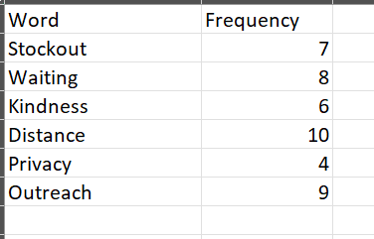
Excel Table-style vs Circle-Style Word Cloud
(PHC Issues)
Privacy
Kindness
Distance
Stockout
Waiting
Outreach

Slide 60

Case Example – Patient Feedback at Pleebo Health Center
'We come early but are seen late.’
'The staff are kind, but drugs are sometimes finished.’
'The clinic is too far to walk.'
Discussion:
Identify main themes: 🚶Access, 💊stockouts, 🏥 quality of care, 🙂staff attitude 😠
What actions can management take?
Notes:
Guide participants to identify key themes (waiting, stockouts, distance) and suggest facility-level actions.

Slide 61
From Data to Action
Qualitative insights can lead to real change:
- Adjust staff scheduling
- Improve patient communication
- Strengthen outreach programs
- Advocate for supplies and infrastructure
Notes:
Stress that qualitative findings must be discussed in review meetings to trigger action.

Slide 62
Key Takeaways
Qualitative data explains the 'why' behind trends.
- Use Excel and Word Clouds to analyze and present findings.
- Always connect insights to actions that improve service quality.
Notes:
Reinforce the importance of blending qualitative and quantitative data for holistic decision-making.

Slide 63
Acknowledgement
Questions?
Notes:
Thank participants and acknowledge partners. Invite feedback.

Slide 64
Scenario-Based Exercise –Understanding Qualitative Data Analysis
  Scenario: Voices of the Community
Duration: 30 minutes
Materials: Printed feedback statements, sticky notes, flipchart, marker and pen
In groups of 4–5, Use the qualitative statements provided, analyze and categorize the feedback
Scenario
Community members from three villages (Gbolobo, Gewloken, and Rock Town) provided comments on PHC services. Feedback includes concerns about waiting time, drug stockout, discrimination, outreach, and staff behavior.
Feedback statements:
We wait too long before being attended to.
Sometimes the clinic runs out of malaria medicine.
The midwife is always kind and listens.
There’s no privacy in the consultation room.
We like when the staff visit our village for outreach.
The clinic opens late on Mondays.

Slide 65
Exercise – Organizing and Analyzing Qualitative Feedback
Feedback statements:
We are treated well when we come for ANC.
The place is too far to walk.
They charge small money for a card before you can see the doctor
Sometimes we come and find the clinic close early
The consultation room is too small for comfort
The midwife explain things clearly to us
Some of the staff talk rude to patients when the clinic is busy
The new nurse does not greet or interact with patients
Often there are no strips to check blood sugar
Group Task:
1. Identify 4 key themes.
2. Summarize findings in a table on flip chart
3. (Optional) Create a Word Cloud.
4. Identify the top 3 priority issues
5. Recommend one management action per theme
.
Notes:
Encourage participants to collaborate and think about practical actions based on themes identified.

Slide 66

BREAK
Notes:
Encourage practical discussion and connection to real scenarios.

Slide 67
Session 5

Slide 68
Session 5:5 – Benchmarking

Slide 69
Learning Objectives
Define
Define benchmarking and its purpose in PHC
Identify
Identify appropriate benchmarks for comparison
Interpret
Interpret facility performance fairly
Apply
Apply benchmarking insights to action planning
Notes:
Highlight that benchmarking helps identify best practices and learning opportunities.

Slide 70
What is Benchmarking?
Benchmarking is comparing performance across time, facilities, or standards to improve outcomes.
Example: Comparing ANC4 coverage between similar facilities in the same district
How well are we doing compared to where we should be?
Notes:
Explain that benchmarking encourages healthy competition and shared learning.

Slide 71

Why Benchmarking Matters
Promotes accountability and improvement
Identifies outliers for investigation
Identifies performance gaps early
Encourages best practice sharing
Directs supervision and resource allocation
Notes:
Discuss how benchmarking helps target interventions and motivates staff performance.

Slide 72
Types of Benchmarks
Internal – Compare your own facility across time
External – Compare with other facilities in the same district
Standard-based – Compare with MOH/WHO targets (e.g. 90% immunization coverage)
Notes:
Provide local examples for each type using actual indicators participants work with.

Slide 73

Choosing the Right Benchmark
Benchmarks must be fair and comparable
Consider:
Catchment population
Facility level (clinic vs. hospital)
Accessibility and resources
Example: Comparing Pleebo Health Center to Manolu Clinic may be misleading due to population differences.
Notes:
Encourage reflection on what makes a comparison meaningful or unfair.

Slide 74
Steps in Benchmarking
Select indicators ANC4, deliveries, immunization
1
Collect comparable data
2
Plot results side by side
3
Interpret differences
4
Develop action points
5
Notes:
Walk through each step and explain how benchmarking informs supervision and planning.

Slide 75
Example – Facility Comparison
Facility | Deliveries (Q3) | ANC4 Coverage | Immunization Coverage
Manolu | 48 | 76% | 82%
Pleebo | 72 | 84% | 88%
Cavalla | 55 | 69% | 80%
Discussion:
Who performs best?
Why?
What lessons can others learn?
Notes:
Encourage interpretation of trends while considering catchment area and staffing.

Slide 76
Benchmarking in Action – Pleebo Health Center
Case Example:
In 2024, Pleebo benchmarked ANC4 coverage (72%) against Manolu (78%) and Cavalla (81%).
Findings: late ANC initiation and missed visits.
Actions:
- Community outreach for early ANC
- Follow-up on defaulters
- Improved client flow
Result: ANC4 coverage rose to 84% within 6 months.
Notes:
Use this as an applied example showing how benchmarking can lead to measurable improvement.

Slide 77
Avoiding Benchmarking Pitfalls
Comparing dissimilar facilities (rural vs. hospital)
01
Using poor-quality or outdated data
02
Ignoring contextual factors (population, staffing)
03
Notes:
Reinforce that benchmarking must always include interpretation, not just comparison.

Slide 78
From Data to Action
Benchmarking leads to improvement through:
- Peer learning visits
- Targeted mentorship
- Sharing best practices during review meetings
- Continuous monitoring
Notes:
Explain that benchmarking should drive improvement, not blame or competition.

Slide 79
Key Takeaways
Benchmarking improves accountability and learning
Choose fair and comparable indicators
Use results to guide supervision and action plans
Notes:
Summarize and encourage participants to apply benchmarking in their monthly reviews.

Slide 80
Acknowledgement
Questions?
Notes:
Thank participants and acknowledge partners. Invite feedback.

Slide 81
Scenario-Based Exercise –Applying Benchmarking
  Scenario: Boosting ANC4 Performance at Clinic A
Materials: Worksheet, pens, flipchart
Duration: 30 minutes
In groups of 4–5, review the scenario and complete the exercise as PHC Clinic A’s benchmarking team.
Scenario
Over the last three months you have observed that your PHC Clinic is facing low ANC attendance and lacks critical population data. Community Health workers are not effectively linking pregnant women to care and outreach is weak. Two other clinics have higher ANC uptake, with effective outreach models and community mapping.
As OIC , you form a Benchmarking Team to identify best practices and adopt them.

Slide 82
Group Exercise – Applying Benchmarking
Duration: 30 minutes
Time breakdown:
Task 15mins Presentation 15
Task
Compare the three clinics and identify clinic with lowest and highest performance
List 5 possible reasons for Clinics’ low and high ANC coverage
Recommend 5 strategies to improve coverage(3 months Action Plan)
Present findings

Slide 83
Group Exercise – Applying Benchmarking
You are the Officer-in-Charge (OIC) of Cavalla Clinic. Over the last three months you have observed inconsistent ANC 4 performance, which affects maternal health outcomes.
Your role is to:
Benchmark your facility’s performance against monthly targets
Analyze the gaps
Identify contributing factors
Recommend actionable steps for improvement

Slide 84
Group Exercise – Applying Benchmarking
Duration: 30 minutes
Use provided data (ANC4, deliveries, immunization)
Identify top and lowest performers
Discuss causes of variation
Suggest one action for improvement
Notes:
Encourage groups to focus on practical actions facilities can take to close performance gaps.

Slide 85

THANK YOU
Notes:
Encourage practical discussion and connection to real scenarios.

