Slide 1

Day 3: PHC Data Sources, Interpretation and Data Use
Hard Skills Capacity Building for PHC Performance Management
Analyzing metrics to enhance primary healthcare outcomes

Slide 2
Course Overview

Slide 3
Course Overview
3.1 | Why Data Matters in Primary Health Care
3.2 | Overview of Key Health Information Systems
3.3 | Ideal Clinic Monitoring System
3.4 | Using DHIS for Routine Data Analysis
3.5 | Understanding and Using Tier.Net Data
3.6 | District Health Barometer (DHB)
3.7 | Interpreting Data and Communicating Insights
3.8 | SMART Targets and Action Planning
3.9 | Group Activity – Data Interpretation and SMART Planning
3.10 | Wrap up and Reflection

Slide 4

Purpose and Learning Outcomes
Enhance Data Interpretation Skills
  Learn to access and interpret health data for evidence-based decision-making.
Utilise Health Information Systems
  Identify key health information systems and navigate dashboards and reports effectively.
Formulate SMART Targets
  Learning to create SMART targets and action plans to improve service delivery and monitor performance.
Promote Data-Driven Culture
  Fostering a culture of data-driven decision-making to ensure better health outcomes in PHC facilities.
Notes:
The purpose of this module is to strengthen the ability of Primary Health Care (PHC) managers and staff to access, interpret, and apply health data for evidence-based decision-making. Participants will learn to identify key health information systems, navigate dashboards and reports, interpret trends and gaps, and formulate SMART targets and action plans. These skills are essential for improving service delivery, monitoring performance, and fostering a culture of data-driven decision-making within PHC facilities. By mastering these competencies, managers can ensure that routine data informs planning and interventions, ultimately leading to better health outcomes for communities.

Slide 5

Course Overview
Data-Driven Decision Making
  Using data improves service delivery, resource allocation, and accountability within health systems.
Health Information Systems
  Tools like DHIS, Tier.net, Ideal Clinic Monitoring System and DHB dashboards provide essential data for planning and monitoring.
Practical Application Training
  Live demonstrations and group exercises build confidence in interpreting and communicating data findings.
Setting SMART Targets
  Learn to set SMART targets and develop action plans based on data insights to improve performance.
Notes:
This module focuses on strengthening the ability of Primary Health Care (PHC) managers and staff to use data effectively for decision-making. Data-driven decision-making is critical for improving service delivery, resource allocation, and accountability within the health system. By understanding and applying data insights, PHC teams can identify gaps, monitor progress, and implement targeted interventions that lead to measurable improvements in health outcomes. The session introduces participants to key health information systems such as DHIS, Tier.net, ETR.net, and the District Health Barometer (DHB) dashboard. These tools provide essential data for planning, monitoring, and evaluating performance. The module emphasizes practical application through live demonstrations, hands-on exercises, and group activities, ensuring participants can confidently navigate dashboards, interpret trends, and communicate findings. Ultimately, this module aims to foster a culture of evidence-based management where decisions are informed by accurate, timely, and relevant data rather than assumptions or anecdotal evidence. Participants will also learn how to set SMART targets and develop mini action plans that translate data insights into actionable strategies for improving facility-level performance.

Slide 6
3.1 Why Data Matters in Primary Health Care

Slide 7

Why Data Matters in PHC
Data Foundations in Health
  Data forms the basis for managing health systems by identifying gaps and tracking progress effectively.
Data in PHC Decision-Making
  Data helps PHC managers understand patient volumes, outcomes, and operational challenges for better decisions.
Examples of Key Health Indicators
  Immunisation, HIV/TB and NCDs data reveal treatment adherence and programme effectiveness in PHC settings.
Creating Data-Driven Culture
  Embedding data use in management promotes continuous learning, accountability, and evidence-based actions.
Notes:
Data is the foundation of effective health system management. It provides evidence for identifying service delivery gaps, allocating resources efficiently, and monitoring progress toward health targets. In PHC settings, data helps managers understand patient volumes, treatment outcomes, and operational challenges. For example, immunization coverage data can reveal whether children are receiving timely vaccinations, while HIV and TB indicators highlight treatment adherence and program performance and NCDs data reveal whether screening of NCDs such as hypertension and diabetes is being done. Using data enables managers to prioritize interventions, justify resource requests, and demonstrate accountability to stakeholders. Without data, decisions are often based on assumptions, which can lead to inefficiencies and poor health outcomes. This module emphasizes that data is not just for reporting purposes; it is a powerful tool for driving improvement and achieving measurable results. By embedding data use into routine management practices, PHC teams can create a culture of continuous learning and evidence-based action.

Slide 8

What Happens When Data is Missing or Poor Quality?
No/ Poor Quality Data
Good quality data
Decisions based on assumptions
Late or reactive responses
Resources misallocated
Conflicting reports
Loss of trust in data
Evidence-based decisions
Early problem detection
Targeted support
Clear priorities
Accountability and learning
Planning • Resource allocation • Performance review • Supportive supervision

Slide 9
Session 3.2: Overview of Key Health Information Systems

Slide 10
Overview of Key Health Information Systems & Sources
Ideal Clinic
Are systems in place?
Tier.Net/ Registers
What is happening to patients?
DHIS
What is the facility producing
District Health Barometer
How does this compare and trend?
  Ideal Clinic Monitoring System (ICMS)
  A national system used to monitor, assess, and support improvement in PHC facility performance.
District Health Information System (DHIS)
  DHIS is South Africa's national platform for aggregated facility data, tracking routine health service delivery statistics.
Tier.Net
  Tier.Net manages patient-level HIV and TB data, supporting ART initiation, retention, and viral suppression reporting.
District Health Barometer (DHB)
  DHB is a public dashboard aggregating data for benchmarking and trend analysis across districts and provinces.
Notes:
South Africa’s health system relies on several key information systems for data collection and analysis. The District Health Information System (DHIS) is the national platform for aggregated facility data, capturing routine service delivery statistics such as immunization coverage and antenatal visits. Tier.Net is an electronic patient management system focused on HIV and TB programs, storing patient-level data and generating reports on ART initiation, retention, and viral suppression. ETR.Net, historically used for TB data, compiles treatment outcomes and case notifications, though it is gradually being integrated into Tier.Net. The District Health Barometer (DHB) is a public-facing dashboard that aggregates data from DHIS and other sources, enabling benchmarking and trend analysis across districts and provinces. Ideal clinic Monitoring Systems is used to monitor, assess and support improvement in PHC facility performance. Understanding these systems is critical for PHC managers to monitor performance, identify gaps, and plan interventions effectively. Let’s delve deeper into each system.

Slide 11
How The Systems Work Together
DHIS: Measures what services are delivered (aggregate service data)
Tier.Net: Tracks individual patient care and outcomes
Ideal Clinic: Assesses whether facility systems support quality service delivery
Note: These systems are complementary and not duplicative.
Notes:
These systems are often talked about separately, but they actually tell different parts of the same story.
DHIS tells us what services were delivered. Tier.Net tells us what happened to individual patients. ICMS tells us whether the clinic systems support good service delivery in the first place.
So, if DHIS shows poor immunisation coverage, ICMS might help explain why e.g. staff shortages, vaccine storage issues, or poor patient flow.
No single system is enough on its own. As managers, you need to be used together.

Slide 12
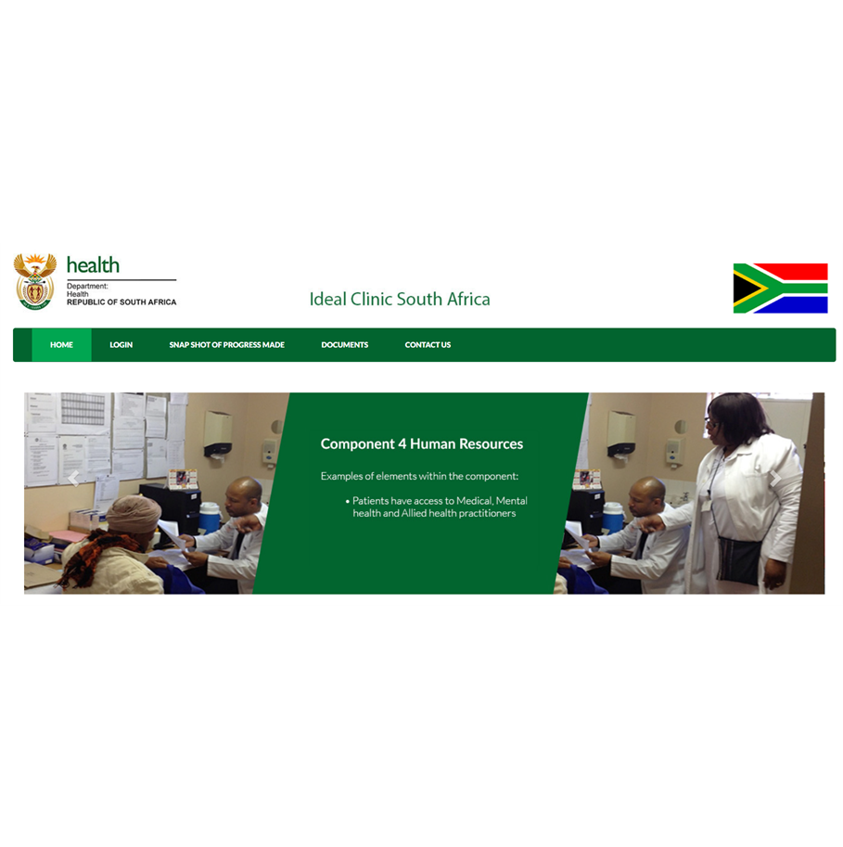
Session 3.3: Ideal Clinic Monitoring System

Slide 13
What is the Ideal Clinic Monitoring System?
Purpose of the Ideal Clinic Monitoring System
A national system used to monitor, assess, and support improvement in PHC facility performance
Focuses on facility systems, service readiness, and quality of care
Supports progress towards National Core Standards (NCS).
Notes:
Before we move deeper into DHIS and dashboards, it’s important to talk about the Ideal Clinic Monitoring System, or ICMS.
ICMS is not about counting services or patients. It’s about whether the clinic itself is set up to function properly.
ICMS looks at whether the systems, processes, and conditions are in place for quality care to happen. If those systems are weak, then even good staff and good intentions will struggle to deliver good outcomes.
So think of ICMS as answering the question: Is my clinic ready and organised to deliver quality PHC services?

Slide 14
How the Ideal Clinic Monitoring System Works
Facility assessment conducted
Using a standard national Ideal Clinic tool
Systems and processes reviewed
Infrastructure, staffing, clinical processes, patient flow, governance
Scores and findings generated
Per component and overall
Feedback shared with facility & district
Strengths, gaps, priorities
Findings used for improvement planning
Linked to QI actions and support

Slide 15
What the Ideal Clinic Monitors
Infrastructure and space
Human resources
Medicines, supplies, and equipment
Clinical governance
Information management
Patient flow and waiting times
Support services and facility management systems
Notes:
Ideal clinic covers a broad range of areas, from infrastructure and staffing to medicines, governance, information management, and patient flow.
What’s important to understand is that ICMS is not checking individuals. It’s looking at systems i.e. how the clinic works as a whole.
For example, if patients wait too long, ICMS helps us look at flow, staffing, and organisation, not just blame people for working slowly.
This is why ICMS is such a useful management tool because it helps identify where the system is not supporting staff to do their work well.

Slide 16
What does Ideal Clinic Measure?
Infrastructure & Equipment
  Availability of functional consulting rooms
  Essential equipment present and working
Human Resources & Organisation
  Staffing levels vs norms
  Staff allocation and role clarity
Clinical Service Delivery
  Organisation of patient flow
  Integration of services (e.g. HIV, TB, NCDs)
Medicines, Supplies & Information
  Medicine availability
  Use of SOPs and guidelines
Patient Experience & Governance
  Waiting times
  Complaint management
  Management meetings and review processes
ICMS focuses on systems and readiness, not monthly service outputs

Slide 17
ICMS is a PHC Management Tool
Ideal Clinic is not an audit tool; it is a management and improvement tool.
What PHC Managers use ICMS for:
  Identifying systems gaps
  Informing management decisions
  Prioritising support and resources
  Tracking progress over time
  ICMS explains WHY performance looks the way it does in routine data.

Slide 18
Using ICMS for Management: Identify, Inform, Support, Track
Identify
System weaknesses (e.g. staffing, patient flow, medicines
Repeated problem areas across assessments
Inform
Facility improvement priorities
District planning and escalation decisions
Support
Targeted supervision
Coaching and mentoring
Resource mobilisation
Track
Improvement over time
Whether actions taken addressed the problem
Notes:
Clarify: ICMS findings should trigger management action, not sit in a report

Slide 19

Using ICMS results as a PHC Manager
Identify
identify system gaps and priorities
Inform
inform Quality Improvement (QI) initiatives
Support
support routine planning and management
Track
track improvements over time
Notes:
As a PHC manager, your role is not to manage the ICMS tool, but to use the information it produces. When ICMS results are available, they should be discussed with the team. Ask: What are the key gaps? Which ones are within our control? Which ones need district support?
ICMS findings are very useful for prioritising Quality Improvement work. Instead of guessing where problems are, ICMS helps you focus on system weaknesses that matter most.
Ideally, ICMS findings should feed into routine planning, supervision discussions, and QI projects.

Slide 20
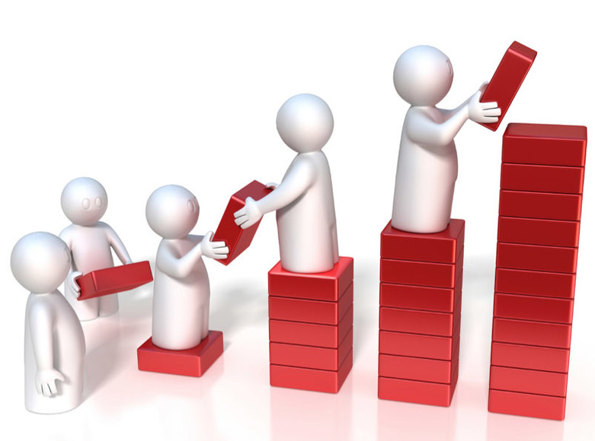

Common Misunderstandings About ICMS
ICMS is not “just an audit”
ICMS is not only for compliance reporting
ICMS is not separate from daily management
ICMS is a management and improvement tool
Notes:
A common misunderstanding is that ICMS is just another audit or compliance exercise. In reality, ICMS is a management and improvement tool. If we treat it as a tick-box exercise, we lose its value. Another misunderstanding is that ICMS is separate from daily management. In fact, it should inform everyday decisions about staffing, organisation, and priorities. The goal is to use ICMS to strengthen systems so that good performance becomes easier to achieve.
So if we think about the flow of information from the facility to national level: ICMS tells us whether the clinic systems are working,Tier.Net tells us what is happening to patients, DHIS tells us what services are being delivered, and the District Health Barometer shows broader trends and comparisons. With that in mind, let’s now move into using DHIS data for routine analysis and decision-making.
Image credit: https://media.licdn.com/dms/image/v2/C4E12AQGP5eXWAeanhg/article-cover_image-shrink_720_1280/article-cover_image-shrink_720_1280/0/1530885230638?e=2147483647&v=beta&t=-3w3z4M2VxJtE_AtzO6T3cmxizoNoK9kNOJXrVPqp6M

Slide 21
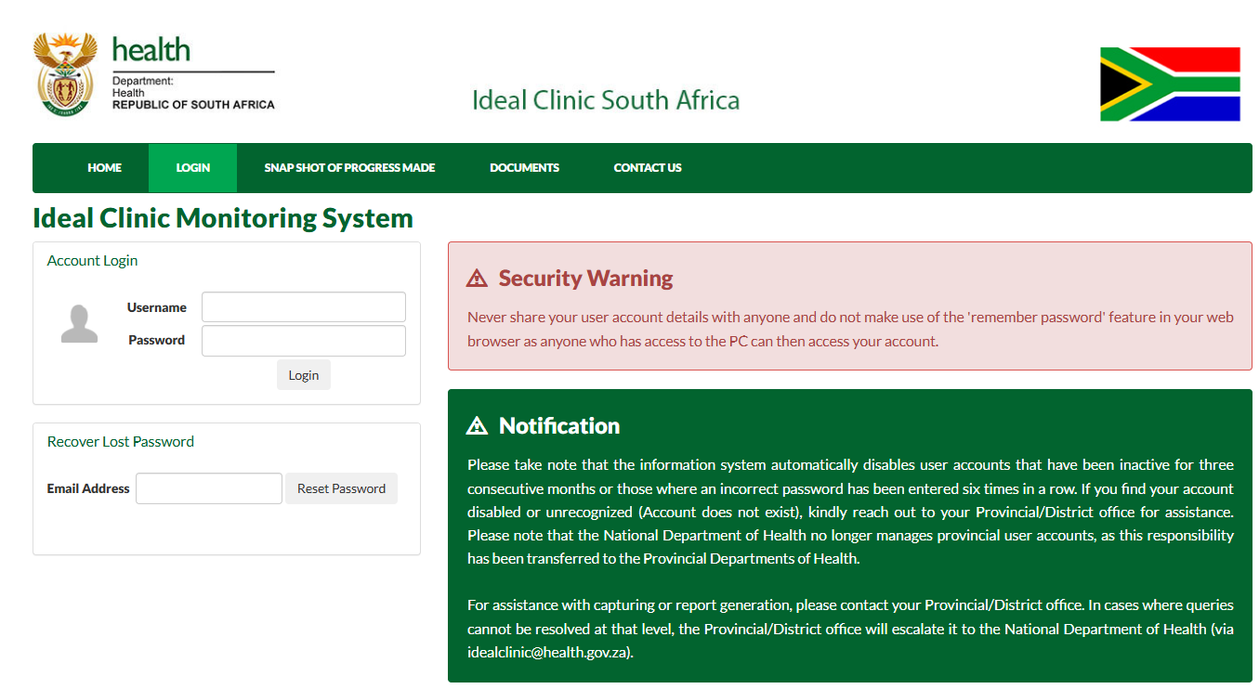
ICMS Assessments – What PHC Managers Should Know
ICMS assessments are conducted periodically by district or provincial teams
Facilities are assessed against standard components
Results are captured electronically and tracked over time
A web-based application is used to monitor the various elements on the dashboard. The application allows managers on all levels (district, provincial and national) to monitor the progress made.
Notes:
You may already be familiar with ICMS assessments that happen periodically at your facility.
These assessments are usually done by district or provincial teams, and the results are captured electronically so that progress can be tracked over time.
The key thing to remember is that ICMS is meant to support improvement. It is not designed to punish facilities or managers.
The real value is not the score itself, but what the score tells us about where we need to focus our efforts.
To access the application and obtain information on how to register go to the documents tab. The Snapshot of progress made tab gives a National overview to the public on the progress made with the Ideal Clinic dashboard which can be viewed online: https://www.idealhealthfacility.org.za/

Slide 22
MOCK ICMS Summary (Simulated)
ICMS Component | Status
Patient Flow and Waiting Time Management | ❌ Not Met
Medicines and Supplies Management | ❌ Not Met
Human Resources Organisation | ⚠️ Partially Met
Use of Information for Decision-Making | ⚠️ Partially Met
Infrastructure and Equipment | ✅ Met
Governance and Management Processes | ✅ Met
Summary of Key Findings
Areas Requiring Immediate Attention
Patient flow processes are not clearly defined or implemented
Waiting times are not routinely monitored or reviewed
Medicine stock management processes are inconsistently applied
Areas Requiring Strengthening
Staff roles and allocation not optimally aligned to service demands
Routine data is available but not consistently used in decision-making forums
Areas Performing Adequately
Infrastructure meets minimum functional requirements
Regular management meetings are conducted
Notes:
This is a simulated ICMS dashboard extract for training purposes. It is intended to demonstrate how ICMS findings can be used for management decision-making.
Findings indicate system-level gaps that may contribute to service delivery inefficiencies. Targeted management actions and follow-up support are recommended

Slide 23
From ICMS Findings to Quality Improvement (QI) Actions
ICMS Tells us WHAT is wrong
QI Helps us understand WHY
QI helps us decide WHAT TO DO
Data helps us TRACK PROGRESS
Notes:
Say:
“We’ve just used ICMS as a management tool to identify gaps, inform decisions, determine support needs, and think about tracking.”
Pause briefly.
“However, ICMS on its own does not fix problems.”
Step 1: Emphasise the distinction (2 minutes)
Say:
“ICMS tells us what is wrong at a system level. It does not tell us why the problem exists or how to fix it.”
Point to the first line on the slide.
“For example, ICMS may show that patient flow is not working well, but it does not explain where the bottleneck is or what change would work best.”
Step 2: Introduce QI as the response mechanism (3 minutes)
Say:
“This is where Quality Improvement comes in.”
Point to the middle of the slide.
“QI tools help us understand why a problem is happening by looking at processes, root causes, and how work is actually done.”
Add:
“QI then helps us decide what to do, by testing small, realistic changes rather than large plans that may fail.”
Step 3: Reinforce tracking and learning (2 minutes)
Say:
“Once changes are tested, data helps us track progress.”
“We look at whether the change improved the system, whether it needs adjustment, or whether we should try something else.”
Reinforce:
“This creates a continuous improvement cycle, rather than a once-off assessment.”
Step 4: Explicit bridge to Day 4 and Day 5 (do not skip)
Say clearly:
“Tomorrow, in Day 4, we will focus on the Quality Improvement tools that help turn ICMS findings into practical action.”
“On Day 5, you will apply this full cycle in a practicum: using data, setting priorities, testing improvements, and planning how to monitor progress.”
End with:
“ICMS helps us see the problem. QI helps us solve it.”

Slide 24
ICMS in Practice: Using Findings for Decision-Making
(Group Exercise)
Working in small groups complete the following exercise. Compile your answers in a PowerPoint presentation ready to share with the whole class.
Step 1: Review ICMS findings
  Identify 2-3 weak areas from an ICMS summary (provided example)
Step 2: Ask management questions
  What system is failing?
  Who is affected?
  Is this within facility control or requires district support?
Step 3: Decide on action
  What support is needed?
  Who should provide it?
  What is realistic in the short term?
Step 4: Track improvement
  What evidence will show improvement?
  When will progress be reviewed?
Notes:
This exercise simulates how ICMS should be used in routine management meetings

Slide 25
Session 3.4: Using DHIS for Routine Data Analysis
Notes:
Before we get started, please emphasise that PHC managers are not expected to operate DHIS, but must understand how to interpret outputs, ask the right questions, and act on the data.

Slide 26
Using DHIS for Routine Monitoring
What is DHIS used for?
  Monitoring routine service delivery over time
  Tracking performance trends, not isolated figures
  Supporting planning, review, and management decisions
DHIS helps managers answer:
  Are services improving, declining, or stable?
  Are we meeting agreed targets?
  Where do we need to focus management attention?
Notes:
Emphasise that DHIS is a routine management tool, not just a reporting requirement.
Reinforce that DHIS data is aggregated service data, not patient-level data.
Avoid system navigation detail at this stage & focus on use rather than how to click.

Slide 27
Key Principles for Interpreting DHIS Data
Before interpreting DHIS data, always check:
Data completeness
Are all facilities reporting?
Trends over time
Look at multiple months, not one data point
Comparisons
Compare against:
  Targets
  Previous periods
  Other districts or facilities
NB: Trends matter more than single numbers
Notes:
Explain each principle briefly:
Data completeness:
Incomplete reporting can make performance look worse (or better) than it really is.
Trends:
One bad month does not necessarily mean poor performance. Patterns over time tell the real story.
Comparisons:
Data becomes meaningful when we compare it to something — a target, history, or peers.

Slide 28
DHIS in Practice: Trend Analysis and Comparison
Demonstration
Select a relevant PHC indicator
(e.g. immunisation coverage, ANC early booking, headcount)
Check reporting completeness
(Are all facilities reporting?)
Analyse trends over time
(Look at several months, not one data point)
Compare performance
(Against targets, previous periods, or peers)

Slide 29

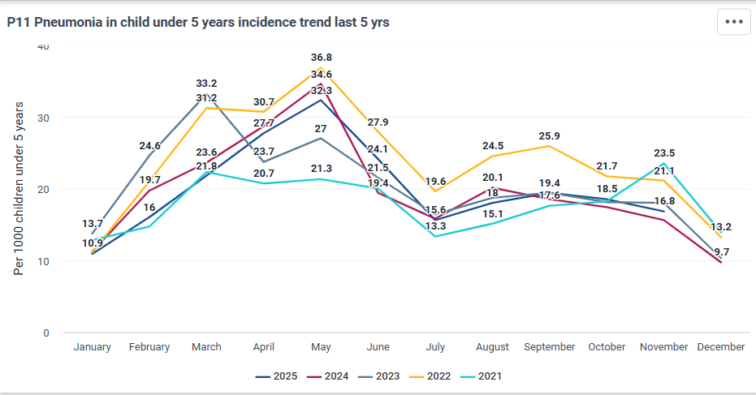
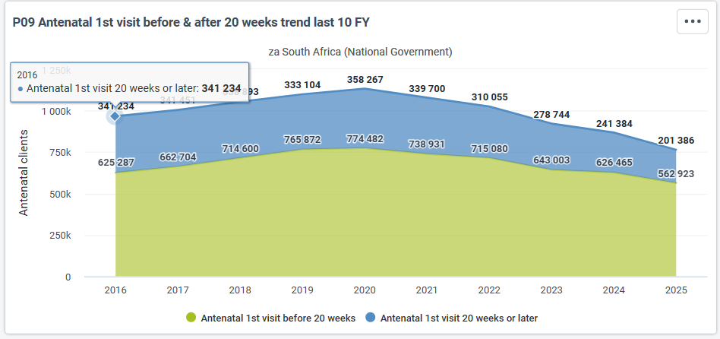
Interactive Exercise: DHIS Trend Interpretation
Working in pairs, analyse the graph and discuss:
  Is the performance improving, declining or stable?
  How does it compare to expectations or targets
  Agree on one management concern or priority.
Notes:
Step 1: Demonstration (5–7 minutes)
Use facilitator access, screenshots, or exported reports.
Select one familiar PHC indicator (e.g. ANC early booking, immunisation coverage).
Show at least 12 months of data.
Briefly point out:
Direction of the trend
Any unusual spikes or drops
Say explicitly:
“We are not learning DHIS navigation today. We are learning how to read what DHIS is telling us.”
Step 2: Pair-based interpretation (5–7 minutes)
Ask participants to work in pairs.
Guide them to:
Focus on interpretation, not explanation
Avoid proposing solutions yet
Agree on one management concern
Walk around and listen for:
Over-focus on one month
Attempts to blame individuals
Jumping straight to solutions
Gently redirect where needed.
Step 3: Brief plenary (3–5 minutes)
Invite 2–3 pairs to share:
The trend they observed
The priority issue they identified
Reinforce:
“DHIS helps us decide where to act. Quality Improvement helps us decide how to act.”

Slide 30
Session 3.5: Tier.Net Overview and Usage

Slide 31

Accessing Reports and Key Indicators
Tier.Net Report Types
  Managers access Monthly Summary and Cohort Analysis reports to monitor HIV and TB programme data effectively.
Monthly Summary Insights
  Monthly Summary highlights active ART patients, new initiations, and lost-to-follow-up cases for quick assessment.
Cohort Tracking and Outcomes
  Cohort reports track patient retention and treatment outcomes over time to identify success and gaps.
Data Export and Review
  Data can be exported or printed for facility or district meetings to support program discussions and decisions.
Notes:
Tier.Net is designed to manage patient-level data for HIV and TB programs. Managers can access reports such as the Monthly Summary and Cohort Analysis to monitor program performance. The Monthly Summary provides a snapshot of active ART patients, new initiations, and lost-to-follow-up cases. Cohort reports track retention and outcomes over time, offering insights into treatment success and gaps. These reports help managers identify trends, assess program effectiveness, and prioritize interventions. Data can be exported or printed for review and discussion during facility or district meetings. Understanding Tier.Net outputs is essential for improving patient retention and achieving program targets.

Slide 32
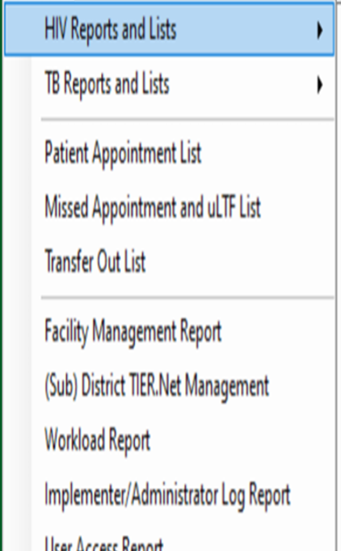
TIER.Net Functions
Access
Access Reports menu
Generate
Generate Monthly Summary
Generate
Generate Cohort Report (12-month retention)
Export or Print
Export or Print report
Notes:
PHC Managers have the mid-level access role of an Administrator. An administrator can view data, but not capture any data. An administrator cannot export patient identifiers in MS Excel but can delete patients however, even if a patient is deleted they will still be stored in memory.

Slide 33
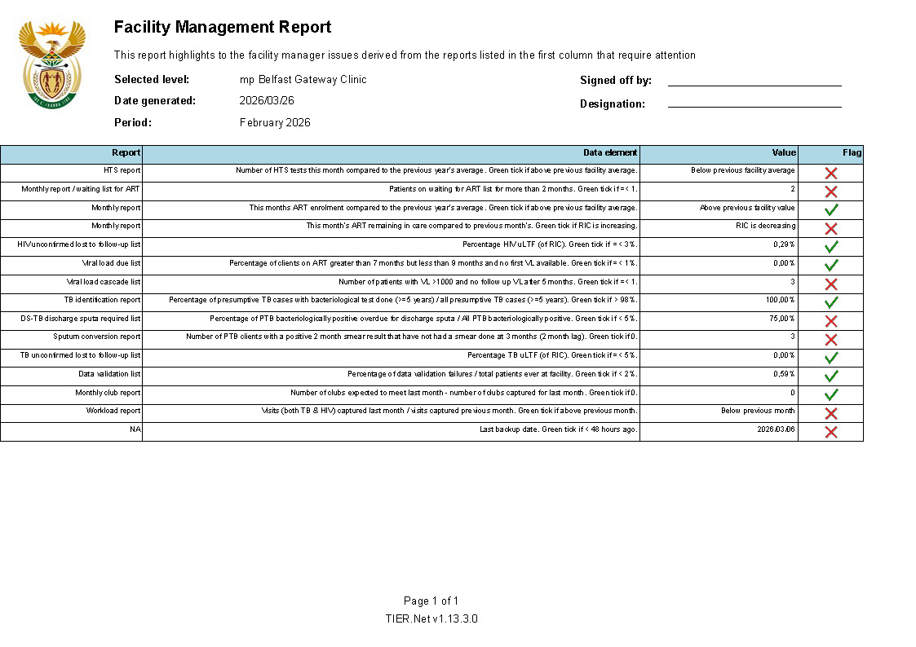
Step 1: Understanding Tier.Net outputs:
*Monthly Summary Report
Key section in the Monthly HIV Report
  ART initiation and restart activity
  Total Remaining on ART (TROA)
  Transfers in and out
  TB Preventive Treatment (TPT)
  Differentiated Models of Care (RPC enrolment)
Management focus: understanding movement, retention, and risk, not data entry
*This Tier.Net Monthly Summary Report is simulated and used for training purposes only
Notes:
This is a Tier.Net Monthly Summary Report, which many of you already receive or sign off on. As managers, the question is not whether you captured this data, but what this report is telling you.
“What stands out to you immediately in this report?”
Prompt if needed: “What does the Total Remaining on ART tell us?”
“What do the restart numbers suggest?”“Is RPC enrolment high or low?”
Reinforce:
“Each number here represents real patients in care.”

Slide 34

Interactive decision-making exercise
Working in pairs, identify one programme risk and one management action you would take in the next month.
Share risk identified and action proposed.
Notes:
Examples they may identify (do not show upfront):
High uLTF list → strengthen defaulter tracing
Low TPT initiation → review TPT screening process
RPC enrolment at 52% → expand external pick-up points

Slide 35
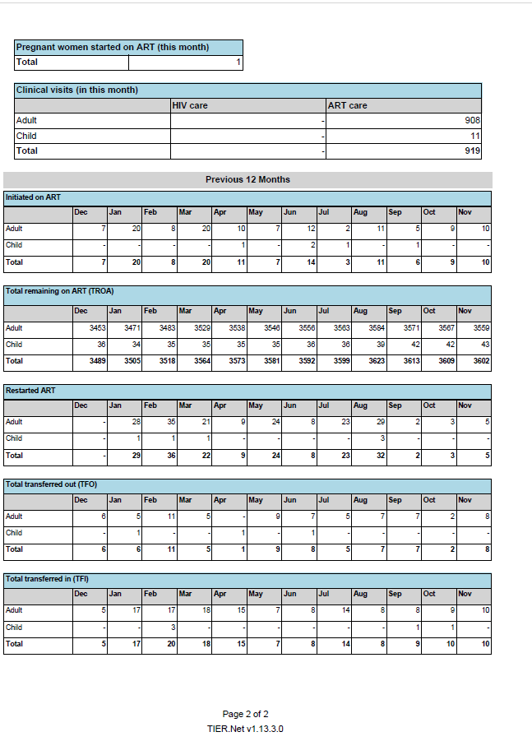
Trend Analysis
Trends available in Tier.Net:
  ART initiations (monthly)
  Total Remaining on ART (TROA)
  Restarts on ART
  Transfers in and out
Example management observations:
  TROA increased steadily from 3 489 (Dec) to 3 602 (Nov)
  ART initiations fluctuate month to month
  Restart numbers indicate ongoing treatment interruption

Slide 36
Group Discussion: Interactive Trend Interpretation
Look at the trends for the past 12 months:
ART initiations
Total Remaining on ART (TROA)
Restarts on ART
Transfers in and out
Discuss in pairs:
Is the programme growing, stable, or declining?
Where do you see risk or concern?
What might explain the pattern you see?
Output:
Identify ONE priority issue for management attention
Notes:
This slide is an interactive interpretation exercise. Participants are not expected to calculate indicators or memorise numbers.
Ask participants to work in pairs and look at the 12-month trends shown in the Tier.Net report.
Guide them to focus on: Whether the programme is growing or stagnating, Whether restarts suggest treatment interruption, Whether TROA growth is keeping pace with initiations
After 5–7 minutes, ask 2–3 pairs to share: The trend they noticed, One management concern it raises
Reinforce that trend interpretation helps managers decide where to act, not just report numbers.

Slide 37
Session 3.6: District Health Barometer (DHB) Dashboard

Slide 38

Navigating and Using DHB for
Benchmarking
Dashboard Overview
  DHB provides a user-friendly platform to visualize health indicators at district and provincial levels.
Data Filtering and Selection
  Users select health themes and filter data by province, district, and specific indicators for detailed insights.
Comparative Analysis
  The dashboard enables comparison of district data with provincial averages and other districts to identify gaps.
Exporting and Reporting
  Charts and data can be exported easily for use in reports and presentations to support decision making.
Notes:
The DHB dashboard provides an accessible platform for visualizing health indicators at district and provincial levels. To use it, visit the DHB website and select a health theme such as RMNCH or Infectious Diseases. Choose an indicator of interest, filter by province and district, and view the latest values and multi-year trends. The dashboard allows comparisons with provincial averages and other districts, helping managers identify strengths and gaps. Charts can be exported for inclusion in reports or presentations. By leveraging DHB data, managers gain a broader perspective on performance and can align facility-level efforts with district priorities.

Slide 39
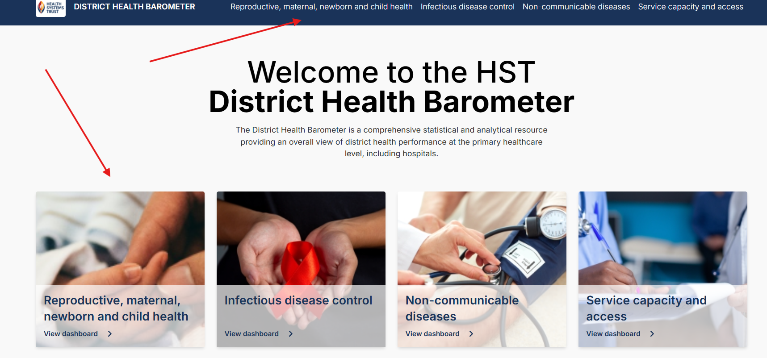

DHB DEMO STEPS
1. Access https://dhb.hst.org.za
2. Select Theme (e.g., RMNCH, Infectious Diseases)

Slide 40
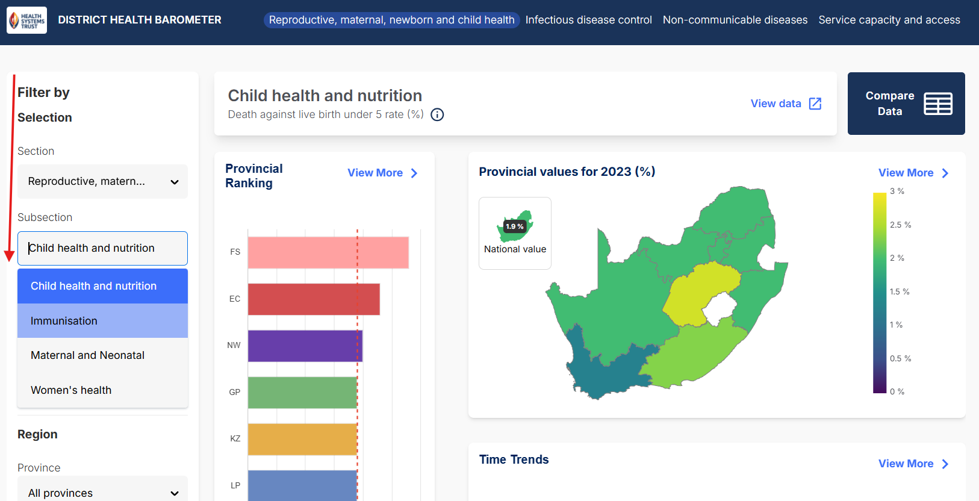
Indicator Selection & Filtering
Choose Indicator (e.g., Immunisation coverage)

Slide 41
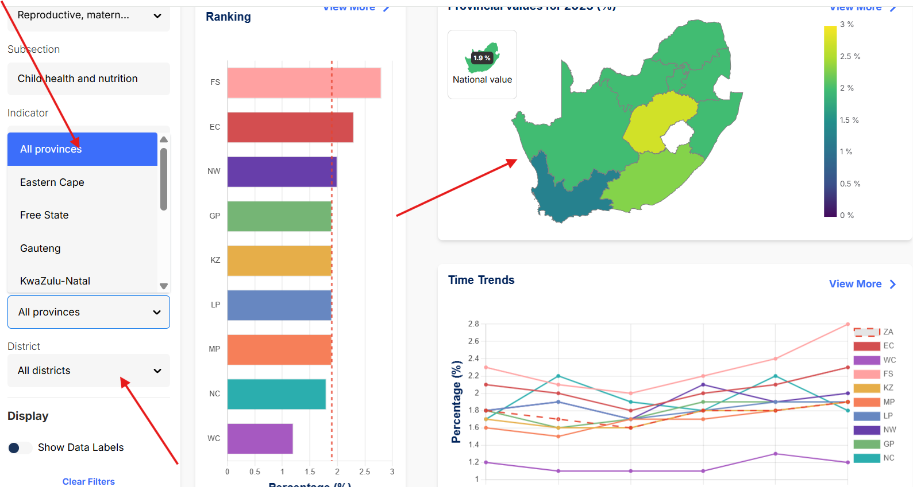
Filter by Geography
4. Filter by Province/District

Slide 42
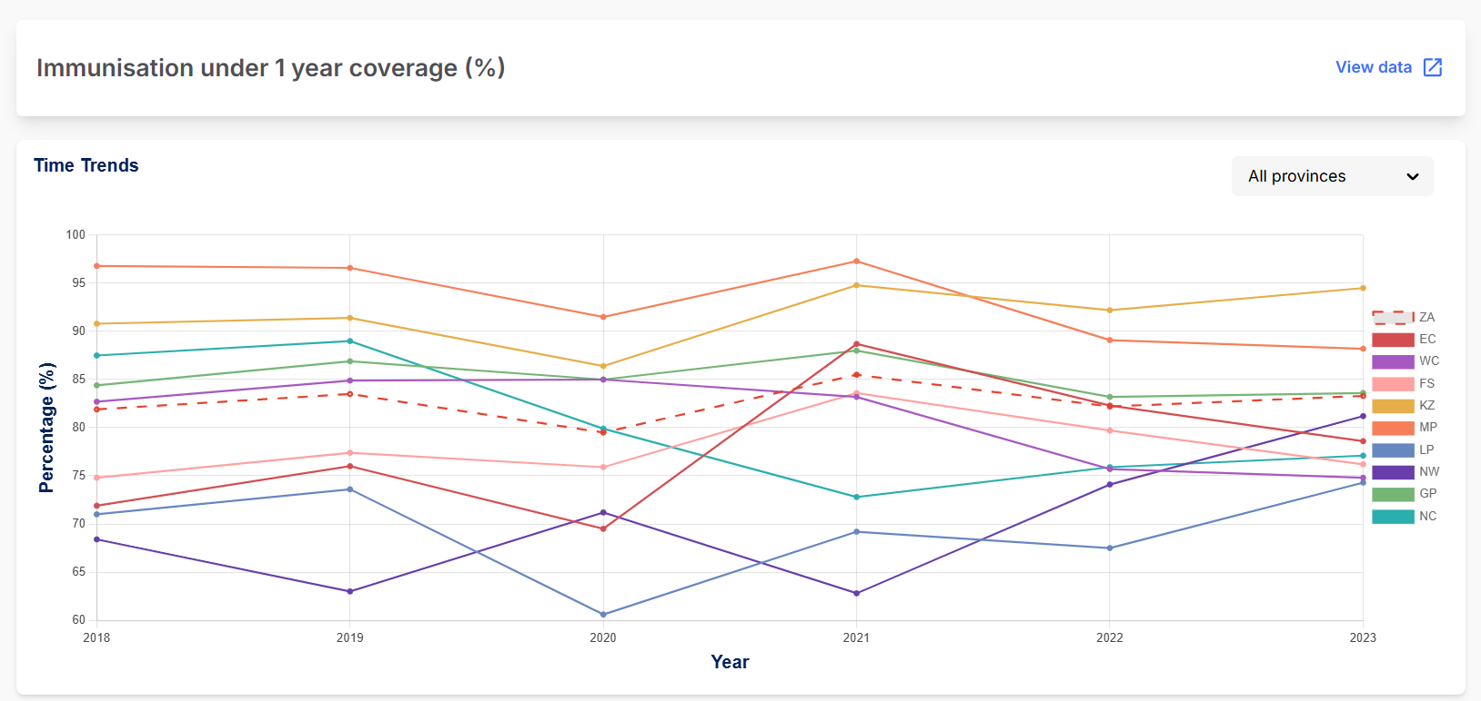
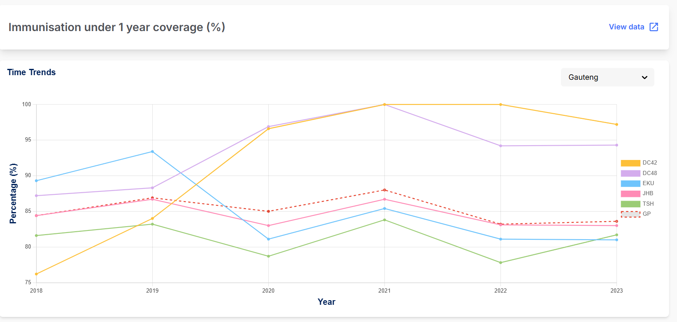
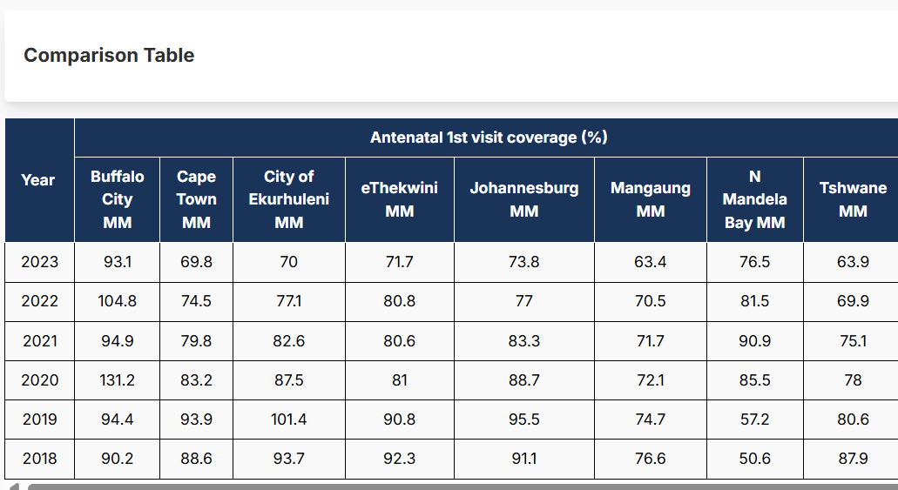
View Trends and Compare

Slide 43
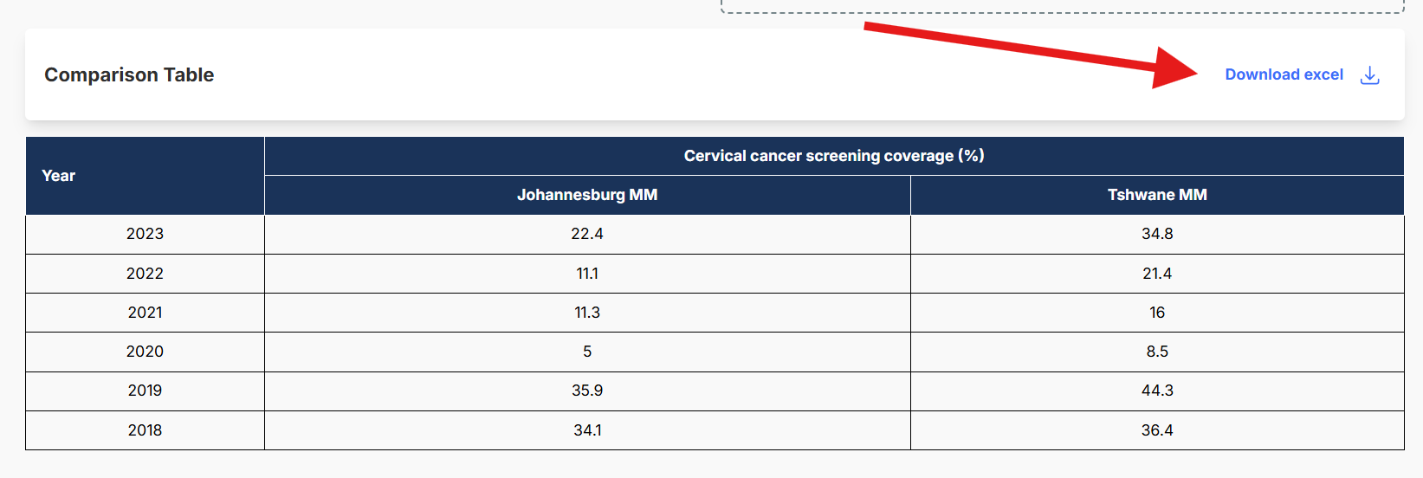
Option to download data

Slide 44
Reflective Exercise
Work in pairs and discuss:
What does your district’s performance look like compared to others?
Which indicator would you prioritise for further investigation?
What question would you take back to your district team?
Output: One priority question for management discussion

Slide 45
Session 3.7: Interpreting Data and Communicating Insights
Notes:
By now, you have gathered a variety of data: routine service stats from DHIS, patient outcomes from Tier.Net/ETR.Net, and comparative indicators from the DHB. The next crucial step is making sense of this data – turning numbers into insights, and insights into action. In this section, we focus on interpreting what the data is telling us, writing those insights clearly, and then planning SMART actions for improvement.

Slide 46

Turning Data into Action
Data Interpretation Strategies
  Analyzing trends and comparing performance to targets helps identify strengths, gaps, and equity issues in data.
Effective Data Communication
  Writing concise statements explains what data shows and why it matters for clear understanding and decision-making.
SMART Action Planning
  Using the SMART framework ensures actions are specific, measurable, achievable, relevant, and time-bound for success.
Implementing Improvements
  Setting realistic goals with steps like outreach or process changes drives meaningful improvements in services.
Notes:
Interpreting data involves analyzing trends, comparing values to targets, and identifying strengths and gaps. Managers should ask key questions: Is performance improving or declining? How does it compare to benchmarks? Are there equity issues across facilities? Once insights are clear, communicate them effectively by writing concise statements that explain what the data shows and why it matters. Use the SMART framework to plan actions: Specific, Measurable, Achievable, Relevant, and Time-bound. For example, if ANC early booking is below target, set a realistic improvement goal and outline steps such as community outreach or process changes. Clear communication and actionable plans ensure that data drives meaningful improvements in PHC services.

Slide 47

Activity: Hands-on Data Exploration
TASK
Select
Select two indicators on the DHB dashboard
Find
Find the latest value and 5-year trend
Note
Note one strength and one gap
Tips for Interpreting Charts
Check the axis and units (%, rate, number)
Look at direction of trend
Compare against benchmarks
Remember: higher is not always better
Notes:
Each participant (or pair) will choose at least two indicators on the DHB dashboard to explore for their district (or a district of their choice). Suggest one RMNCH indicator and one NCD indicator – you can use that as a guideline. For example: one could be Immunization coverage (RMNCH), another could be ART retention or TB treatment success (Communicable/NCD).
They should find the latest value and the 5-year trend for each chosen indicator in their district.
If possible, they should also check comparison to provincial or national average, or another district (which the DHB allows by toggling benchmarks).
They will document or note down: the values, the trend (increasing/decreasing/flat), and think of at least one positive finding (something encouraging) and one concern (a gap or issue) from the data for their district. For example: “Our immunization is high (strength), but postnatal visit rate is low (gap).”

Slide 48
Writing a data insight
Step 1: Identify Problem
Step 2: Justification
Choose one problem reflected in the data
E.g. Low antenatal early booking rate (only 50%)
Explain why it’s important in 1-2 sentences using data
E.g. Only 50% of pregnant women book before 20 weeks in our clinic (trend has been flat for 3 years, provincial average is 65%). This delay in ANC can lead to poor maternal outcomes, so it’s a critical gap to address.
Notes:
• Identify One Priority Problem: Each participant (with input from group) should choose one problem area they feel is a priority to address. It should be something reflected in the data – e.g., “Low antenatal early booking rate (only 50%)” or “High default rate in TB treatment (15%)”. They should ensure the problem is backed by evidence: a trend and a gap (like declining trend or below target).
Write a Justification: For that one chosen priority, have them write 1-2 sentences why it’s important. Essentially, this is their rationale, using the data. Example: “Only 50% of pregnant women book before 20 weeks in our clinic (trend has been flat for 3 years, provincial average is 65%). This delay in ANC can lead to poor maternal outcomes, so it’s a critical gap to address.”

Slide 49
Data Interpretation & Prioritisation
In your groups, discuss:
What trends do you see?
How does performance compare to targets?
What might explain the results?

Slide 50

Group Report Back
Each group presents very briefly (2 minutes) the top 1-2 priorities they identified

Slide 51
Crafting a Summary Brief
Introduction sentence: What is the overall focus (e.g., “This report summarizes the Q1 2025 performance of XYZ Clinic in key program areas: Maternal Health, HIV, and TB.”).
Key achievements or strengths: Start on a positive note if possible. “Immunization coverage improved to 95%, exceeding the target, and ANC early booking increased by 10 percentage points compared to last year.”
Key challenges or gaps: Identify the critical issues. “However, the TB treatment success rate dropped to 75%, below the 85% target, due to an increase in patients lost to follow-up. Additionally, ART 12-month retention remains a concern at 78%.”
Possible causes or context: Briefly mention if you know why. “The drop in TB success coincided with staffing shortages in the tracing team. Retention challenges in ART may be linked to drug stock-outs experienced in Feb and Mar.”
Next steps (if appropriate): Foreshadow actions. “We plan to strengthen patient follow-up through community health workers and are implementing an early missed-appointment tracking system next quarter.”
Notes:
Often, managers need to communicate a broader picture in a summary report or brief – for example, a quarterly performance report for a sub-district. This usually involves writing a short narrative (a few paragraphs) that highlights the main points from the data, and sometimes includes tables or charts. Keep the language clear and non-technical where possible, especially if the audience includes non-clinical managers or community stakeholders.

Slide 52
Activity: Outline a Brief
Introduction: What period and scope? (e.g., “Q1 2025, District ABC performance summary”).
Highlights (Good): 1-2 bullets of good performance.
Issues (Bad): 1-3 bullets of under-performance.
Underlying factors: any known reasons (optional).
Action/Next Steps: Any potential solutions/actions required

Slide 53
Session 3.8: SMART Targets and Action Planning

Slide 54

SMART Target Setting and Action Planning
Formulating SMART Targets
  Learn to create Specific, Measurable, Achievable, Relevant, and Time-bound targets for clear accountability.
Developing Action Plans
  Mini action plans outline key activities, responsible persons, and timelines to ensure practical improvement steps.
Data-Driven Improvement
  Planning translates data insights into actionable strategies and progress monitoring for effective implementation.
Notes:
After identifying priority gaps through data analysis, participants learn to formulate SMART targets: Specific, Measurable, Achievable, Relevant, and Time-bound. Setting SMART targets ensures clarity and accountability in improvement efforts. For example, instead of stating 'Improve antenatal care,' a SMART target would be 'Increase antenatal first visit before 20 weeks from 50% to 70% by March 2026.' Participants also develop mini action plans outlining key activities, responsible persons, and timelines. These plans translate data insights into concrete steps for improvement, such as community outreach, staff training, or process adjustments. Facilitators guide participants through examples and provide templates to structure their plans. This segment emphasizes that data-driven planning is not just about setting goals but also about defining actionable strategies and monitoring progress. By the end of this activity, participants have a draft plan they can implement in their facilities, reinforcing the practical relevance of the module.

Slide 55
SMART Targets
Specific
Measurable
Achievable
Relevant
Time-bound
Specific: Clear and focused on one issue or indicator.
Measurable: Quantifiable (with a number/percentage to know success).
Achievable: Ambitious but attainable given resources.
Relevant: Tied to the identified priority and broader goals.
Time-bound: Has a deadline or timeframe. Use an example unrelated to their project first (for instance, “Increase clinic hand hygiene compliance from 60% to 90% by December 2025”)

Slide 56
Example 1: Indicator ANC < 20 weeks rate
Baseline: 45% (2023).
Target: 65% by end of 2025 (in 2 years).
Why: Significant gap vs provincial 65% and national goal 70%; early ANC improves outcomes.
Actions: 1) Community health workers conduct monthly awareness in communities about early booking; 2) Implement a “fast-track” system at clinic for first trimester pregnancies to reduce waiting times; 3) Review ANC register weekly to follow-up women who miss early booking.
Owner(s): PHC Manager (oversees), CHW team (action 1), Clinic nursing team (actions 2 & 3).

Slide 57
Example 2: Hypertension Control Rate
Baseline: 55% of known hypertensives controlled (2023).
Target: 70% by Dec 2024.
Why: Reduce complications (stroke), achievable with improved follow-up (some districts at 70% already).
Actions:
  1) Establish a hypertensive club for peer support and medication adherence;
  2) Telephonic follow-ups for patients with high BP readings monthly;
  3) Ensure medication availability – coordinate with pharmacy to avoid stockouts.
Owner: Chronic care nurse (club), data clerk (calls & tracking), pharmacy assistant (med supply monitoring).

Slide 58
Example 3: TB Treatment Success Rate
Baseline: 82% (2022 cohort).
Target: 90% by Q4 2024.
Why: Meets national target, aligns with WHO goals; will reduce TB transmission.
Actions:
  1) Strengthen defaulter tracing – assign CHWs to contact missed patients within 48 hours;
  2) Weekly TB team review of patient list to catch issues early;
  3) Collaborate with DOT supporters for daily observed therapy for high-risk patients.
Owner: TB nurse (coordinate), CHWs (tracing), DOT volunteers (support).

Slide 59
Session 3.9: Group Activity: Data Interpretation and SMART Planning

Slide 60
Activity: Action Planning
Your Task
Expected Output
Set
Set one SMART Target
Identify
Identify 2-3 key actions
Assign
Assign responsibility
Completed Mini Action Plan per participant
Notes:
Each participant formulates a SMART target for their chosen priority indicator, and outlines 2-3 key actions with responsible persons (owners) to achieve that target, using the provided template (Indicator, Baseline, Target, Why, Actions, Owner). There is a template on the next slide.

Slide 61
Mini Action Planning Table
Indicator | Baseline (Year) | Target (By when) | Why this target? | 2-3 Key Actions (How) | Owner (Who)
Example: ANC <20 weeks (%) | 60% (2023/24) | 75% (by Mar 2026) | Close gap vs prov. 72%; feasible with outreach | - CHW early booking drives - Fast-track first visits - Monthly cohort review | Clinic manager
Notes:
We will fill out a mini action planning table. Choose one priority problem/indicator from your data (perhaps the gap you identified earlier). For that indicator, set a baseline, a target, and list actions. Remember to keep targets ambitious yet achievable. Setting it too low isn’t inspiring, too high might be unrealistic and demotivating. You can always adjust as you implement.

Slide 62

Presentations and Feedback
Share your priority problem, SMART target, and proposed actions in a brief presentation.
Notes:
The final segment of the module focuses on communication skills, enabling participants to present their data findings and improvement plans clearly and persuasively. Each participant or group shares their identified priority problem, SMART target, and proposed actions in a brief presentation. Facilitators and peers provide constructive feedback, highlighting strengths and suggesting refinements. This exercise builds confidence in communicating data-driven decisions to different audiences, such as facility staff, district managers, or community stakeholders. Effective communication ensures that improvement plans gain buy-in and support, which is critical for successful implementation. The session concludes with a summary of key takeaways: the importance of data use, practical skills in navigating systems, and the role of SMART planning in driving change. Participants are encouraged to apply these skills in their daily work and continue fostering a culture of evidence-based management.

Slide 63
Game: Data Truth or Myth
Test your knowledge on data facts and misconceptions
Standing up = TRUE
Sitting = FALSE
Statements
“Higher numbers always mean better performance”
“One bad month means the program is failing”
“If coverage is high, quality must be good”
“Data errors don’t affect decisions”

Slide 64



Wrap-up and Reflection
Questions
What was easiest about today?
What was most challenging?
What system or dashboard will you use first after this training?
Key messages
Different systems answer different questions.
Interpretation turns data info insight.
SMART targets link data to action.
Celebrate learning – progress matters more than perfection!

