Slide 1
Hardskills Training for PHC Mangers In Liberia
QUALITY IMPROVEMENT
December 8-12, 2025

Slide 2
Objectives
At the end of this training, participants will understand
Data Quality Improvement

Slide 3
CONTENT
Introduction to Quality and Quality Improvement
Process Mapping
Root Cause Analysis
PDSA Cycles

Slide 4
Session 4.1 Introduction of Quality & Quality Improvement

Slide 5
Objectives
By the end of this Session, participants will be able to,
Define Quality and its role in healthcare service delivery.
Understand basic elements of quality in the context of clinical application, patient satisfaction and Patient safety.
Define Quality Improvement (QI) and identify key components of the model for improvement.

Slide 6
Brain Teaser
What is Quality and Quality Improvement In Health Care??
Response from 3 Participants, each from a participating county (total of 12 participants per training region-Southeastern and Western Liberia)

Slide 7
Definition of Quality & Role In Health Care
Quality, what does it means?
SYNONYMS from the Mariam Webster Dictionary:
Standard
Grade
Yardstick
Hallmark
Preferment....etc....

Slide 8
Definition of Quality & Role In Health Care Cont’d
For the purpose of this session, we will consider the following defininition of QUALITY
In Primary Health Care (PHC), quality is defined by the extent to which services are safe, effective, and people-centered, delivered in a way that achieves desired health outcomes while balancing efficiency, equity, and timeliness.

Slide 9
Definition of Quality & Role In Health Care Cont’d
.
The ultimate goal is to support universal health coverage by making sure that essential care is accessible, high-quality, and meets individuals' needs and values.

Slide 10
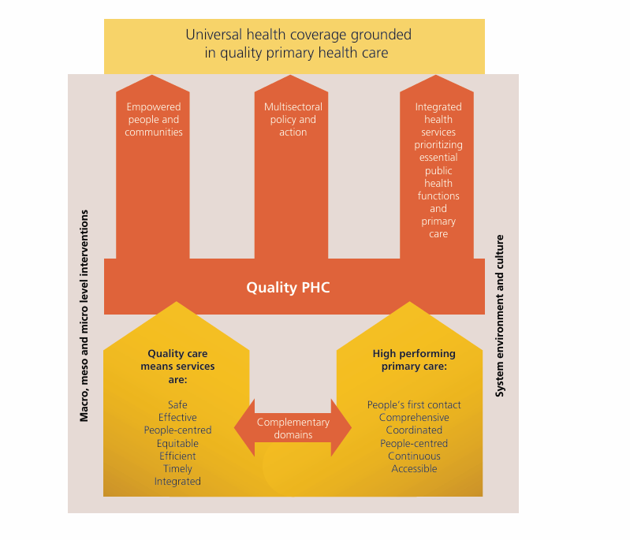
Definition of Quality & Role In Health Care Cont’d
.

Slide 11
AS PHC MANAGERS, HOW DO WE QUANTIFY OR MEASURE QUALITY?

Slide 12
Models for Quantifying or Measuring Quality
1) SERVQUAL model (the gap model of service quality)
Developed by Zeithaml, Parasuraman, and Berry in the 1980s, remains a highly esteemed framework for evaluating service quality.
According to this model, the distance between a customer's expectations and their actual perceptions greatly influences service quality.

Slide 13
Models for Quantifying or Measuring Quality
1) SERVQUAL model (the gap model of service quality)
It identifies five key dimensions that are crucial in detrmining the quality of Service:
tangibles, reliability, responsiveness, assurance, and empathy.
This model is valuable for businesses seeking to enhance customer satisfaction and loyalty.

Slide 14
Models for Quantifying or Measuring Quality
1) SERVQUAL model (the gap model of service quality)

Slide 15
Models for Quantifying or Measuring Quality
2) CIPP model (Context Inputs Processes and Products)
It provides a dynamic framework for looking at several aspects of a particular service.
It requires careful planning and is labour intensive as multiple data collection methods are often required in order to carry out comprehensive CIPP evaluation.

Slide 16
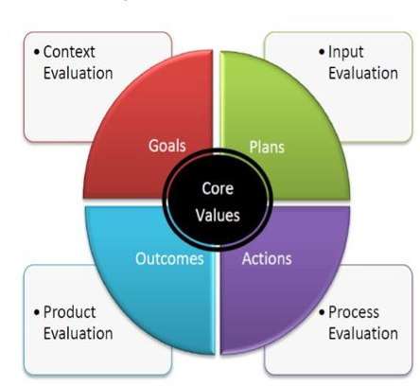
Models for Quantifying or Measuring Quality
2) CIPP model (Context Inputs Processes and Products)

Slide 17
Models for Quantifying or Measuring Quality
3) Logic model
The Logic Model is a linear model that can be used for both planning and evaluating healthcare programs.
Its uncomplicated user friendly design makes it an attractive choice. It consists of four basic components (inputs, activities, outputs and outcomes).

Slide 18

Models for Quantifying or Measuring Quality
3) Logic model

Slide 19
Models for Quantifying or Measuring Quality
4) Donabedian model
a conceptual model that provides a framework for examining health services and evaluating the quality of healthcare.
It assesses the quality of a service based on three main categories: structure (building, staff), processes (patient pathways, referral patterns) and outcomes (mortality, morbidity, waiting times).

Slide 20
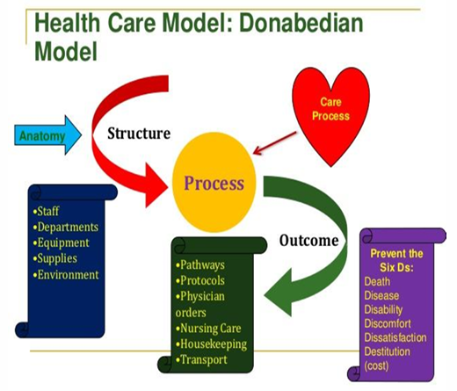
Models for Quantifying or Measuring Quality

Slide 21
Basic elements of quality in the context of clinical application, patient satisfaction and Patient safety
In the Context of PHC, basic elements of quality care includes,
Safety | Preventing harm to patients from the care that is intended to help them. It is the foundation for all other aspects of quality.
Effectiveness | Providing care that is based on scientific knowledge and evidence, to achieve the best possible outcomes for every patient.
Patient-Centeredness | Providing care that is respectful of and responsive to individual patient preferences, needs, and values.
Timeliness | Reducing waiting times and sometimes harmful delays for both those who receive and those who provide care.
Efficiency | Avoiding waste of equipment, supplies, and ideas, and maximizing the benefit of available resources to achieve the best outcomes.
Equity | Providing care that does not vary in quality because of personal characteristics like gender, ethnicity, geographic location, or socio-economic status.

Slide 22
Quality Improvement (QI) and key components of the model for improvement.
How is quality & quality improvement, is there a difference?

Slide 23
Quality Improvement (QI) and key components of the model for improvement.
Quality | Quality Improvement
The extent to which healthcare services for individuals and populations increase the likelihood of desired health outcomes and are consistent with current professional knowledge | Systematic and continuous actions that lead to measurable improvement in healthcare services and the health status of targeted patient groups

Slide 24
Quality Improvement (QI) and key components of the model for improvement.
1980s: Quality improvement theorist Edwards Deming laid the groundwork with his concepts of quality and his "System of Profound Knowledge". The PDSA cycle, a core part of the later model, was adapted from his work.
1996 onwards: The Institute for Healthcare Improvement (IHI) adopted and promoted the model, leading to its widespread use in healthcare settings, where it is sometimes referred to as the "IHI model".
Today: The model remains a foundational tool for quality improvement initiatives, widely recognized and applied globally. It is credited with helping to drive innovation, testing, and the spread of improvement work

Slide 25
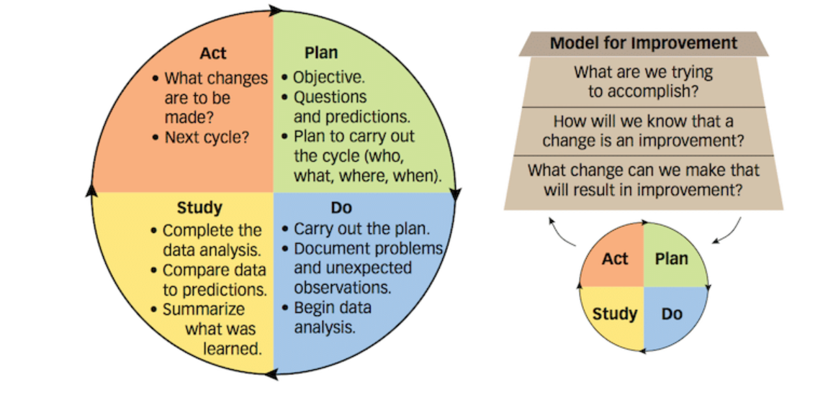
Quality Improvement (QI) and key components of the model for improvement.
The MIF Model consists of two parts:
Part I – Three Fundamental Questions (3Qs)
Part II – Plan, Do, Study, Act (PDSA) Cycles

Slide 26
Quality Improvement (QI) and key components of the model for improvement -- QI TOOLS
TOOL | USAGE
Brainstorming | Generating ideas
Nominal group technique | Generating ideas
Affinity Diagrams | Organising and categorising ideas
Five Whys | Defining a problem (determining root cause)
Fishbone (Ishikawa) | Exploring and determining factors that cause or influence a problem (cause and effect)
Pareto | Identifying the causes that have the greatest impact on a problem, which assists with determining where to focus an improvement effort
Process Mapping | Visualising and understanding what happens in a process (for redesign)
Force Field Analysis | Identifying factors that can support or hinder a potential solution. Understanding these factors and using strategies to reduce barriers can increase the chances of the solution being successfully implemented
Cause & Effect Diagrams | Identifying multiple individual causes of a single problem
PDSA Cycle | Solving Problems and Implemnting Change

Slide 27
Quality Improvement (QI) and key components of the model for improvement -- QI TOOLS
Eventhough, there are a number of QI tools (as seen in the previous slide), but only a few of these QI tools will be introduced in the course, namely
Process Mapping
Fishbone Analysis
5 Whys
Cause and Effect
PDSA

Slide 28
ACTIVITY 1: Group Relection for Improvement In Patient Care
This group activity is designed to help participants brainstorm on improvement in patient care at the primary health care level.
Instructions
• In 3 groups of 4 participants, think of some aspects of the daily care for patients at the primary health care level that you would like to improve. For example,
Patient Safety (Reducing Hospital-Acquired Infections, Medication Errors)
Improved Communication (Patient-Healthworker communication improvement).

Slide 29
ACTIVITY 1: Group Relection for Improvement In Patient Care
Health System Strengthening (Utilizing health information systems and medical records to facilitate population management and improve overall efficiency).
You can figure out and do a group activity on a topic other than those provided.
Things to consider during activity,
Problem to improve?
Change proposed to address the problem?
Outline how change will be implemnted?
Outline of how to measure change to determine if led to improvement?

Slide 30
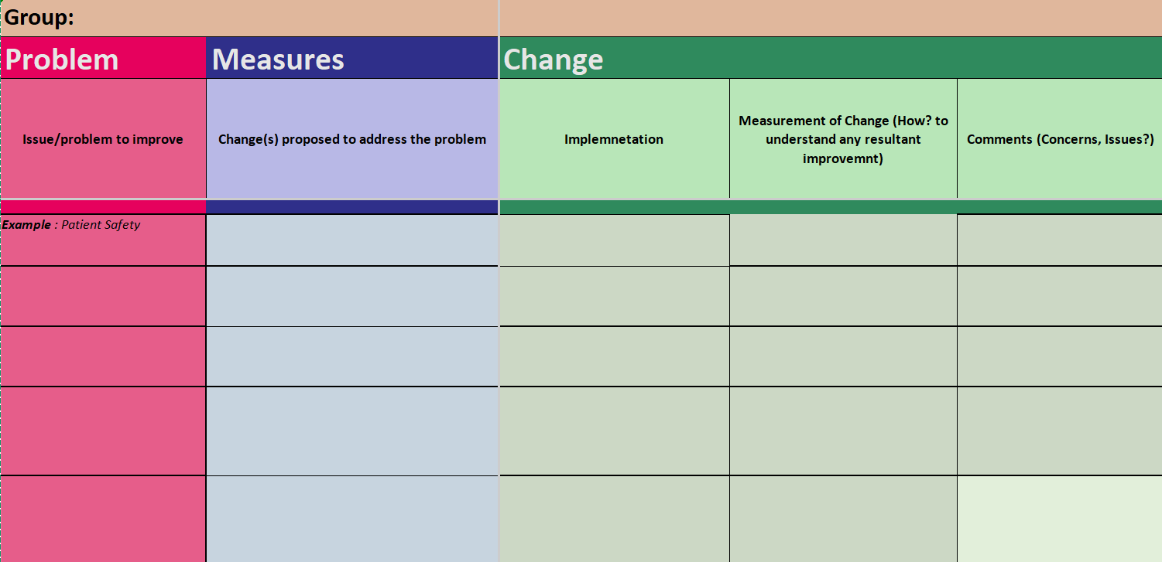
ACTIVITY 1: Group Relection for Improvement In Patient Care
Example of the On-paper Template

Slide 31
Session 4.2 : Process Mapping

Slide 32
Session Content
Defining processes
Importance of processes in QI
Opening Activity
Elements of a process map
What is Process Mapping?
Process Mapping and QI Work
How to Create a Process Map
How to Identify Problems in a Process Using a Process Map
Breakout: Small Group Activity

Slide 33

Defining process
Process (in the context of healthcare) is a set of interrelated or interacting activities which transforms inputs into outputs or health outcomes.

Slide 34
Importance of processes in QI
When Processes are improved and standardized, they can be used as powerful tool to improve quality management. The results are but not limited to:
Consistency
Continuous improvement
Patients satisfaction.

Slide 35
PROCESS MAPPING

Slide 36
Definition of Process Mapping
A visual or graphical representation of steps involved in a process.
Used to
Identify gaps and inefficiencies
Clarify roles and responsibilities
Support process standardization

Slide 37





Basic Elements of A Process Map
A block defining the start or end of a process.
A block representing a decision.
A block for a process or activity for which there are no doubts.
A block indicating a wait or delay.
Connecting the flow of activities and decisions.

Slide 38
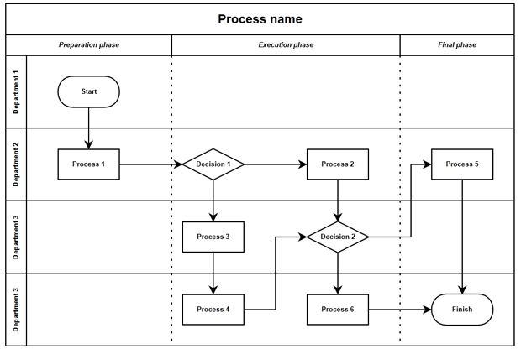
Opening Activity: Swimlane Diagram Creation

Slide 39
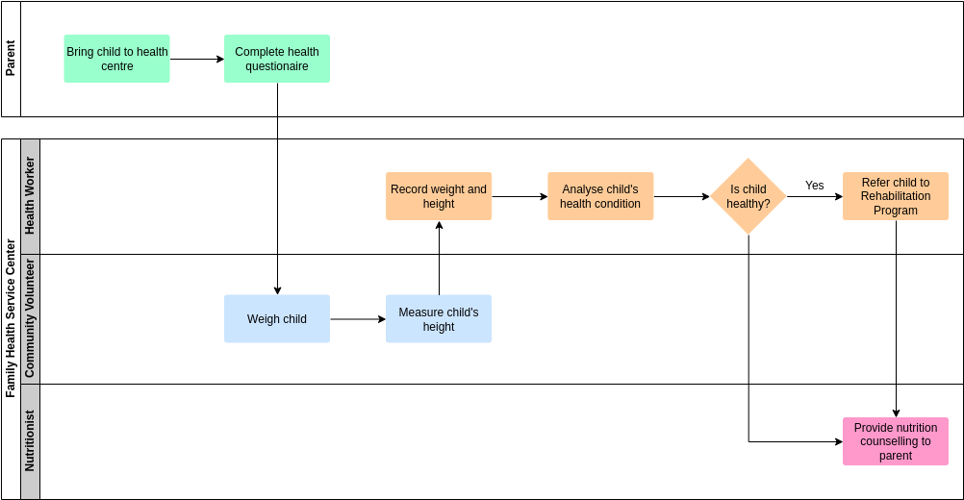
Example of Applying Swimlane Diagram to Real Life Problem(s)
My Child Looks Stunted:

Slide 40
Opening Activity: Swimlane Diagram Creation
Instructions
4 Groups of 3 persons each
Each group is to create and apply Swimlane diagram to one of these real life situations:
1) My daughter is getting married
2) Car won’t start
3) Kitchen Sink is leaking
4) Phone won’t turn on

Slide 41
Opening Activity: Swimlane Diagram Creation
Activity Reflection:
Clarity of roles and responsibilities
Identifying process flow
Handoffs and communication
Discovery of parallel activities
Identifying inefficiencies and improvements
Bottlenecks
Uncovering assumptions
Impact on decision-making

Slide 42
Process Mapping (In the Context of Healthcare Processes)
Example: A Patient Enters A Facility:

Slide 43
Whole Group “Walk Through” Activity on Process Mapping
PATIENT CARE At Facility Z:
Instructions:
3 groups of 4 persons each. The exercise is for 15 minutes
Using stick-on pads on clipboards, do a process map for a patient who enters facility Z on November 1, 2025 via the OPD
After the excercise, there will be Full Group Review and Discussions on generated process maps

Slide 44
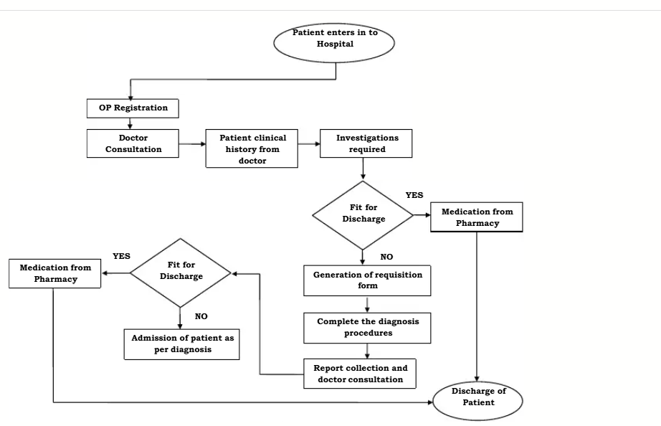
Group Exercise on Process Mapping Cont’d
Your Finished Process Map for a Patient at Facility Z should atleast look like this:

Slide 45
Let Us Discuss !
Now That You Have An Understanding of Process Mapping,
1) When was the last time you used it at your facility?
2) In which context is it applicable to your daily work?

Slide 46
ANY RELATIONSHIP BETWEEN PROCESS MAPPING
&
QI ?
YES? Those in favor ........... Raise Your Right Hands!
No ? Those in favor........ Raise Your Left Hands!

Slide 47
There is a Relationship Between PROCESS MAPPING & QI
Process mapping has multiple uses in QI work. It helps us:
Understand how things are currently done
Identify where things are going wrong
Determine how to make improvements in current processes.

Slide 48
GROUP ACTIVITY 1 : CREATING A PROCESS MAP
Instruction to Participants:
3 Groups of 4 participants each.
Think of a Clinical or Non-Clinical process you believe is inefficient in the context of PHC, that contricbutes to delays, or is leading to suboptimal outcomes in patient health or satisfaction.
Use the appropriate symbols (presented in the slide on basic elements of process mapping)to represent start/end points, decision points, appropriate sequence, etc. Construct a Process Map and Do a Presentation.

Slide 49
GROUP ACTIVITY 2 : Quality Improvement Process Mapping
Scenario-Based Activities:
3 Groups, 4 participants per group, Create a Process Map for the following:
A. First ANC Visit for 20y/o Primigravida at 8 weeks Gestational Age. (Group 1).
B. A Postpartum Day 5 visit of a 32y/o P₃+⁰L₃ to your facility. (Group 2).
C. Followup Immunization for 3 Months Old Infant. (Group 3)

Slide 50
BREAK

Slide 51
Session 4.3 : Root Cause Analysis

Slide 52
Session Content
Presentation
Root Cause Analysis Defined
Steps of RCA
5 Whys Method
Cause and Effect (fishbone) Diagrams
What is a Cause and Effect Diagram
How to use a Cause and Effect Diagram
Why are Cause and Effect Diagrams useful?
Group Activities
Root Cause Analysis can be used through applying different tools/methods alone and/or in combination. Two will be presented in this session and used for Group Activities: 5 whys, fishbone/Cause & Effect

Slide 53
Root Cause Analysis Defined

Slide 54
Root Cause Analysis Defined
The Collins Dictionary defines ROOT CAUSE as the fundamental reason for the occurance of a problem.
The National Institute of Health (NIH) defines Root Cause Analysis (RCA) as a method used in healthcare to systematically identify and address underlying causes of adverse or sentinel events to enhance patient safety and mitigate risks.

Slide 55
When to Use RCA In QI ?
Root Cause Analysis can be applied in QI to understand the origin of defects, which is crucial for preventing future occurrences.
RCA in QI:
Prevention of Recurring Issues
Continuous Improvement
Systemic Problem Solving

Slide 56
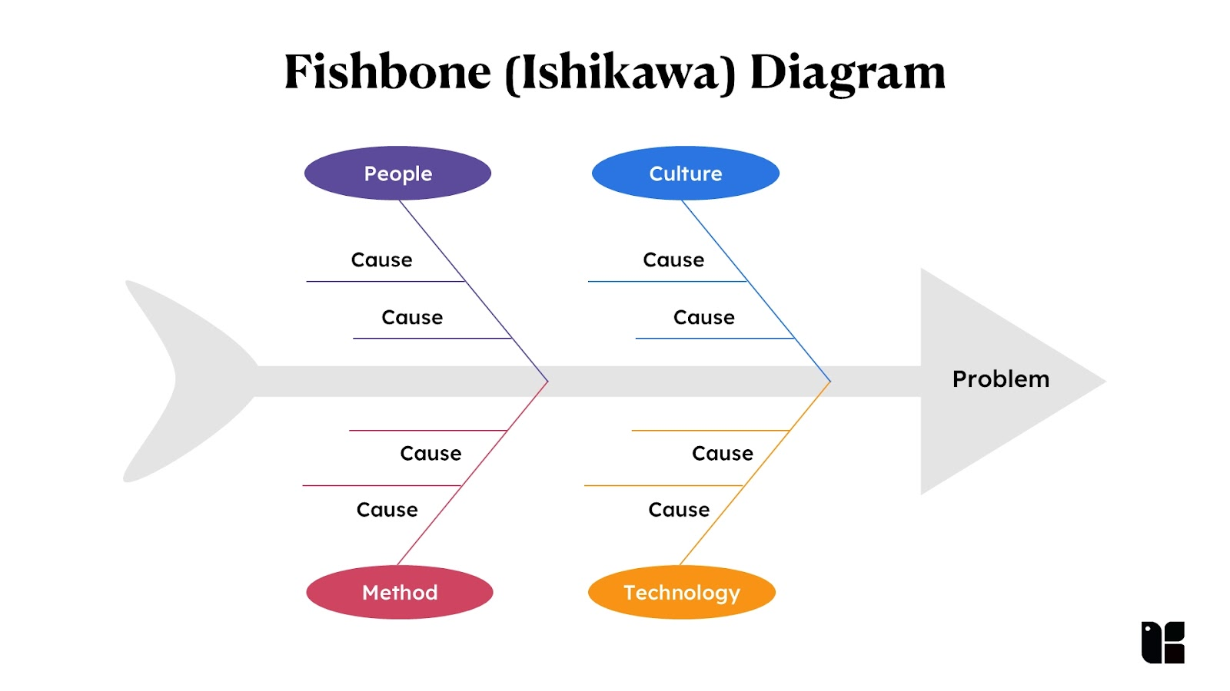
Root Cause Analysis Tools
Goal: identify the true reason of a failure. We will consider two (2) of the many tools:
1) Fishbone (Ishikawa) Diagram

Slide 57
Root Cause Analysis Tools
Fishbone (Ishikawa) Diagram
graphically display the relationship of the causes to the effect and to each other and helps teams identify areas for improvement
Named after Japanese engineering professor Kaoru Ishikawa in the 1960s, who helped apply them to manufacturing processes.
Shaped somewhat like a fish, these charts are sometimes called fishbone or "Fishikawa" diagrams.
Ishikawa diagrams often follow the "Six M's": manpower, machinery, methods, materials, measurement, and mother nature.

Slide 58
Root Cause Analysis Tools
Fishbone (Ishikawa) Diagram

Slide 59
Apllication of a Fishbone Diagram (A Walk Through)
Example: Laboratory Results Got Delayed (Suggest Causes)

Slide 60
Apllication of a Fishbone Diagram (A Walk Through)
Example: Laboratory Results Got Delayed (Completed Diagram)

Slide 61
Root Cause Analysis Tools
Fishbone (Ishikawa) Diagram -- Group Exercise (3 groups)
Problem Statement: High incidence of patient falls during the night shift, compromising patient safety and care quality.
Facts gathered during a preliminary investigation of a patient fall:
Time of fall: During the night shift
Location of fall: Patient’s room, near the bed
Staff on duty: One nurse and one aide for the entire floor
Equipment status: Bedside rails were not raised, and the call button was out of reach
Patient condition: Elderly with a history of falls, on medication that affects balance

Slide 62
Root Cause Analysis Tools
Fishbone (Ishikawa) Diagram -- Group Exercise
Problem Statement: High incidence of patient falls during the night shift, compromising patient safety and care quality.
DEVELOP A FISHBONE DIAGRAM
(Referencing Fishbone Diagram in previous slides )

Slide 63
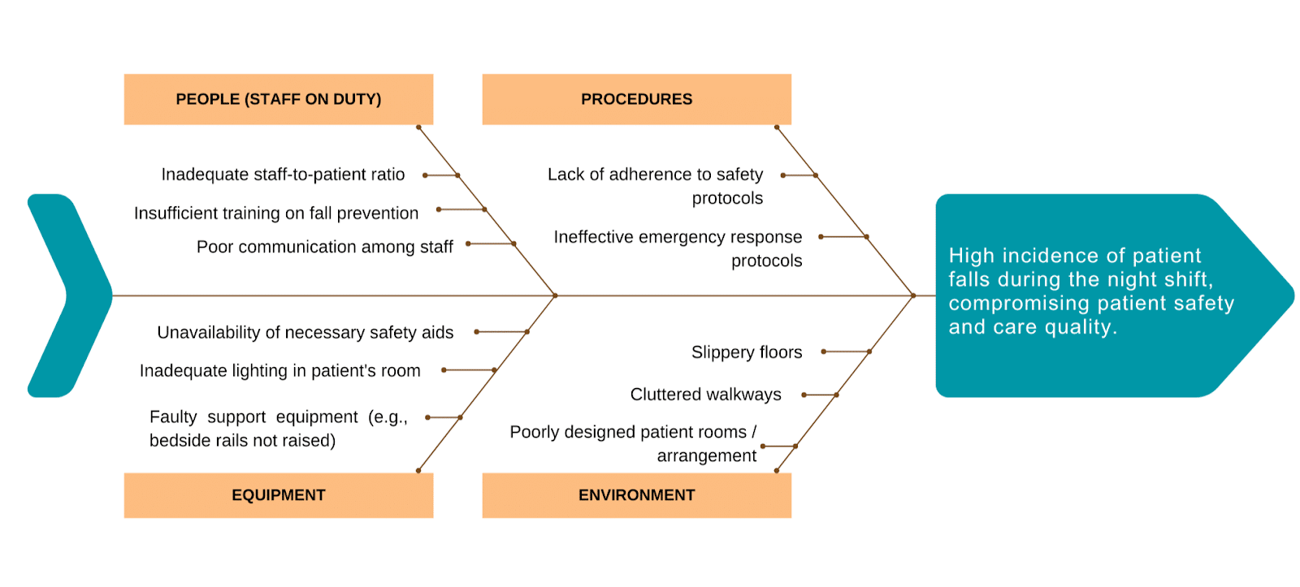
Root Cause Analysis Tools
Fishbone (Ishikawa) Diagram -- Group Exercise (FINISHED DIAGRAM SHOULD LOOK LIKE THIS)

Slide 64
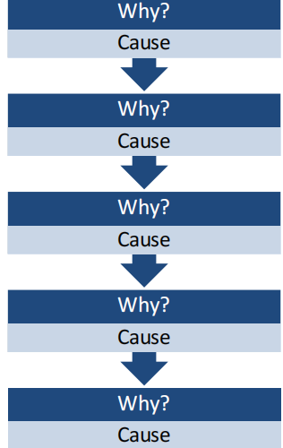
Root Cause Analysis Tools
2) 5 Whys Technique
For an Effective Root Cause Analysis.
When to Use 5 Why?
Service Delivery Issues
Internal Issues (optional)
Quality and System control issues

Slide 65
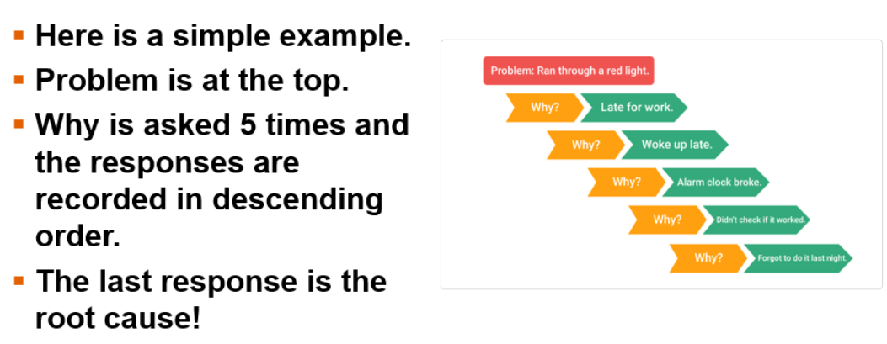
Root Cause Analysis Tools
2) 5 Whys Technique
EXAMPLE

Slide 66
Root Cause Analysis: Scenario-Based Group Activity
Instruction: In 4 groups of 3 persons, review the Postpartum Hemorrhage Management scenario and create a Cause-and-Effect Diagram.
Time: 45 minutes
Materials: Flipchart paper, markers, Cause & Effect handout
Scenario:
In facility A, postpartum hemorrhage accounts for most of the maternal referrals and mortalities. Management of postpartum hemorrhage is very important in the reduction of marternal morbidity and mortality. As part of management, timely referral of hemorrhaging mothers is key, yet there is delay in the referral of patients, and it usually takes up to 8hours on foot for patients to reach the nearest health facility which has comprehensive obstetric and newborn care.
A County Level Team is tasked with identifying root causes and proposing actionable solutions to improve quality of care.

Slide 67
Root Cause Analysis Group Activity Cont’d
Exercise Steps:
1. Create a Cause and Effect Diagram categorizing reasons for
delay in referral (TEMPLATE TO BE COMPLETED BY PARTICIPANTS)
Methods (of Referral)
Machinery (Modes of Patient Transportation)
Management (Prior to and during Referral)
Materials (Medicines, and Medical Consumables used during Referral)
Manpower (Healthcare Providers and Patient Care-givers)

Slide 68
Root Cause Analysis Group Activity Cont’d
Exercise Steps:
1. Create a Cause and Effect Diagram categorizing reasons for
delay in referral
TEMPLATE TO BE COMPLETED BY PARTICIPANTS
METHODS
MACHINERY
EFFECT
MANAGEMENT
MATERIALS
MANPOWER

Slide 69
Root Cause Analysis Group Activity Cont’d
Exercise Steps:
2. Prioritize causes and apply the 5 Whys technique
3. Identify potential solutions to root causes
4. Choose one solution to test, and describe how you'd measure impact
Final Outputs:
• Completed Cause and Effect Diagram
• Prioritized list of root causes
• Improvement idea with a brief implementation/testing plan

Slide 70


Slide 71
Session 4.4 : PDSA Cycle (Part I)

Slide 72
Quality Improvement and the Improvement Cycle in Retrospect
In Primary Health Care (PHC), quality is defined by the extent to which services are safe, effective, and people-centered, delivered in a way that achieves desired health outcomes while balancing efficiency, equity, and timeliness.
The ultimate goal is to support universal health coverage by making sure that essential care is accessible, high-quality, and meets individuals' needs and values.

Slide 73
Quality Improvement and the Improvement Cycle in Retrospect
Models for Quantifying or Measuring Quality:
1) SERVQUAL model (the gap model of service quality)
2) CIPP model (Context Inputs Processes and Products)
3) Logic model (Reflect...what is it?)
4) Donabedian model (Reflect...what is it?)

Slide 74
Quality Improvement and the Improvement Cycle in Retrospect
Basic Elements of Quality:
1) Safety
2) Effectiveness
3) Patient-Centeredness
4) Timeliness
5) Efficiency
6) Equity
Quality Improvement : Systematic and continuous actions that lead to measurable improvement in healthcare services and the health status of targeted patient groups.

Slide 75
Quality Improvement and the Improvement Cycle in Retrospect
The Improvement Cycle:

Slide 76
Quality Improvement and the Improvement Cycle in Retrospect
QI Tools:
1) Brainstorming
2) Nominal group technique
3) Affinity Diagrams
4) Five Whys
5) Fishbone (Ishikawa)
6) Pareto
QI Tools:
7) Process Mapping
8) Force Field Analysis
9) Cause & Effect
10) Diagrams
11) PDSA Cycle √

Slide 77
The PDSA CYCLE

Slide 78

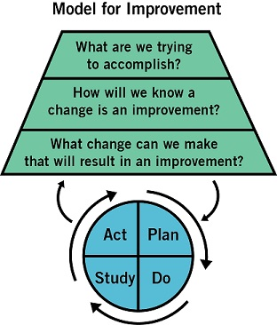
How Can We Improve?
1. Will. You must have the will to improve
3. Execution. You must make it real.
2. Ideas. You must have ideas about alternatives to the status quo.

Slide 79
Steps In A PDSA Cycles
Step 1: Set an Aim
How good?
For whom?
By when?
...............................................
Bold
Realistic
Clear
Concise
Measureable
Meaningful

Slide 80
Steps In A PDSA Cycles
Which is the better aim statement?
Reduce all types of hospital-acquired infections by as much as possible, as quickly as possible.
Decrease the rate of hospital-acquired pneumonia for patients in the ICU from 23 infections per 1,000 catheter days to less than 5 infections per 1,000 catheter days by December 31.

Slide 81
Steps In A PDSA Cycles
Step 2: Establish Measures
Outcome measures
Process measures
Balancing measures
...............................................
Where are we going?
What are we doing?
What else is happening?

Slide 82
Steps In A PDSA Cycles
Step 2: Establish Measures
Which measure is which?
Average number of times patients receive recommended oral care in 24 hours process
Patient and staff satisfaction scores balancing
Rate of hospital-acquired pneumonia per 1,000 catheter days in the ICU outcome

Slide 83
Steps In A PDSA Cycles
Step 3: Developing Changes
Process analysis tools
Benchmarking
Technological solutions
Creative thinking
Change concepts

Slide 84
Steps In A PDSA Cycles: Change Concepts
Eliminate waste
Improve workflow
Optimize inventory
Enhance the producer-customer relationship
Change the work environment
Manage time
Manage variation
Design systems to prevent errors
Focus on the design of products and services

Slide 85
Steps In A PDSA Cycles: Change Concepts
What changes could improve oral care in the ICU?
Improve workflow
Optimize inventory
Change the work environment
Manage variation
Design systems to prevent errors
Other ideas?

Slide 86
Steps In A PDSA Cycles: Change Concepts
What changes could improve oral care in the ICU?
Improve workflow Ensure mouth-cleaning supplies are kept in ready-to-go state
Optimize inventory Ensure toothbrushes, mouthwash, etc. are consistently available
Change the work environment Train hospital staff on proper mouth-cleaning technique and importance
Manage variation Update oral care policy to be consistent with International guidelines for all patients
Design systems to prevent errors Post the oral-care protocol in visible places

Slide 87

Steps In A PDSA Cycles
Step 4: Testing Changes

Slide 88
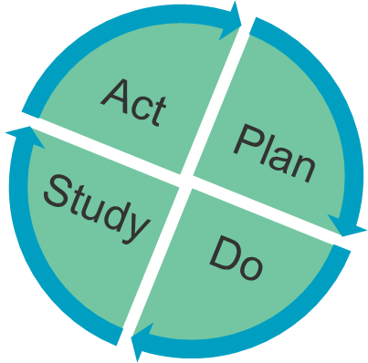

Steps In A PDSA Cycles
Step 4: Testing Changes
Plan
  Questions & predictions
  Who/what/where/when?
Do
  Observe the test
  Document results
Study
  Draw run charts
  Analyze the data
Act
  Refine the change and plan for the next cycle

Slide 89
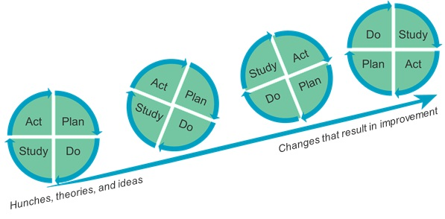


Linking PDSA Test Cycles
Start small
Think ahead
Don’t wait to begin!

Slide 90
PDSA Test Cycles: End of Lectures Discussion
What PDSA cycles do you use in your daily work, even if that’s not the name you use for them?
What’s the value of a failed PDSA cycle?
Think about the last PDSA cycle you ran in your personal life — even if you didn't know it was a PDSA cycle at the time. Was it successful? Why or why not?

Slide 91
BREAK

Slide 92
A Walkthrough on Applying the PDSA Cycle - An Example
The Scenario:
Facility: Teyah’s Community Clinic
Problem: The average patient wait time is 45 minutes.
Goal: Reduce the average patient wait time to ≤15 minutes within one month.
Hypothetical Intervention: Implementing a new patient triage system where a nurse conducts a brief assessment upon arrival to better prioritize and direct patients.

Slide 93
A Walkthrough on Applying the PDSA Cycle - An Example
Plan: Develop a Hypothesis and Test Plan
The "Plan" stage involves defining the objective, predicting the outcomes, and outlining the specifics of the small-scale test
Steps:
1) Define the Objective: Implement a new nurse triage system to improve patient flow and reduce average wait times.
2) Formulate a Prediction: We predict that by triaging patients at the front desk, we can reduce average wait times by at least 50% for those patients in the test group, without negatively impacting the quality of care or staff workload.

Slide 94
A Walkthrough on Applying the PDSA Cycle - An Example
Plan: Develop a Hypothesis and Test Plan
Steps:
3) Establish Metrics: We will measure average wait time (time from check-in to being seen by a provider) and patient satisfaction scores.
4) Develop the Test Plan:
i) Who: Nurse Betty (who helped design the new system) and the front desk staff.
ii) What: The new triage system will be tested on Monday and Tuesday afternoons only.

Slide 95
A Walkthrough on Applying the PDSA Cycle - An Example
Plan: Develop a Hypothesis and Test Plan
Steps:
4) Develop the Test Plan:
iii) When: The test will run for two weeks (four afternoon sessions total).
iv) Where: The main clinic reception area.
v) Data Collection: Front desk staff will record check-in times and "seen by provider" times for all test patients

Slide 96
A Walkthrough on Applying the PDSA Cycle - An Example
Do: Execute the Plan on a Small Scale
The "Do" stage is where the planned change is carried out. This is a deliberate test, not a full implementation.
Steps:
1) Communicate: Nurse Betty and front desk staff are briefed on the new procedures and data collection methods.
2) Execute the Test:
i) On the designated Monday and Tuesday afternoons, Nurse Betty is positioned at the front desk.

Slide 97
A Walkthrough on Applying the PDSA Cycle - An Example
Do: Execute the Plan on a Small Scale
Steps:
2) Execute the Test:
ii) As patients arrive, she quickly assesses them and directs them to the appropriate area (e.g., immediate exam room, waiting area, a specific lab).
iii) Staff conscientiously record the required time data.
3) Monitor and Document Issues: Throughout the process, the team documents any unforeseen problems, such as a patient refusing the triage, or a bottleneck developing in an exam room.

Slide 98
A Walkthrough on Applying the PDSA Cycle - An Example
Study: Analyze the Results and Learn
The "Study" stage involves analyzing the data collected in the "Do" stage and comparing the results to the original prediction
Steps:
1) Review the Data: The team collects all recorded times and calculates the average wait time for the test patients across the four sessions.
2) Compare to Prediction:
i) Prediction: Average wait time reduced by 50%.

Slide 99
A Walkthrough on Applying the PDSA Cycle - An Example
Study: Analyze the Results and Learn
Steps:
2) Compare to Prediction:
ii) Actual Results: The average wait time for test patients was 25 minutes, a 44% reduction from the original 45 minutes
3) Analyze Learnings: The team observes that while wait times improved significantly, a new bottleneck was created in one specific exam room. They also noted high patient satisfaction with the quicker initial interaction

Slide 100
A Walkthrough on Applying the PDSA Cycle - An Example
Study: Analyze the Results and Learn
Steps:
4) Summarize: The test was a success but requires a minor adjustment to address the new bottleneck before expanding the scope.
Act: Adopt, Adapt, or Abandon
The "Act" stage is where the team uses the insights gained from the "Study" phase to decide their next steps.

Slide 101
A Walkthrough on Applying the PDSA Cycle - An Example
Act: Adopt, Adapt, or Abandon
Steps:
1) Decision: Based on the positive results and clear area for improvement, the team decides to adapt the intervention.
2) Adapt the Plan: The team modifies the process to address the bottleneck (e.g., assigning a second medical assistant to the specific exam room when the triage system is active).

Slide 102
A Walkthrough on Applying the PDSA Cycle - An Example
Act: Adopt, Adapt, or Abandon
Steps:
3) Prepare for the Next Cycle:
i) The team plans a second PDSA cycle. The "Plan" for this next cycle will test the modified triage system (now with the extra medical assistant support) over a full week instead of just two afternoons.
ii) If that cycle is successful, the change will eventually be adopted as the new standard operating procedure for the entire clinic.

Slide 103
A Walkthrough on Applying the PDSA Cycle - An Example
This process of planning, doing, studying, and acting allows the clinic to implement meaningful changes while minimizing risk and maximizing efficiency!

Slide 104
A Walkthrough on Applying the PDSA Cycle
In Maryland County, Rural Liberia, Facility X saw a decline in ANC Visits in Q2 and Q3 of 2025.
Q2 ANC Visits (Target) | Q2 ANC Visits (Actual) | Q3 ANC Visits (Target) | Q3 ANC Visits (Actual)
2,500 | 2,300 | 2,500 | 2,000

Slide 105
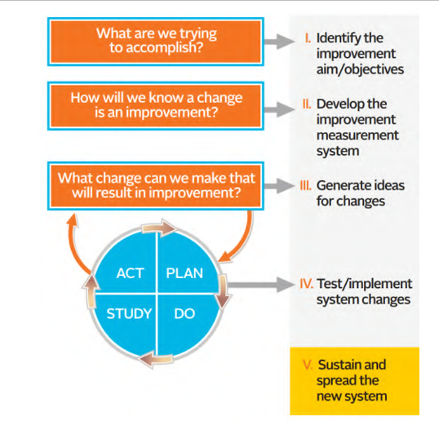
A Walkthrough on Applying the PDSA Cycle
In Maryland County, Rural Liberia, Facility X saw a decline in ANC Visits in Q2 and Q3 of 2025.
At the community level:
Establish goals for the number of pregnant women that community health workers— CHAs, CHVs, CHSS and trained traditional midwives (TTMs) who work for the facility should refer to ANC services.
Launch of a door-to-door campaign by community health workers and TTMs to communicate the importance of initiating ANC during the first trimester.

Slide 106
A Walkthrough on Applying the PDSA Cycle
In Maryland County, Rural Liberia, Facility X saw a decline in ANC Visits in Q2 and Q3 of 2025.
At the community level:
Integrate comprehensive ANC services into clinical outreach (mobile clinics), to ensure facility-based health providers, including maternal and child health (MCH) nurses, provide integrated health services within the community
Increased frequency of outreach in the communities (weekly).

Slide 107
A Walkthrough on Applying the PDSA Cycle
In Maryland County, Rural Liberia, Facility X saw a decline in ANC Visits in Q2 and Q3 of 2025.
At the facility:
Training of MCH nurses in the early diagnosis of pregnancy using physical examination and assessment of presumptive signs and symptoms
Set targets for clinicians to screen for cases of amenorrhea (absence of menstrual period) in all women of childbearing age and refer to ANC services, if indicated.

Slide 108
A Walkthrough on Applying the PDSA Cycle
In Maryland County, Rural Liberia, Facility X saw a decline in ANC Visits in Q2 and Q3 of 2025.
At the facility:
Have MCH nurses give daily morning talks to patients in the general waiting area seeking services in the facility about the importance ANC visits.

Slide 109
A Walkthrough on Applying the PDSA Cycle
With the measures stated in the walkthrough, there is an expected increase in ANC Visits at facility X for Q4.

Slide 110
Session 4.5 : PDSA Cycle (Part II):
GROUP ACTIVITIES

Slide 111

PDSA ACTIVITY 1
COIN SPINNING ACTIVITY
Coin spinning—it’s a thing!
Longest coin spinning duration
Who: Keita Hashimoto
What: 25.71 seconds
Where: Tochigi, Japan
When: 17 July 2014
Do you have any theories on how Keita can spin a coin for so long?

Slide 112
PDSA ACTIVITY 1
COIN SPINNING ACTIVITY
Participants are divided into 6 groups (6 tables)
Two contestants per table. Pairing from different facilities or different counties encouraged.

Slide 113
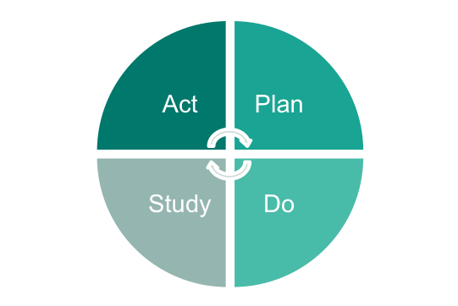
PDSA (Plan–Do–Study–Act) Cycle-Practice
COIN SPINNING ACTIVITY
BASELINE TEST
PLAN – Record your current theory and a prediction
Time starts when the coin starts spinning
Time stops when the coin stops wobbling and lays flat
DO – Record results and other observations
STUDY – Study results and record learning
ACT – Decide what to test next

Slide 114
PDSA (Plan–Do–Study–Act) Cycle-Practice
COIN SPINNING ACTIVITY
OUR NEW AIM:
By the end of this session, we will increase the length of time we spin a coin by 50%.

Slide 115

PDSA (Plan–Do–Study–Act) Cycle-Practice
COIN SPINNING ACTIVITY
LET’S SPIN SOME COINS!
Objective
Spin a coin for the longest amount of time (15 min)
Materials
Coins -quarter, dime, nickel, penny
Plan-Do-Study-Act (PDSA) tracker form
Smartphone timer
Directions
Get into 4 groups of 3 people (2 teams per table)
Designate a spinner, timekeeper, and recorder
Time starts when the coin starts spinning
Time stops when the coin stops wobbling and lays flat

Slide 116
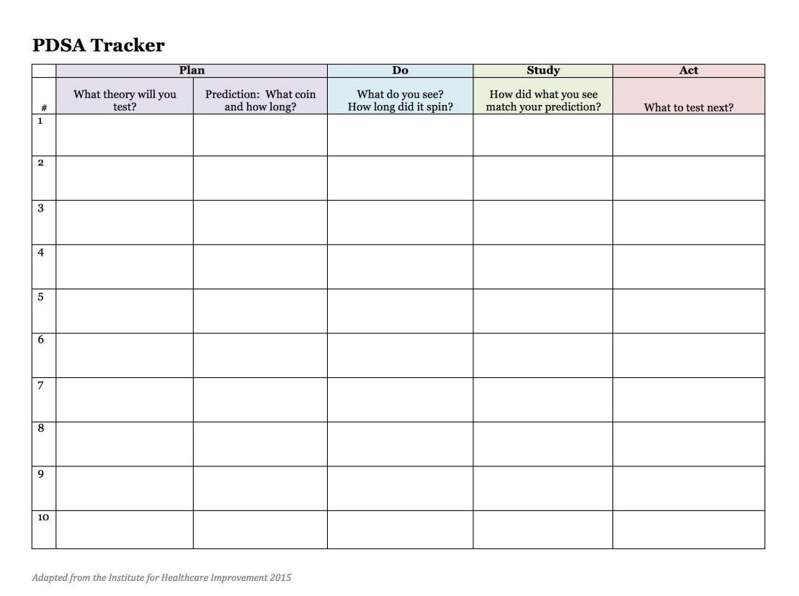
PDSA (Plan–Do–Study–Act) Cycle-Practice
COIN SPINNING ACTIVITY (TABLE TO COMPLETE)

Slide 117
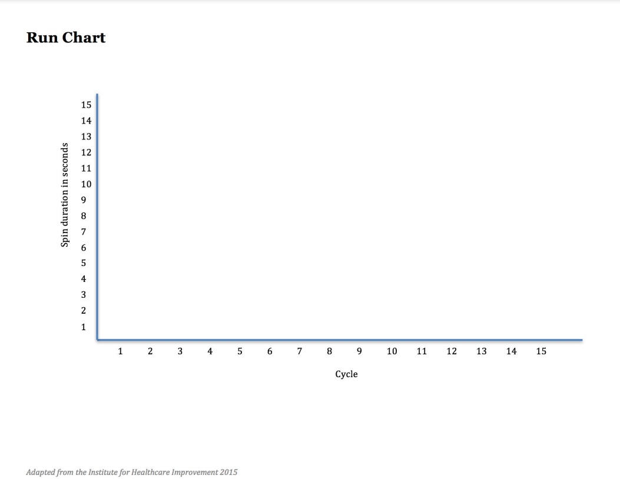
PDSA (Plan–Do–Study–Act) Cycle-Practice
COIN SPINNING ACTIVITY (GRAPH TO COMPLETE)

Slide 118
PDSA (Plan–Do–Study–Act) Cycle-Practice
COIN SPINNING ACTIVITY
LET’S SPIN COINS AGAIN!
For Each Cycle
PLAN – Record your current theory and a prediction
Time starts when the coin starts spinning
Time stops when the coin stops wobbling and lays flat
DO – Record results and other observations
STUDY – Study results and record learning
ACT – Decide what to test next
Run as many cycles as possible

Slide 119

PDSA (Plan–Do–Study–Act) Cycle-Practice
COIN SPINNING ACTIVITY

Slide 120

PDSA (Plan–Do–Study–Act) Cycle-Practice
COIN SPINNING ACTIVITY
DISCUSSIONS (Per Group)
What’s your theory about what makes a coin spin for a long time?
Did your theory change as you conducted tests? If so, in what ways? What did you learn?
What roles did recording your theory and making a prediction play for you in the testing cycle?
What value did you see in each step in the PDSA process?

Slide 121
PDSA ACTIVITY 2
FALLACY ACTIVITY
Fallacy: a mistaken belief, especially one based on unsound argument.
It is important to identify and debunk fallacies surrounding PDSA cycle to garner support for their implementation!

Slide 122
PDSA ACTIVITY 2
FALLACY ACTIVITY
Instructions to Participants:
• Different fallacies are posted around the room (on large sheets of paper)
• All participants: take 20 minutes to walk around
• Write why the fallacy is mistaken on a post-it note and stick it on the
fallacy sheet
• Example of a fallacy: “If the test fails, we will look bad”
• Example of why the fallacy is mistaken: Every test is an opportunity to learn

Slide 123
PDSA ACTIVITY 2
FALLACY ACTIVITY
Fallacies
Fallacy 1: “You can only run a PDSA cycle once you have the perfect change idea and implementation plan”
Why is this not true?
Fallacy 2: “We don’t need to test this change idea, because it has been tested elsewhere”
Why is this not true?

Slide 124
PDSA ACTIVITY 2
FALLACY ACTIVITY
Fallacies
Fallacy 3: “We need to firmly stick to the plan”
Why is this not true?
Fallacy 4: “If the change appears to work, we don’t need to study it”
Why is this not true?

Slide 125
PDSA ACTIVITY 2
FALLACY ACTIVITY
Fallacies
Fallacy 3: “We need to firmly stick to the plan”
Why is this not true?
Fallacy 4: “If the change appears to work, we don’t need to study it”
Why is this not true?

Slide 126
PDSA ACTIVITY 2
FALLACY ACTIVITY
Fallacies
Fallacy 5: “One test is enough”
Why is this not true?
Fallacy 6: “If the test fails, we will look bad”
Why is this not true?
Fallacy 7: “This is not how we do it...”
Why is this not true?

Slide 127
Questions & Discussions !

Slide 128
Facilitators Meeting: Feedback

