Slide 1

PHC Quality Improvement Training
Day 4:
Quality Improvement (QI) and Data Communication

Slide 2



Course Overview
Session 4.1: Introduction to Quality and Quality Improvement
Session 4.2: Process mapping
Session 4.3: Root cause analysis
Session 4.4: Developing change ideas
Session 4.5: Conducting the PDSA cycle
Session 4.6: Wrap-up and reflection
Notes:
Process mapping is a not a root cause analysis tool,4.5 has been edited
Session 4.8 & 4.9 removed ,changed 4.14 to 4.9

Slide 3

Session 4.1:
Introduction to Quality and Quality Improvement

Slide 4

4.1 Introduction
Defines Quality Planning, Quality Improvement (QI), and Quality Assurance (QA).
Explains how data analysis identifies gaps in health service delivery.
Highlights the use of measures of central tendency (mean, median) to interpret data.
Development of a SMART QI Project Aim Statement
Describes facility performance assessment methods including the Gemba Walk approach
Introduces key Root Cause Analysis tools:
Examines management-related and psychological factors influencing facility performance
Family of measures
Principles of a SMART change idea/intervention
Plan-Do-Study-Act (PDSA) model using SMART indicators within the PDSA cycle & data analysis
QI introduction
Notes:
Operation Phuthuma removed

Slide 5

4.1. Introduction-Quality Management components in Health Care
Juran’s Trilogy
Quality
Planning
Quality Planning : design systems to meet patient needs. Policy ,guidelines and SOP development phase
Quality Assurance – monitor compliance with standards (OHSC, Ideal Clinic).
Quality Improvement – close performance gaps using root cause analysis + interventions.
Quality
Improvement
Quality
Control

Slide 6
4.1. Introduction: Definition of Quality health Care in PHC settings
This refers to the delivery of accessible, safe, patient-centred, evidence-based and efficient care that meets the health needs of individuals and communities. It ensures that services are provided timely, respectfully, and in a manner that upholds the standards set by the National Core Standards,Ideal Clinic Realization and Maintenance (ICRM) programme
Dimensions of Quality Management
For people who use the services | For those providing services
Safe: Health care services rendered by well trained staff who can diagnose correctly and prescribe the correct treatment. | Well-led - They are open and collaborate internally and externally and are committed to learning and improvement.
Effective: receive health care services timeously ,no long waiting time | Sustainable - They use their resources responsibly and efficiently, providing fair access to all, and according to need of their populations
Patient centered: Crae is respectful and responsive to your needs and values | Equitable - They provide care that does not vary in quality because of a person’s characteristics.
Notes:
Slide decongested

Slide 7

4.1 Introduction-Definition of Quality Improvement
in Health Care
Key principles
Definition of QI in healthcare – It is a systematic, data-driven, team-based approach to improving patient care, safety, efficiency, and outcomes (Jones, B. 2019)
We propose defining it is the combined and unceasing efforts of everyone—healthcare professionals, patients and their families, researchers, payers, planners and educators to make the changes that will lead to better patient outcomes (health), better system performance (care) and better professional development (learning) by (Batalden et al. 2007)
Identify gaps in care
Understand root causes
Test interventions (PDSA cycle)
Measure progress with data
Notes:
This slide belongs in session 4.1

Slide 8
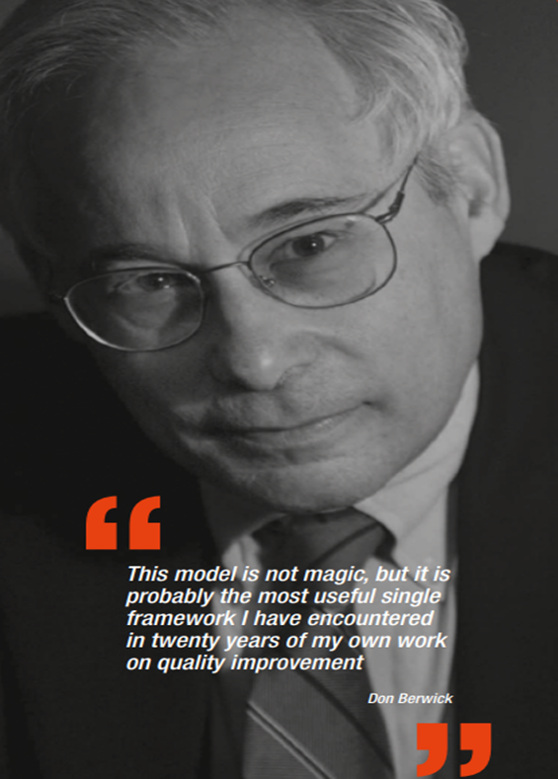
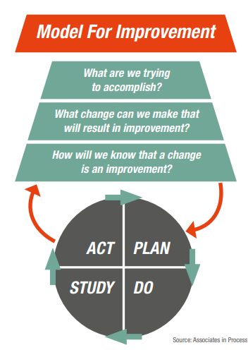
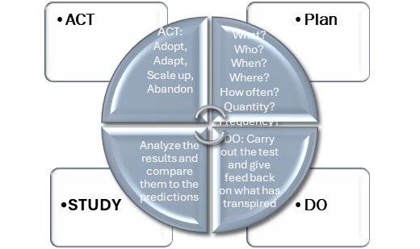
4.1. Model for Improvement in Health Care
According to Don Berwick and Colleagues Explain the ‘How-to Guide’ for Quality Improvement Model is a simple, structured framework that helps teams make meaningful and measurable improvements in health care . It is built in 2 parts
Three fundamental questions | 2. PDSA Cycle

Slide 9



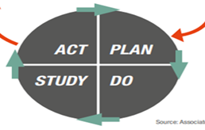

4.1 Similarities between OP/QI & Ideal clinic
Ideal clinic Continuous Quality Improvement (CQI)
Assess: Baseline medians established, root causes done & QI plans developed | Aim statement set Root Cause Analysis done change idea developed | Assess compliance and set baseline performance; use feedback and gap analysis for root cause identification. Develop structured improvement plans with clear actions, responsibilities, and timelines
Analyze: determine the impact of the change idea | Study: what are the lessons learned | CQIP review to analyze the impact of the change as per PDSA cycle
Anchor: Develop SOP and implement | Act: Adopt, Adapt, Abandon , scale up | Act: Adopt, Adapt, Abandon , scale up
Notes:
Slide decongested

Slide 10
Session 4.2:
Developing an Aim statement

Slide 11

4.2 Introduction-Aim statement Development
Definition: An Aim Statement in a Quality Improvement (QI) project is a clear, concise, and specific declaration of what the team intends to achieve within a defined timeframe
Benefits
Provides Clear Direction-defines what the team wants to achieve
It sets measurable targets for objective tracking of progress
Aligns Team Efforts towards common goals
Guides selection of interventions to achieve desired goals
4.1 Definition of an Aim
statement and its benefits
Specific
Clearly defines what need to improve & which areas
Measurable
Includes numerical targets & track progress
achievable
Realistic given the resources and constraints
Relevant
Aligns with strategic goals
Model for Improvement 1st question :What are trying to achieve ?
Notes:
Slide decongested

Slide 12

4.2 Introduction-Aim statement Development
4.1 Definition of an Aim
statement and its benefits
SMART Aim Statement Template
At (Facility Name)__________________we aim to improve (Indicator Name)_______________,from a baseline median of _______________________ , to a post QI median of _____________ by (date) ______________________
Model for Improvement 1st question :What are trying to achieve ?

Slide 13
4.2 Introduction-Aim statement Development
Analyze if the following aim statements are SMART
4.1 Group Exercise
Aim statement | Yes/No
I aim to lose weight to 60kg by Dec 2020
At Boipelo clinic we aim to improve the viral load uptake rate a weekly baseline median of 60% ( 8 data points from Feb ‘25-Mar ‘25) to a post QI median of 95% by 30 June 2025
At Palms clinic we aim to improve TB screening from a weekly baseline median of 68% to post QI median of 95% by 30 November 2020
I aim to arrive at work by 07:00 daily in the next 6 months

Slide 14
Session 4.3:
Process Mapping

Slide 15

4.3 Process Mapping
Definition of a Process Map tool
Definition of a Process Mapping tool
Functions of Process Mapping
Definition: A process map is an effective tool that provides a clear visual representation of the key activities and tasks within a process, illustrating how they are connected and interact with one another.
Visualize workflow :Map out steps in a process
Identify inefficiencies: bottle necks waste , etc
Improve Quality: Steam-line processes ,reduce errors and enhance patient care
Standardize procedures consistent workflow& protocols
Enhance communication: clarify roles , responsibilities and expectations
Functions of a Process Mapping Tool
Model for Improvement 2nd question :What change can we make to lead to an improvement
Notes:
Slide decongested into 3

Slide 16
4.3 Process Mapping-Symbols of Process Mapping
Oval: for beginning or end
Rectangle: for Task or activity
Diamond : decision making point
Document symbol: Document or record
Arrow : Direction
It is Important to map out what happens not what should happen
Symbols of Process Mapping
Model for Improvement 2nd question :What change can we make to lead to an improvement
Notes:
Decongested into 3

Slide 17
4.3 Process Mapping –Group exercise
Develop a process map of ordering food at a restaurant. Use the above provided process map symbols ,thus
Oval: for beginning or end
Rectangle: for Task or activity
Diamond : decision making point
Document symbol: Document or record
Definition of a Process Mapping tool
Functions of Process Mapping
Symbols of process mapping
Group Exercise on developing Process Map
Identification of bottlenecks , waste, unnecessary steps
Model for Improvement 2nd question :What change can we make to lead to an improvement
Notes:
Process slide decongested into 3

Slide 18
4.3 Process Mapping-Symbols of Process Mapping
Group exercise
Oval: for beginning or end
Rectangle: for Task or activity
Diamond : decision making point
Document symbol: Document or record
Arrow : Direction
Group exercise
Use the guidance (shapes) provided to develop a process map of ordering food in the restaurant until payment
Symbols of Process Mapping
It is Important to map out what happens not what should happen
Model for Improvement 2nd question :What change can we make to lead to an improvement
Notes:
Decongested into 3

Slide 19
Session 4.4:
Gemba Walks

Slide 20

4.4 Process Mapping-Gemba Walk
A Gemba Walk is a management practice where leaders or supervisors go to the actual place where work happens.
It is not a Root Cause Analysis tool but rather an information gathering or verification strategy when conducting root cause exercise
Direct Observation of Work Processes
  Facility managers and QI leaders visit service points (e.g., reception, consulting rooms, pharmacy, lab) to see how work is done rather than relying on reports.
  This helps identify inefficiencies, delays, and workflow gaps affecting performance.
Engage with Frontline Staff
  Managers interact with staff to understand challenges, gather insights, and recognize good practices.
  This promotes open communication and strengthens teamwork.
Notes:
Gemba walk slides decongested and moved to process map section

Slide 21
4.4 Process Mapping-Gemba Walk
A Gemba Walk is a management practice where leaders or supervisors go to the actual place where work happens.
It is not a Root Cause Analysis tool but rather an information gathering or verification strategy when conducting root cause exercise
Identify Root Causes of Problems
  Observations made during the walk help uncover underlying causes of performance issues (e.g., long waiting times, stockouts, data errors).
  These insights inform targeted Quality Improvement actions.
Promote Continuous Improvement and Accountability
  Findings are discussed with the team to develop and implement corrective measures.
  Regular Gemba Walks create a culture of ongoing learning, problem-solving, and accountability for performance outcomes.
Notes:
Gemba walk slides decongested and moved to process map section

Slide 22
4.4 Process Mapping- Gemba Walk Principles
A Gemba Walk is a management practice where leaders or supervisors go to the actual place where work happens.
It is not a Root Cause Analysis tool but rather an information gathering or verification strategy when conducting root cause exercise
When conducting a Gemba walk, a health-care clinic manager should use simple, practical tools to observe and understand how the system really works. Key tools include a Gemba checklist, current-state process map, observation notes, basic data collection tools, SOPs, and root cause analysis tools (e.g. 5 Whys). Respectful questioning, patient flow diagrams, and an action tracker help identify waste, bottlenecks, and improvement opportunities, ensuring observations lead to meaningful quality improvement rather than blame
Notes:
Gemba walk slides decongested and moved to process map section

Slide 23
4.4 Process Mapping –Process Map analysis
Concept | Findings
Waste | This step does not add value
Unnecessary step | This step is not required
Parallel step | This step can be done at the same time same time as another
Bottleneck | This step slows down the entire process
Process Mapping Analysis-
Identification of bottlenecks , waste, unnecessary steps
Benefits of Process map analysis
Identifying waste, unnecessary steps, and parallel steps helps teams to:
Reduce waiting times
Improve patient flow
Use staff time more efficiently
Simplify processes before testing change ideas (PDSA)
Model for Improvement 2nd question :What change can we make to lead to an improvement
Notes:
New slide to give guidance on what parallel steps , unnecessary steps ,waste and how to identify them

Slide 24
Session 4.5:
Root Cause Analysis

Slide 25
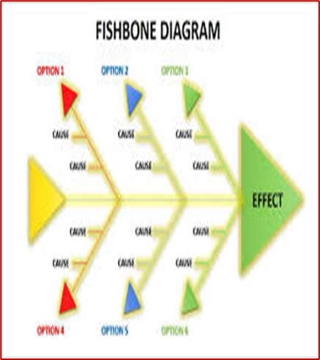
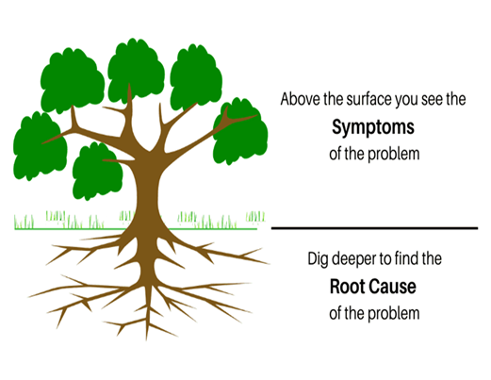
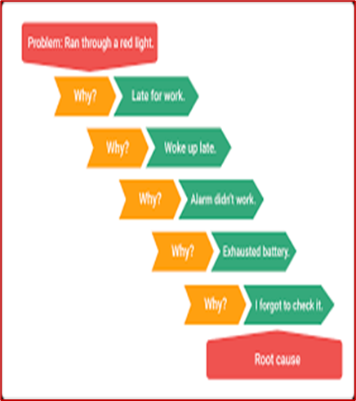
4.5 Root Cause Analysis-Definition of Root cause analysis (fishbone & 5 WHYS)
Root Cause analysis tools
Fishbone
5 WHYS
Definition of Root Cause Analysis: is a structured method to identify the underlying causes of a problem or adverse event, aiming to implement solutions that prevent it from recurring
The Root Cause Analysis are as follows
Fishbone is used when there are multifaceted contributory factors that cause the underperformance
5 WHYs is used to drill deeper once the gap is found in the system , it can be used to compliment Fishbone or Process Map
Model for Improvement 2nd question :What change can we make to lead to an improvement

Slide 26

4.5 Root cause analysis-Fishbone
Definition of a Fishbone Diagram, also called the Ishikawa Diagram or Cause-and-Effect Diagram, is a visual tool used to systematically identify and organize potential causes of a problem. It looks like a fish skeleton, with the “head” representing the problem and the “bones” representing categories of possible causes
Purpose : Organize all possible causes under structured categories (e.g staff, processes, resources) to identify root causes and prioritize areas of improvements
It is used when there are complex problems with multiple contributing factors e.g Long waiting times in ART clinics due to staff shortages, unclear protocols etc
Root Cause analysis tools
Fishbone
5 WHYS
Model for Improvement 2nd question :What change can we make to lead to an improvement
Notes:
decongested

Slide 27
4.5 Root cause analysis-Fishbone diagram completion
Group Exercise (Steps to follow)
Topic: Low Viral Load (VL) Uptake Rate in Children <5 Years
Define the Problem Clearly
  Write the problem at the “head” of the fish : “ Low VL uptake rate in children <5 years”
Brainstorm Possible Causes
  Break into small teams and list all possible reasons why VL uptake is low . Encourage thinking across categories:
    People: Staff shortages, lack of training, caregiver knowledge gaps.
    Process: Poor documentation, unclear VL monitoring schedule.
    Equipment: Limited lab machines, sample transport delays.
    Environment: Overcrowded clinics, rural access issues.
    Materials: Stock-outs of test kits or reagents.
    Policy: Delayed guideline updates, weak monitoring systems
Theme and Organize Causes
    Place each cause under the relevant category on the Fishbone diagram.
    Use flip charts or a whiteboard for visibility
Model for Improvement 2nd question :What change can we make to lead to an improvement
Notes:
decongested

Slide 28
4.5 Root cause analysis-Fishbone diagram completion
Group Exercise (Steps to follow)
4. Drill Deeper (Optional but Recommended)
Use 5 Whys within each category to dig into the root causes. e.g:
  Cause: “File not flagged for VL”
  Why? ART start date missing
  Why? Clinician rushed
  Why? Only one clinician sees HIV patients
  Why? Staff shortage
  Why ? Budget constraints
5. Complete the Fishbone
  Add all findings (including deeper causes) to the diagram.
  This gives a visual map of direct and underlying causes
Prioritize Solutions
  Discuss which root causes are most impactful and feasible to address.
  Link to quality improvement actions (e.g., staff training, SOP updates, electronic flagging)
Model for Improvement 2nd question :What change can we make to lead to an improvement
Notes:
decongested

Slide 29
4.5 Root causes analysis-5 WHYs Root cause
Best for: Simple or moderately complex problems where a single main cause is suspected.
Root Cause analysis tools
5 WHYs definition
Purpose
Steps to Follow
Definition of 5 Whys:
The 5 Whys is a simple, structured problem-solving technique used to identify the root cause of an issue by repeatedly asking the question “Why?” (usually five times, but as many as needed). Each answer forms the basis of the next question, drilling deeper until the fundamental cause is uncovered.
Purpose
To move beyond symptoms and find the underlying cause of a problem.
To support quick decision-making and corrective action.
Steps
Define the problem clearly then Ask “Why did this happen?” and write down the answer.
Repeat the question for each answer until you reach the root cause.
video on 5 whys with practical example - Google Search
Model for Improvement 2nd question :What change can we make to lead to an improvement
Notes:
decongested

Slide 30
4.5 Root cause analysis- 5 WHYs example
Root Cause analysis tools
5 WHYs
Purpose
Steps to Follow
Examples:
  Missed Viral Load Monitoring:
    Why was VL not done? → File not flagged.
    Why not flagged? → ART start date missing.
    Why missing? → Clinician rushed.
    Why rushed? → High patient load.
    Why high load? → Only one clinician sees HIV patients.
  Stock-Out of ARVs:
    Why stock-out? → Late order.
    Why late? → Staff didn’t follow schedule.
    Why? → No clear SOP or training.
video on 5 whys with practical example - Google Search
Model for Improvement 2nd question :What change can we make to lead to an improvement

Slide 31
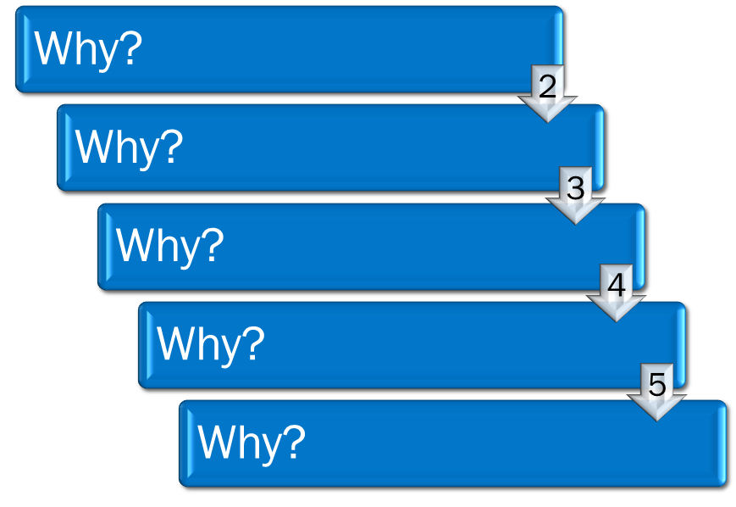
4.5 Root cause analysis-Group Exercise
on utilization of the 5 WHYs
Fun Group Exercise
Scenario: Blocked Kitchen Sink – 5 Whys Root Cause Analysis
A household reports that the kitchen sink is blocked, and water is no longer draining properly. This has disrupted daily activities such as washing dishes and food preparation. The household is requested to conduct a 5 Whys Root Cause Analysis to understand the real reason for the blockage and prevent it from happening again, rather than just unblocking the sink temporarily
1
Model for Improvement 2nd question :What change can we make to lead to an improvement

Slide 32
Session 4.6:
Developing change ideas

Slide 33

4.6 Developing change ideas-Intervention
Intervention
Principles of developing change idea
PDSA cycle model
Group exercises
QI monitoring template
Model for Improvement 2nd question :What change can we make to lead to an improvement ?

Slide 34
4.6. Developing change ideas-Model for Improvement
According to Don Berwick and Colleagues Explain the ‘How-to Guide’ for Quality Improvement Model is a simple, structured framework that helps teams make meaningful and measurable improvements in health care.
It is built on two parts:
1.Three Fundamental 2.PDSA Cycle
Questions

Slide 35


4.6 Developing change ideas-Principles & Techniques
for change idea identification
Principles to follow when developing change ideas
Sourcing Best practices
  Benchmarking
  Turning an Idea into a concept
Techniques for identifying new ideas:
Process Mapping and analysis
  Remove unnecessary steps
  Remove waste :waste of resources , time and Money
  Reorder steps
  Remove Handoffs-Patient passed from one step to another
  Identify bottleneck and take the pressure off i.e run steps parallel
Model for Improvement 2nd question :What change can we make to lead to an improvement ?
Notes:
decongested

Slide 36

4.6. Developing change ideas-
Example of a SMART change idea
Inadequate Number of registers
What | Procure 12 index testing registers for 12 HTS counsellors
Who | Facility Manager and Quality Assurance team
When | First week of every month
Where | Siamisang Clinic
How will it be done | Fill out and submit the Health Information Tool request form to the sub-district information officer
How often | quarterly
How much | 12 Index registers
Model for Improvement 2nd question :What change can we make to lead to an improvement ?

Slide 37

4.6. Change Idea development-Group Exercise
Convert the following change idea into a SMART change idea
Change idea: To implement staff motivation and appreciation program
What is the Root Cause? High absenteeism rate because staff is demoralized
What will be done?
Who will do it?
When?
Where?
How will it be done?
How often/frequency?
And /OR quantity?
Model for Improvement 2nd question :What change can we make to lead to an improvement ?

Slide 38
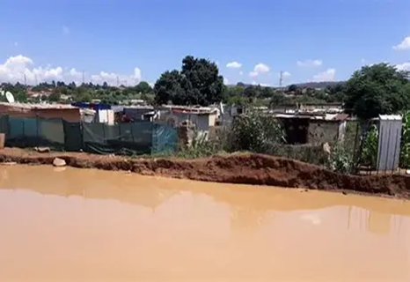

4.6. Change Idea development-Group Exercise
Develop change ideas on how you will address the Root causes f the scenario provided below
During a recent cholera outbreak in Hammanskraal, the Siamisang clinic conducted a rapid Root Cause Analysis using patient interviews, case reviews, and environmental assessments. The team identified the main root cause as the use of unclean water for cooking and drinking, worsened by poor hand-washing and unhygienic household practices reported by patients.
Based on this finding, as a facility team you are required to develop a practical Change Idea that directly addresses these hygiene and water-safety gaps and can be implemented and tested as part of a Quality Improvement Project at the clinic.
Model for Improvement 2nd question :What change can we make to lead to an improvement ?

Slide 39
4.6. Change Idea development-Group Exercise
Based on the slide above , the prioritized root cause is unclean water for cooking and drinking leading to cholera.
Develop a change idea and record it in the template below
What will be done?
Who will do it?
When?
Where?
How will it be done?
How often/frequency?
how much (quantity)
Model for Improvement 2nd question :What change can we make to lead to an improvement ?

Slide 40
Session 4.7:
Conducting PDSA cycle

Slide 41

4.7 Conducting PDSA Cycle-
PDSA definition ,purpose and benefits
What is a PDSA Cycle?
A PDSA Cycle stands for Plan–Do–Study–Act.
It is a structured, iterative method used in quality improvement (QI) to test changes on a small scale, learn from the results, and adjust before implementing the change more broadly.
It helps teams learn what works, what doesn’t, and why—using real data from their own setting
Purpose of a PDSA Cycle
The main purposes are to:
Test a change on a small scale before rolling it out.
Learn quickly whether a change leads to improvement.
Identify barriers or unexpected issues early
Act
Plan
Do
Study
Model for Improvement 2nd question :What change can we make to lead to an improvement ?

Slide 42
4.7 Conducting PDSA Cycle-
PDSA definition ,purpose and benefits
Purpose of a PDSA Cycle:
Refine and adapt interventions for better results.
Build staff confidence in the change.
Promote continuous improvement, not one-time fixe
Benefits of Using PDSA
Using PDSA cycles provides:
  ✔ Low risk—changes are tested on a small scale.
  ✔ Rapid learning—you get quick feedback.
  ✔ Data-driven decisions—not assumptions.
  ✔ Team engagement—everyone participates in problem-solving.
  ✔ Sustainability—solutions strengthened before full implementation.
  ✔ Flexibility—cycles can be repeated and adapted
.
Act
Plan
Do
Study
Model for Improvement 2nd question :What change can we make to lead to an improvement ?
Notes:
decongested

Slide 43
4.7 Conducting PDSA Cycle-
4 stages of the PDSA cycle
The Four Stages of the PDSA Cycle
Below is a clear explanation of Plan, Do, Study, and Act, including what needs to be completed in each step.
1. PLAN – Define the change and prepare for testing
The team decides what change they want to test and how they will measure success.
What is included in PLAN:
Describe the problem and the aim.
Write down the change idea to test (the intervention).
Identify who, when, where, and what will be done.
Predict what you think will happen.
Decide what data you will collect (e.g., numbers, checklists, time)
Model for Improvement 2nd question :What change can we make to lead to an improvement ?
Notes:
decongested

Slide 44
4.7 Conducting PDSA Cycle-
4 stages of the PDSA cycle
The Four Stages of the PDSA Cycle
1. How to complete PLAN:
Create a simple plan with:
  Clear objective
  Step-by-step action
  Responsibilities
  Tools needed
  Data collection method and timelines
2 Try the change on a small scale (this is the testing phase).What transpired in DO
  Carry out the plan exactly as described.
  Collect the data you planned to collect.
  Document challenges or unexpected events
3.How to complete DO:
  Keep notes on what worked or didn’t work.
  Capture timing, workload issues, or caregiver/staff reactions.
  Avoid judging results yet—just observe
Model for Improvement 2nd question :What change can we make to lead to an improvement ?
Notes:
decongested

Slide 45
4.7 Conducting PDSA Cycle-
4 stages of the PDSA cycle
3. STUDY – Analyze the results
Compare what happened to what you expected.
What happens in STUDY:
  Review the collected data.
  Compare results to your predictions.
  Identify what improved, stayed the same, or became worse.
  Discuss reasons for the findings.
How to complete STUDY:
  Use simple data visualizations (run charts, tallies, percentages).
  Summarizes key lessons: “What did the data tell us? What surprised us? What barriers did we see?”
4. ACT
  Adopt-the change worked well, entrench it into daily routine activities
  Adapt-the change partly worked ,adjust and test them again
  Abandon-the change did not work , try a new idea
  Scale UP-the change is working well in a small scale , test it further in a large scale
Model for Improvement 2nd question :What change can we make to lead to an improvement ?
Notes:
decongested

Slide 46
4.7 Conducting PDSA Cycle-
Adoption of the change idea
Demonstrated Improvement=
continuous Data Improvement
Consistency & Reliability= testing through different staff, days or pt’s group & still positive results
Feasibility in Routine Practice=change should be practical , affordable & sustainable
Staff acceptance & Buy-in=understand ,support and agree , involve those who will carry it out daily
Alignment with guidelines=the change should align with the National clinical guidelines , policies
Documented Learning=PDSA should be well documented (Planned, Done, Studied and Acted upon)
Leadership endorsement=
change should be reviewed & endorsed by relevant facility/district Mx
Plan for standardization=
remove old systems & introduce improved process into daily routine
Model for Improvement 3rd question :How will be tell if change has lead to an improvement ?

Slide 47
Session 4.8:
Wrap-up and reflections

Slide 48


4.8 Group Exercise to conduct RCA using Fishbone
Facility team not implementing the QI projects
Brainstorming using sticky notes
Theming ideas
In your groups, you are required to conduct a structured brainstorming activity using sticky notes to identify possible reasons why Quality Improvement Projects (QIPs) are not being implemented as expected in your respective facilities.
Follow these steps:
Brainstorming: Individually write down possible causes on sticky notes and share them within your group.
Theming: Group similar ideas together to form common themes.
5 Whys Analysis: Select key issues and apply the “5 Whys” technique to identify the underlying root causes.
Fishbone Diagram: Categorize the identified themes and root causes into a fishbone (Ishikawa) diagram
QI template completion : Develop change idea , process measures and complete the QI template
5 WHYS

Slide 49
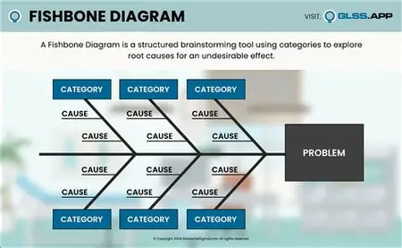
4.8 Group Exercise continues
Facility team not implementing the QI projects
Driver of programmatic excellence | Indicator | Identified Problem | Root Cause identified | Change Idea testing | Process measure

Slide 50
4.8 Conducting PDSA Cycle-
Facility team not implementing the QI projects
 | Plan | Do | Study | Act
 | What ? Who ? How will it be done? | Who threw the plan? How far did the plane land? Any challenges ? Any successes? | What are the lessons learned | Adapt ?Adopt ? Scale Up? Abandon
1st Cycle
2nd Cycle
3rd Cycle
4th Cycle
5th Cycle
6th Cycle

Slide 51


4.8 Wrap Up and Reflections
.4.Absence of a Performance Culture
  No monitoring of key indicators
  Failure to act on low performance trends or patient complaints
5. Lack of Staff Support and Development
  Inadequate supervision and mentoring
  No continuous professional training or performance feedback
  Low staff morale due to poor communication or recognition
6. Non-compliance with Policies and Standards
  Ignoring Ideal Clinic, National Core Standards, OHS, and IPC requirements
  Failure to implement Quality Improvement Plans or follow-up on audit findings

Slide 52
References
Jones, B. (2019) ‘How to get started in quality improvement’, BMJ, 364, k5437. Available at: https://www.bmj.com/content/364/bmj.k5437 (Accessed: 3 November 2025). (bmj.com)
McKenzie, L. (2023) The foundations of quality improvement in health care. [PDF] <internationalforum.bmj.com> Available at: https://internationalforum.bmj.com/wp-content/uploads/2023/11/TUE-P3-1030-Lisa-McKenzie_MEL2023.pdf (Accessed: 3 November 2025). (internationalforum.bmj.com)
Juran, J.M. (1986) The Quality Trilogy. In: Quality Progress, (or equivalent). As referenced in: The Juran Trilogy – what is Six Sigma? (2024) ‘Juran’s Quality Trilogy’, WhatIsSixSigma.net. Available at: https://www.whatissixsigma.net/jurans-quality-trilogy/ (Accessed: 3 November 2025). (whatissixsigma.net)
Institute for Healthcare Improvement (IHI). (2019) Run Chart Rules Reference Sheet. Available at: https://www.ihi.org/sites/default/files/lms/legacy/education/IHIOpenSchool/Courses/Documents/11_RunChartRulesReferenceSheet.pdf (Accessed: 3 November 2025). (ihi.org)
Care Innovations. (n.d.) Run chart rules for interpretation. Available at: https://www.careinnovations.org/wp-content/uploads/Run-Chart-Rules.pdf (Accessed: 3 November 2025). (Center for Care Innovations)

Slide 53
References
Saskatchewan Health Quality (SASK). (2022) Four rules for identifying signals of change in run charts. Available at: https://www.saskhealthquality.ca/wp-content/uploads/2022/03/Run-Chart-Rules.pdf (Accessed: 3 November 2025). (Health Quality Council)
CQUIN workshop PDF / Mpefe/Ketlhapile / NDoH strategy (Operation Phuthuma Mpefe, X. & Ketlhapile, Y. (nd) Operation Phuthuma: CQUIN Workshop. [PDF] Available at: (Accessed: 3 November 2025).
National Department of Health, South Africa. (2022) Ideal ClinicTM Definitions, Components and Checklists. Available at: https://www.health.gov.za (Accessed: 3 November 2025).
National Department of Health, South Africa. (2011) DHMIS Policy. Available at: https://www.health.gov.za (Accessed: 3 November 2025).
National Department of Health, South Africa. (2025) National Indicator Data Set (NIDS). Available at: https://www.health.gov.za (Accessed: 3 November 2025).

Slide 54
References
Saskatchewan Health Quality (SASK). (2022) Four rules for identifying signals of change in run charts. Available at: https://www.saskhealthquality.ca/wp-content/uploads/2022/03/Run-Chart-Rules.pdf (Accessed: 3 November 2025). (Health Quality Council)
CQUIN workshop PDF / Mpefe/Ketlhapile / NDoH strategy (Operation Phuthuma Mpefe, X. & Ketlhapile, Y. (nd) Operation Phuthuma: CQUIN Workshop. [PDF] Available at: (Accessed: 3 November 2025).
National Department of Health, South Africa. (2022) Ideal ClinicTM Definitions, Components and Checklists. Available at: https://www.health.gov.za (Accessed: 3 November 2025).
National Department of Health, South Africa. (2011) DHMIS Policy. Available at: https://www.health.gov.za (Accessed: 3 November 2025).
National Department of Health, South Africa. (2025) National Indicator Data Set (NIDS). Available at: https://www.health.gov.za (Accessed: 3 November 2025).

Slide 55
Thank You/Realeboga

